Slide 1
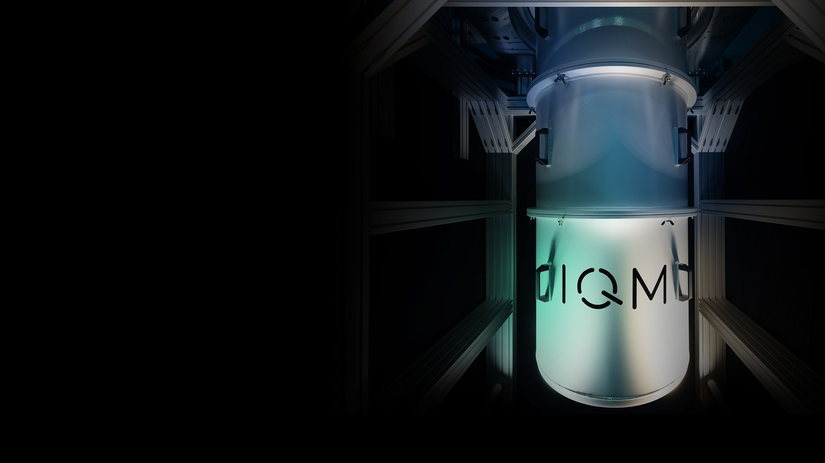




Superconducting quantum Hardware and Architectures
A lecture series by IQM
Authors: Kristine Rezai
Last Updated 06/2025
www.meetiqm.com

Slide 2
A quantum bit

Slide 3
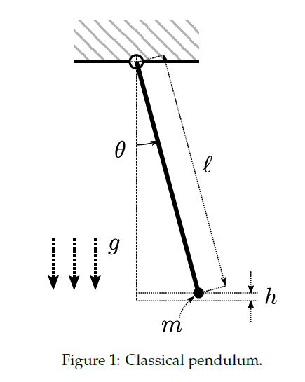
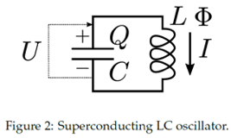
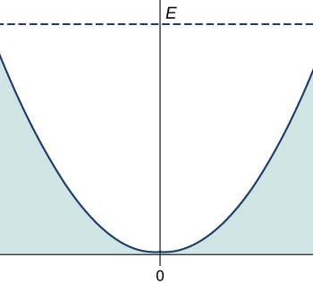



Quantum harmonic oscillator
To understand:
What is harmonic oscillator
Quantized energy levels
*non-zero lowest energy
$$U=cx^{2}$$
Takeaways:
Total energy of system derived from Lagrangian
Eigenfrequency of system derived from energy considerations
$←$ Photon frequency
$E_{total}=Frequency_{photons}∙(N_{photons}+0.5$)

Slide 4
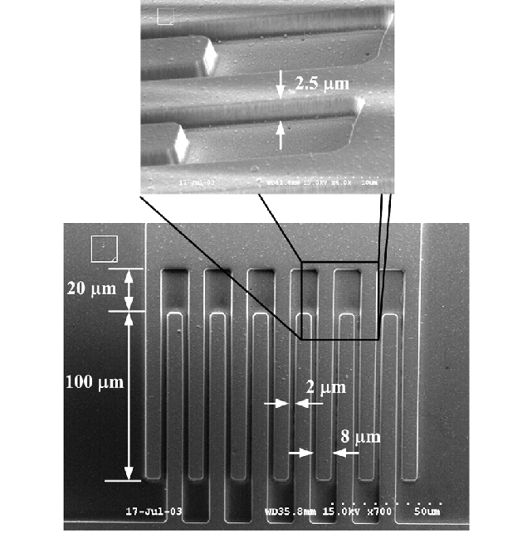
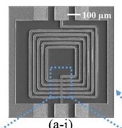
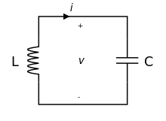

How to make an LC-oscillator on a chip?
Kenney J, Yoon Y et al (2023)

Slide 5
How can it be used as a qubit?
Equidistant energy levels make it difficult to be used as a qubit
Kenney J, Yoon Y et al (2023)

Slide 6
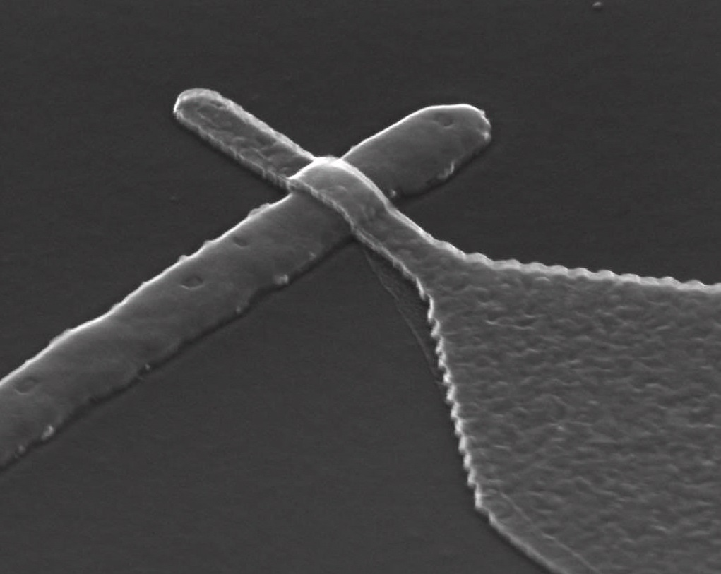
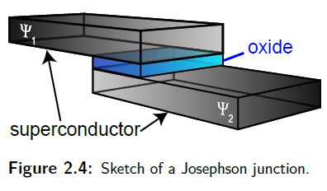

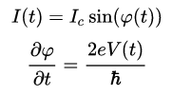


How to create an “anharmonic resonator”?
Introduce the Josephson junction into the circuit
Josephson junction (IMEC)
$E_{J}$ is the Josephson energy
Non-linear inductive element

Slide 7
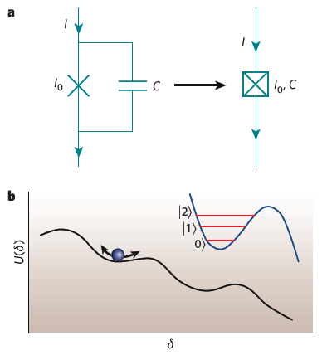
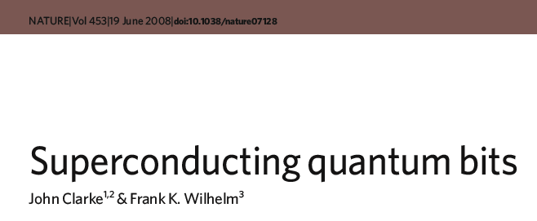


Josephson junction
Where to encode the states?
Phase and Charge commutate (like position and momentum)
If E_{J}>>E_{C} then: 𝜹 - well defined, Q – fluctuates
If E_{J}<<E_{C} then: 𝜹 - fluctuates, Q – defined well
Recommendation: doi:10.1038 / nature07128
$E_{J}$ is the Josephson energy
$E_{C}$ is related to energy stored in capacitors

Slide 8
Popular superconducting qubit designs

Slide 9
There are many ways to arrange Josephson Junctions and Capacitors in a circuit Let’s explore how a few different arrangements lead to different qubit properties!

Slide 10
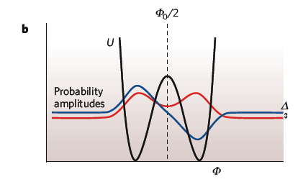
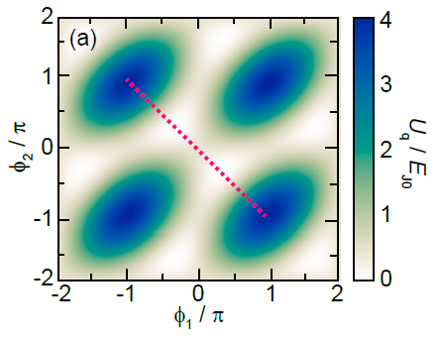
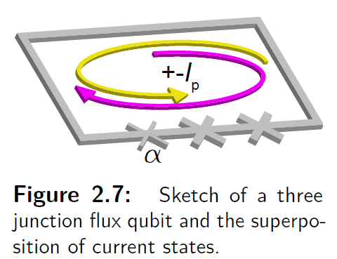



Flux qubit
Flux is also quantized by the way!
E_{J}>>E_{C} (50 times)
doi:10.1038 / nature07128
https://mediatum.ub.tum.de/1326240

Slide 11
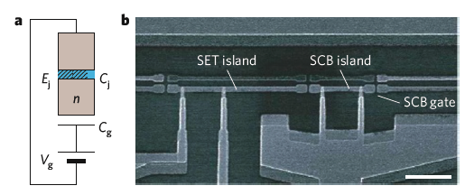
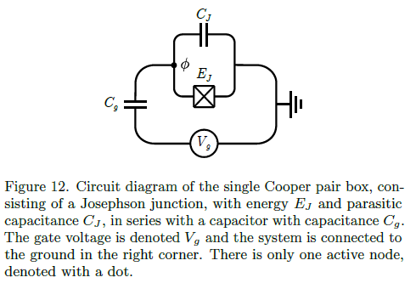

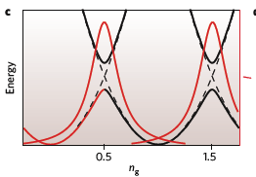

Charge qubit (Cooper-pair box)
Count every cooper pair
E_{J}<<E_{C}
C < 1fF (for E_{C} to be >> k_{B}T) [T=1K]
E_{J}
n=0
n=1
doi:10.1038 / nature07128

Slide 12
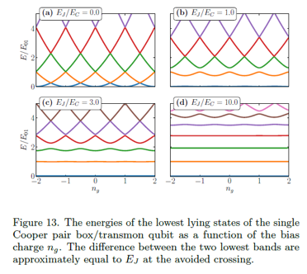

Charge qubit (Cooper-pair box)
Charge noise…
doi:10.1038 / nature07128

Slide 13

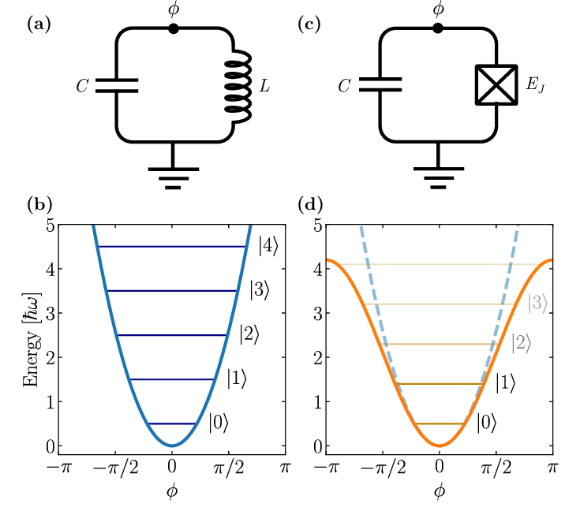
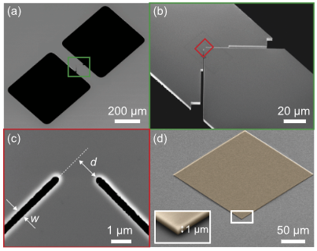

Transmon
Non-harmonic oscillator
Or
Capacitive shunted Josephson junction
Tsioutsios I., Serniak K., et al (2019)
Rasmussen, S., Christensen, et al (2021)

Slide 14
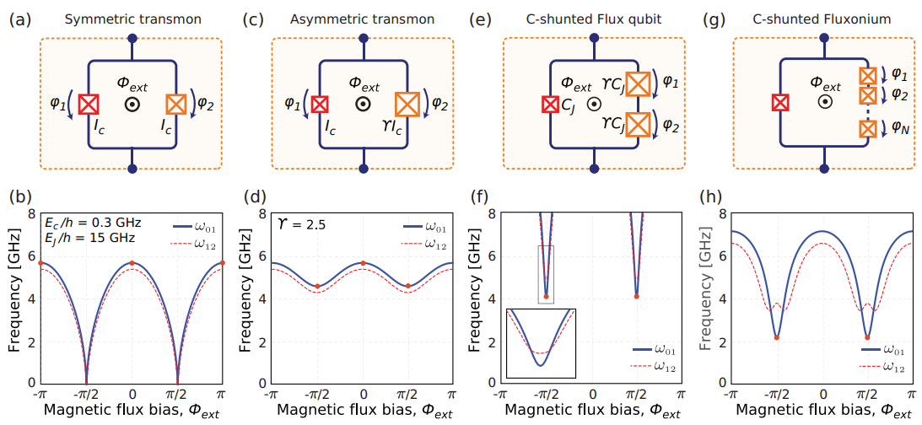
Flux sensitivity
sweetspot

Slide 15
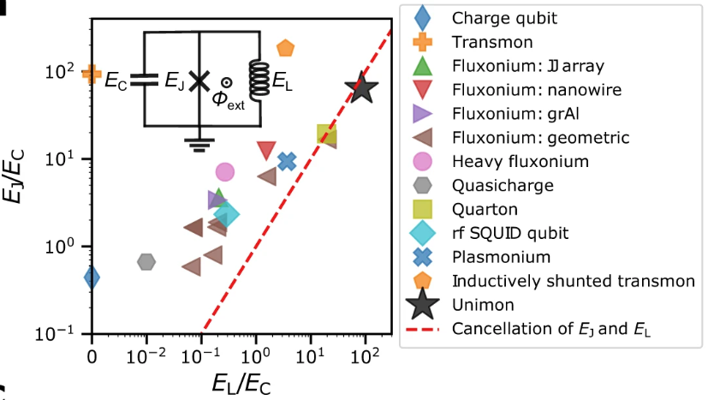
Qubit Zoo
Hyyppä, E., Kundu, S., Chan, C.F. et al. Unimon qubit. Nat Commun 13, 6895 (2022). https://doi.org/10.1038/s41467-022-34614-w

Slide 16
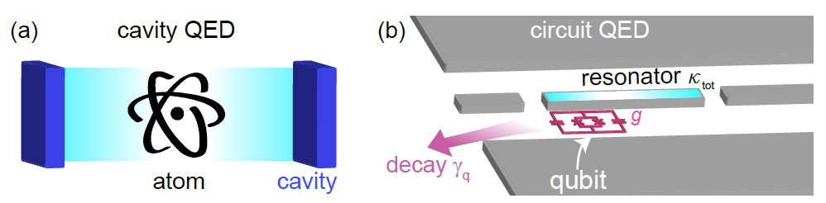
Rabi model, light-matter interaction
Interaction between single atom and electromagnetic field (light)
(Atom has a dipole moment and involved in dipole-dipole interaction) -> excitation, ionization
– Quantum Electro Dynamics

Slide 17
Rabi model, light-matter interaction
A superconducting qubit can play a role of single atom
Make qubit’s dipole moment interact with microwave radiation -> useful for science
(spoiler) this way we will also readout the qubit state

Slide 18
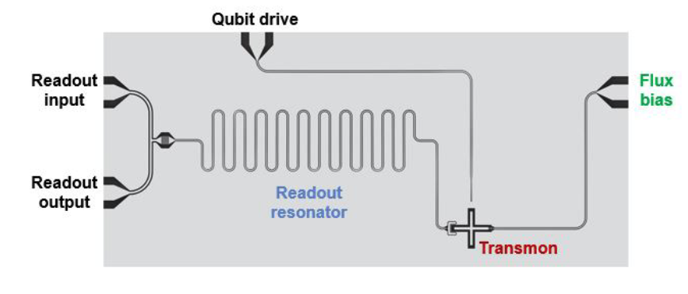
Transmon coupled to resonators for drive, flux bias, and readout
arXiv:2106.11352

Slide 19
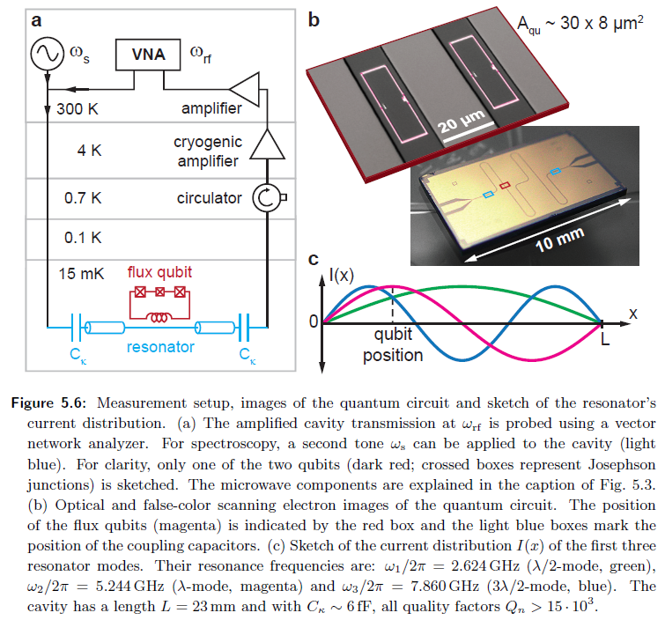




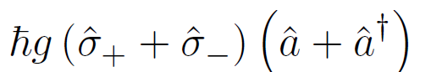
Generalized light-matter interaction: The quantum Rabi model
We recall the following physical properties and their quantum mechanical description
Physical system / parameter | Effective Description
Qubit
Resonator
Magnetic field
Qubit energy bias
If we bring qubit and resonator in close vicinity, we create a mutual inductance leading to a coupling term (interaction Hamiltonian)
Here, we are hiding all physical properties in the coupling constant g
https://www.wmi.badw.de/publications/theses/Niemczyk_Doktorarbeit_2011.pdf

Slide 20
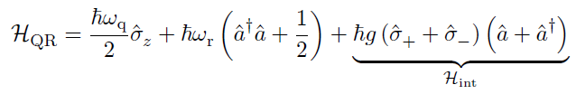
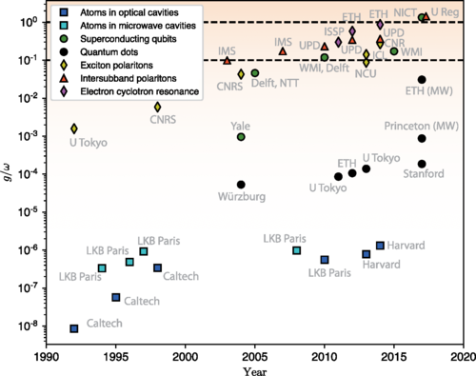
Generalized light-matter interaction: The quantum Rabi model
Adding the individual terms for qubit and resonator results in the system Hamiltonian
The above Hamiltonian is valid in all regimes for g
https://www.wmi.badw.de/publications/theses/Niemczyk_Doktorarbeit_2011.pdf

Slide 21
General note: Circuit QED
Qubits can be seen as artificial atoms and resonators as microwave light.
When we bring them close to each other we create “light-matter” coupling that is treated in the same way as quantum optics.
Superconducting circuits allow on-chip study of quantum optics in regimes that cannot be reached in nature.

Slide 22
General note: Jaynes-Cummings model
Usually one operates quantum circuits in a “practical” parameter regime, called strong coupling limit.
In this limit, the coupling between qubit and electromagnetic field is much stronger as their loss rates but smaller than their eigenfrequencies.
In this regime, the eigenstates experience a qubit state-dependent energy shift. Detecting this shift is used for qubit readout.

Slide 23


Rotating Wave approximation: Jaynes-Cummings model
We consider a transmon qubit that is capacitively coupled to a transmission line resonator. We operate in the strong coupling regime, where g << ω_{q}, ω_{r}.
This allows us to move into the interaction picture (a.k.a. rotating frame)
This Hamiltonian contains both quickly and slowly oscillating components
To get a solvable model, the quickly oscillating "counter-rotating" terms, are ignored. This is referred to as the rotating wave approximation, and it is valid since the fast oscillating term couples states of comparatively large energy difference.
https://mediatum.ub.tum.de/1326240

Slide 24
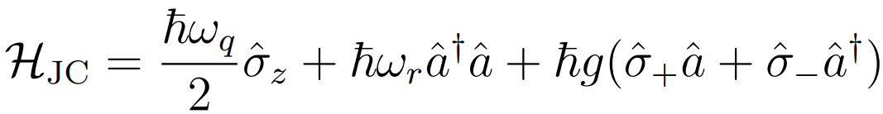
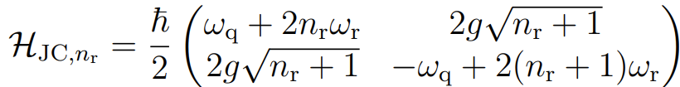
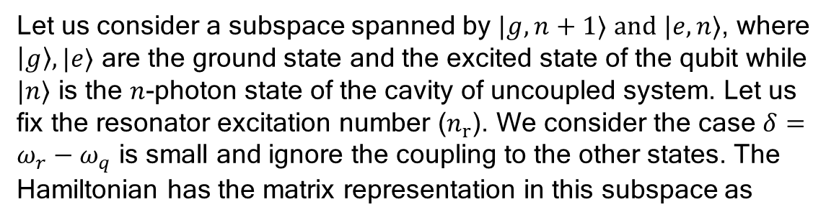
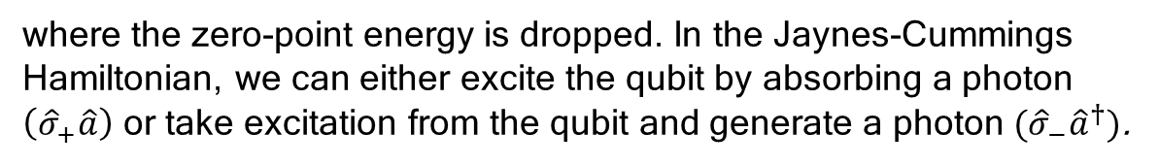

Rotating Wave approximation: Jaynes-Cummings model
Transforming back into the Schrödinger picture the Jaynes-Cummings Hamiltonian is thus written as
$$ℋ_{int}$$
where the zero-point energy is dropped. In the Jaynes-Cummings Hamiltonian, we can either excite the qubit by absorbing a photon $\left({\hat{σ}}_{+}\hat{a}\right)$ or take excitation from the qubit and generate a photon $({\hat{σ}}_{−}{\hat{a}}^{†})$.
Let us consider a subspace spanned by $|g,n+1⟩$ $and |e,n⟩$, where $\left|g\right\rangle , |e⟩$ are the ground state and the excited state of the qubit while $|n⟩$ is the $n$-photon state of the cavity of uncoupled system. Let us fix the resonator excitation number ($n_{r}$). We consider the case $δ=ω_{r}−ω_{q}$ is small and ignore the coupling to the other states. The Hamiltonian has the matrix representation in this subspace as
We can diagonalize this Hamiltonian and discuss two parameter regimes: Resonant, i.e. no detuning between qubit and resonator, and off-resonant, i.e. large detuning.
https://mediatum.ub.tum.de/1326240

Slide 25


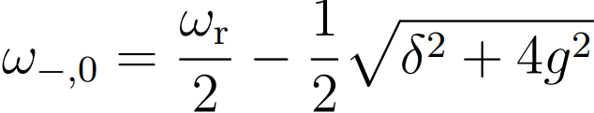
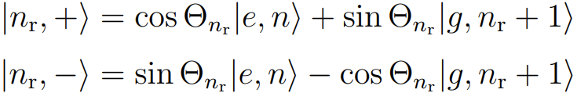

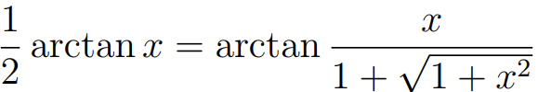
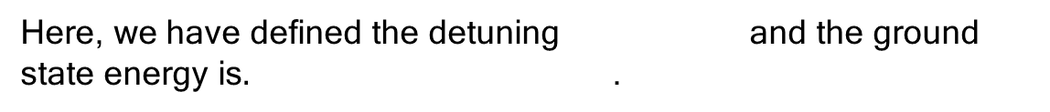
Rotating Wave approximation: Jaynes-Cummings model
The eigenfrequencies of the Jaynes-Cummings Hamiltonian are given as
Here, we have defined the detuning and the ground state energy is$.$ .
The new dressed eigenstates of the system are the superposition states
Here, the mixing angle is a measure for the degree of entanglement between qubit and resonator states. The mixing angle is found as
where we used
https://mediatum.ub.tum.de/1326240

Slide 26
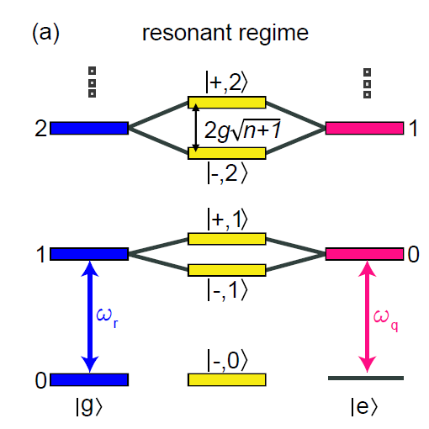



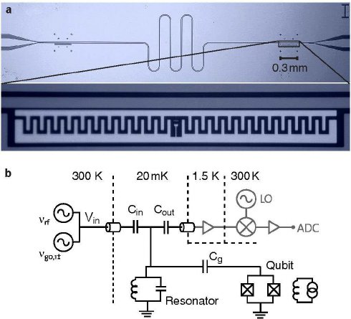
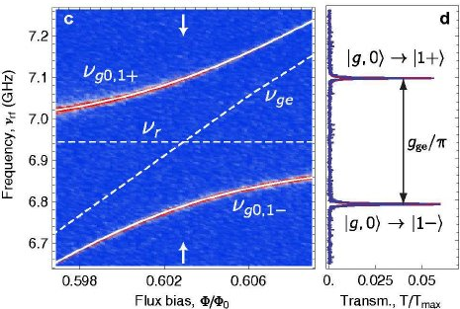
Rotating Wave approximation: Jaynes-Cummings model
When qubit and light mode are on resonance, i.e., , the mixing
angle is maximum and consequently there is strong entanglement.
In this regime, a coherent exchange of excitations between qubit and resonator occurs with the vacuum Rabi frequency 2g. This interaction lifts the degeneracy of the corresponding eigenenergies
by to new doublet eigenstates.
https://arxiv.org/abs/0902.1827
https://mediatum.ub.tum.de/1326240

Slide 27
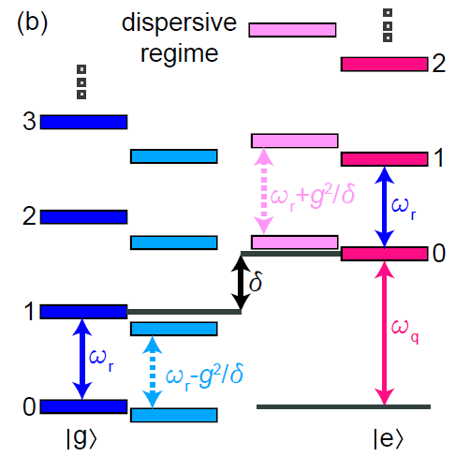
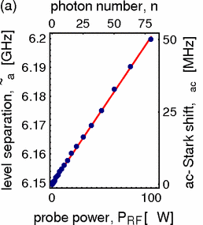
Rotating Wave approximation: Jaynes-Cummings model
In the dispersive regime, the detuning between qubit and resonator
frequency is much larger than the coupling, i.e.,
In this regime, there is no exchange of excitations anymore but virtual photons mediate a dispersive interaction between qubit and
light field. This interaction leads to frequency shifts of the qubit and resonator eigenfrequencies. The dressed states are either more photon-like or more atom-like.
In the atom-like case (close to qubit states), the Hamiltonian can be derived as
Lamb shift
AC-Stark shift
https://journals.aps.org/prl/abstract/10.1103/PhysRevLett.94.123602
https://mediatum.ub.tum.de/1326240

Slide 28

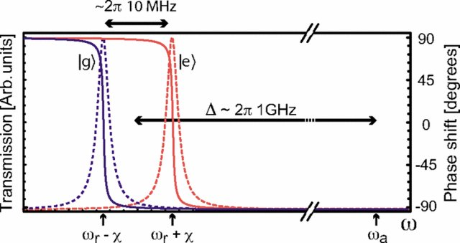
Rotating Wave approximation: Jaynes-Cummings model
In the photon-like case (close to resonator states), the Hamiltonian can be derived as
describing the qubit state-dependent resonator frequency,
which we use for readout purposes.
Key takeaway: In the dispersive regime of the Jaynes-Cummings model, resonators can be used for qubit readout.
https://journals.aps.org/pra/abstract/10.1103/PhysRevA.75.032329
https://mediatum.ub.tum.de/1326240

Slide 29
General note: Jaynes-Cummings model
Usually one operates quantum circuits in a “practical” parameter regime, called strong coupling limit.
In this limit, the coupling between qubit and electromagnetic field is much stronger as their loss rates but smaller than their eigenfrequencies.
In this regime, the eigenstates experience a qubit state-dependent energy shift. Detecting this shift is used for qubit readout.

Slide 30
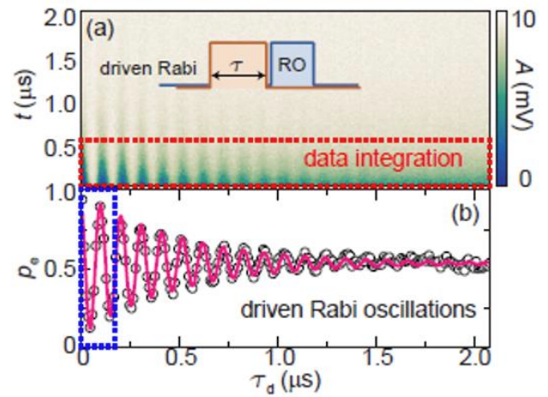




Single-qubit gates with superconducting qubits
Applying a microwave signal to qubit drives Rabi oscillations
The Hamiltonian of the drive is the following
Time evolution from Schrodinger equation:
Choose the time t_{d} such that $t_{d}ΩV_{0}s= π$

Slide 31
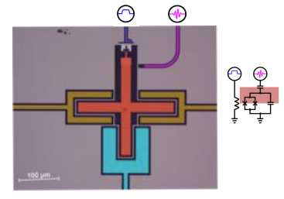
Single-qubit gates with superconducting qubits
Applying a microwave signal to qubit drives Rabi oscillations
The Hamiltonian of the drive is the following

Slide 32
Conclusion
Superconducting circuit design can vary based on the arrangment of Josephon junctions and capacitors
Transmon qubits are the most used superconducting qubit type
Qubits are controlled using microwave signals

Slide 33
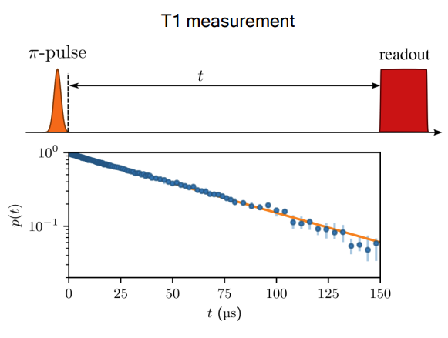

T1 measurement
Qubit loses its excitation due to interaction with the environment
A qubit is never fully isolated:
Lossy materials
Capacitive coupling used to make gates also lead to leakage
The time it takes for the qubit to lose its energy is called T1
Qubit excitation decays exponentially over time
Vepsäläinen,. et al. Impact of ionizing radiation on superconducting qubit coherence.
Nature 584, 551–556 (2020). https://doi.org/10.1038/s41586-020-2619-8

Slide 34
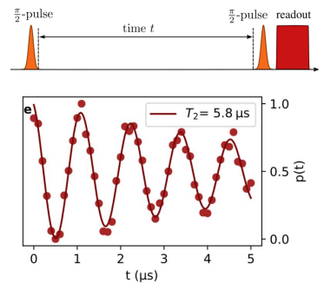

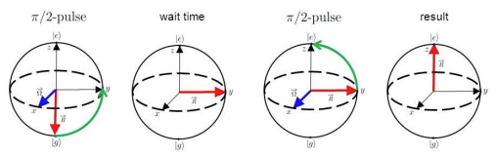
T2 measurement
Ramsey experiment measures the phase φ of the qubit wavefunction
The decay of the oscillations in Ramsey experiment is called dephasing
Dephasing is caused by:
Energy relaxation
Fluctuations in qubit frequency
Vepsäläinen,. et al. Impact of ionizing radiation on superconducting qubit coherence.
Nature 584, 551–556 (2020). https://doi.org/10.1038/s41586-020-2619-8

