Slide 1
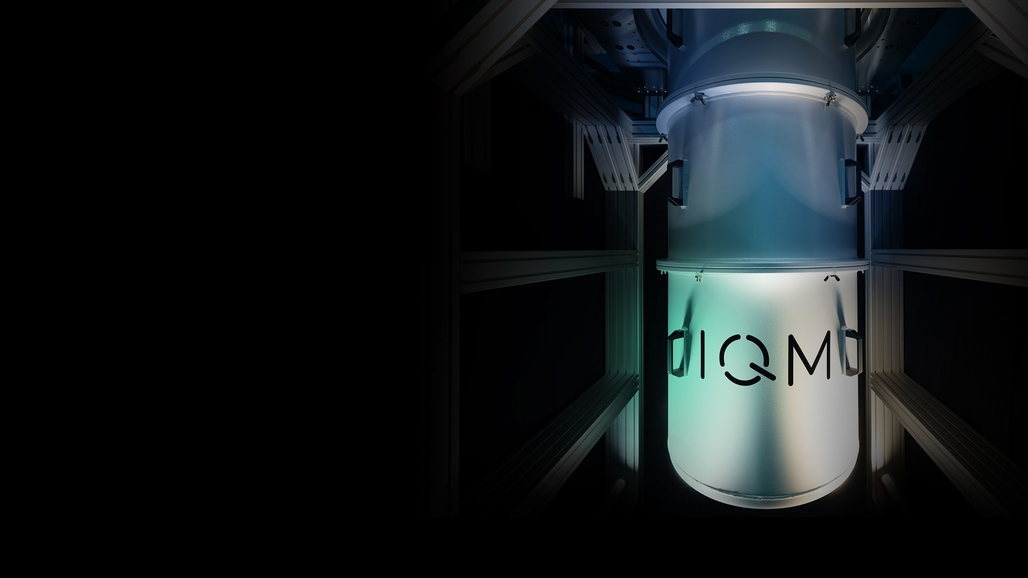




Data encoding and quantum machine learning
A lecture series by IQM and HS RM
Authors: Stefan Seegerer and Nadia Milazzo
Last Updated 10/2025
www.meetiqm.com

Slide 2


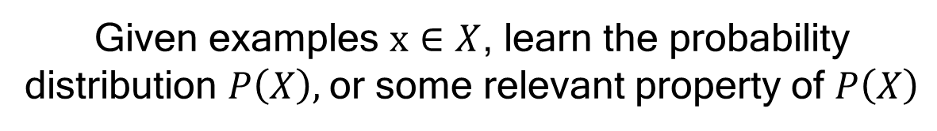
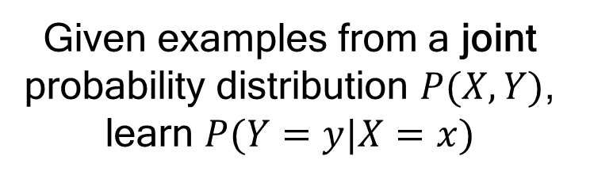
Machine learning
Given a task $T$ to a computer program, we say that it learns from experience $E$if:
SUPERVISED LEARNING
Labeled data
$$P\left(T\right)∝E$$
Given examples from a joint probability distribution $P(X,Y)$,
learn $P(Y=y|X=x)$
Where $P$is some performance metric of the program
Mitchell, T. M. (1997), Machine learning (McGraw Hill)
UNSUPERVISED LEARNING
Unlabeled data
Given examples $x∈X$, learn the probability distribution $P\left(X\right),$or some relevant property of $P\left(X\right)$
Machine learning models are efficient in finding patterns in data

Slide 3


















Quantum computing
NON-LINEARITY
Quantum computing programs
Unitary circuits
$$x_{1}$$
$$w_{1}$$
$$x_{2}$$
$$w_{2}$$
$$R_{x}\left(θ_{1}\right)$$
$$R_{z}\left(θ_{2}\right)$$
$$x_{3}$$
$$w_{3}$$
$$∑$$
$$f$$
output
…
$$w_{n}$$
activation
function
$$R_{x}\left(θ_{3}\right)$$
$$R_{z}\left(θ_{4}\right)$$
X
$$x_{n}$$
bias
$$R_{x}\left(θ_{5}\right)$$
$$R_{z}\left(θ_{6}\right)$$
X
$$R_{x}\left(θ_{7}\right)$$
$$R_{z}\left(θ_{8}\right)$$
X
Non-linearities in quantum physics can come from:
measurement
post-selection
coupling system-environment
LINEAR DYNAMICS

Slide 4
How to merge quantum computing and machine learning?

Slide 5
Data and model
Can quantum computing enhance or innovate machine learning techniques for classical data?
Quantum kernel methods
Quantum neural networks
Type of algorithm
CC
CQ
Classical
Machine
Learning
Can quantum-enhanced machine learning help with quantum data?
Quantum phases of matter
Many-body systems
Type of data
QC
QQ
Can machine learning help in quantum tasks?
Quantum state tomography
Controlling and preparing qubits

Slide 6
Data and model
Can quantum computing enhance or innovate machine learning techniques for classical data?
Quantum kernel methods
Hybrid QNNs
Type of algorithm
CC
CQ
Classical
Machine
Learning
Can quantum-enhanced machine learning help with quantum data?
Quantum phases of matter
Many-body systems
Type of data
QC
QQ
Can machine learning help in quantum tasks?
Quantum state tomography
Controlling and preparing qubits

Slide 7
1. Data encoding

Slide 8
How to encode classical data into a quantum state?
The first step of a quantum machine learning algorithm is the encoding of classical data in a quantum circuit*, i.e., in the so-prepared quantum state.
Classical feature vector
Dimensionality reduction
Data encoding
Basis encoding, amplitude encoding,
angle encoding
X
Optional (but often necessary)
Feature selection, PCA, …
* For gate-based technologies
The quantum circuit encoding the data is usually called a feature map

Slide 9
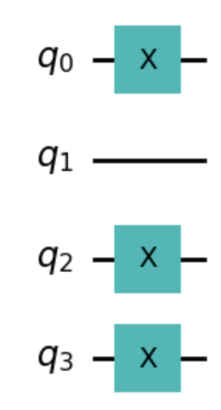




Basis encoding
Idea: Encode binary representation of data in computational basis states
Requires:$N=k⋅n$ qubits for a vector of length $k$ with $n$ binary digits for each vector component
Classical feature vector
Quantum encoding
$$x=\left({2 \atop 3}\right)=\left({{10}_{2} \atop {11}_{2}}\right)$$
$$\left|x\right\rangle =|1011⟩$$

Slide 10
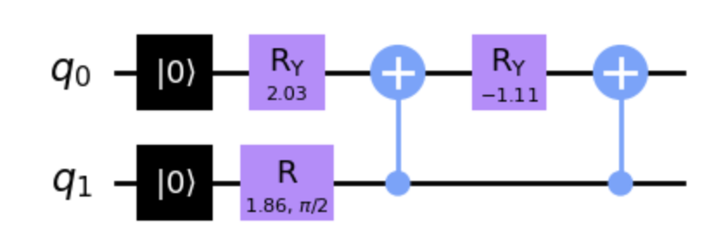
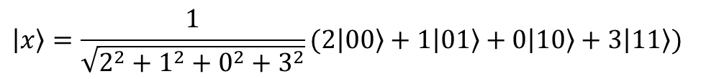




Amplitude encoding
Idea: Encode data in the amplitudes of a quantum state
Requires: $\left.\left\lceil \log_{2}(k)\right.\right\rceil$qubits for a vector of length $k$
$$\left|x\right\rangle =\frac{1}{\sqrt{2^{2}+1^{2}+{0^{2}+3}^{2}}}(2\left|00\right\rangle +1\left|01\right\rangle +0\left|10\right\rangle +3\left|11\right\rangle )$$
Classical feature vector
Quantum encoding
$$x=\left({\begin{matrix}2 \\ 1\end{matrix} \atop \begin{matrix}0 \\ 3\end{matrix}}\right)$$
We need the normalization constant!
$$\left|x\right\rangle$$
$$\sum_{i=1}^{k}{{\left|x_{i}\right|}^{2}= {\left|α\right|}^{2}}$$
State preparation

Slide 11
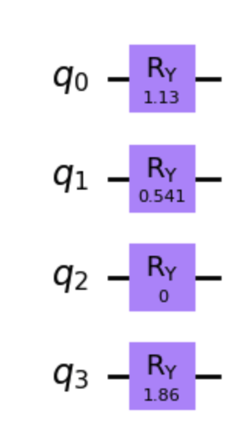




Angle encoding
Idea: Rescale data and encode them in angle rotations
Requires: $k$ qubits for a vector of length $k$
Classical feature vector
Data rescaling
Quantum encoding
$$x=\left({\begin{matrix}2 \\ 1\end{matrix} \atop \begin{matrix}0 \\ 3\end{matrix}}\right)$$
$$x ∈ (0, 2π]$$
$$\left|x\right\rangle$$
It could be any rotation!

Slide 12


Pros & cons of different encodings
Basis encoding
Amplitude encoding
Angle encoding
Minimal
gate operations for state preparation
Good
scaling of # of qubits with classical data dimension
Simple
state preparation – shallow circuit
No
representation
of feature dependencies in classical data
# of qubits =
# of binary digits to represent classical data
Inefficient
state preparation

Slide 13

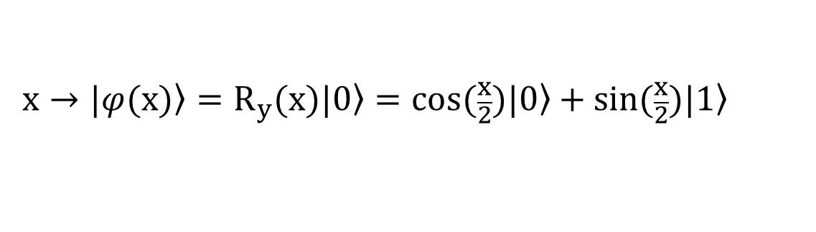


Note on non-linearity
We have seen that a feature map is an encoding $Φ$ such that:
$X:$ input space of classical data
$$Φ: X→H$$
$H:$ Hilbert space of the quantum state
encoding $x∈X$
Consider the angle encoding of input $x$ using the $R_{y}$ gate:
The amplitudes of the quantum state are non-linear in the input x
$$x→|\left.φ(x)\right\rangle =R_{y}(x)|\left.0\right\rangle =cos(\frac{x}{2})|\left.0\right\rangle +sin(\frac{x}{2})|\left.1\right\rangle$$
The needed non-linearities for a quantum machine learning model come from the data encoding step, aka the feature map

Slide 14
2. Examples of feature maps

Slide 15
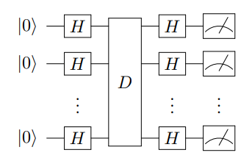
Parametrized quantum circuits
Once the data are encoded in a quantum state, one can add further unitary operations to the state preparation circuit
Common choices in the literature are entangling operations (both feature-dependent or not, e.g., ZZ or CNOT gates)
In the search for quantum advantage, feature maps that are classically hard to simulate should be considered
Instantaneous Quantum
Polynomial-Time
(IQP) circuits
It is hard for a classical sampler to produce samples from the output distribution of the IQP circuit

Slide 16
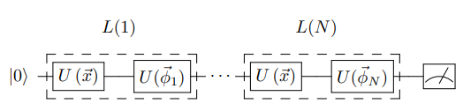
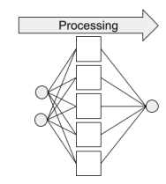
Data re-uploading
The idea: alternate layers of data encoding and parametrized unitaries and repeat that N times
This was shown to enable the construction of a universal classifier with a single qubit!
Circumventing the limitations of no-cloning theorem
Advantages | Disadvantages
Potential enhancement of the performance and expressive power of QML models | Deeper circuits, harder to run on current quantum technologies due to hardware noise
Analogy
Classical NN take the same input many times
Quantum 4, 226 (2020)

Slide 17
3. Quantum routines in ML

Slide 18






Multiple forms of CQ
Use a variational parametrized quantum circuit as the model
Running only some parts of an ML pipeline on a quantum computer
1-qubit gate
$$p_{1}$$
$$p_{3}$$
CQ MODEL
Quantum subroutine
$$p_{2}$$
2-qubit gate
Optimize $p_{1}$, $p_{2}$ and $p_{3}$ based on measurement results
Example: quantum kernel estimation

Slide 19
Quantum kernels

Slide 20
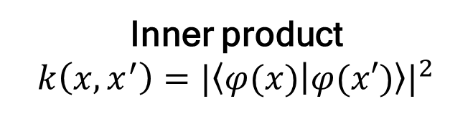
The kernel method
Example: Polynomial kernel
The kernel function quantifies the distance between sample points in the Hilbert space
Inner product
$$k\left(x,x^{′}\right)={|\left\langle φ(x) | φ(x′)\right\rangle |}^{2}$$
φ is the feature map!

Slide 21
The kernel method
Example: Polynomial kernel
The kernel function quantifies the distance between sample points in the Hilbert space
Kernel trick: Avoiding to calculate the explicit mapping!
φ is the feature map!

Slide 22




How to calculate kernels on a QPU
Return probabilities
Destructive SWAP
SUCCESS
It doubles the depth of the circuit
It doubles the width of the circuit
Repeating the measurement for all pairs x,x’ in the classical dataset we obtain the KERNEL MATRIX

Slide 23
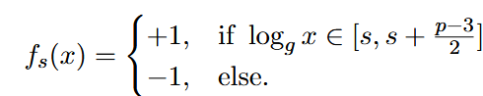
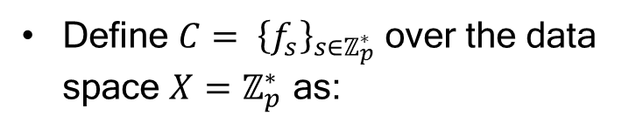
A known example of quantum speedup
Case study: supervised classification with quantum kernels and support vector machines
Result: quantum classifier achieves high accuracy for a classically hard classification problem
DISCRETE LOGARITHM PROBLEM
Consider a large prime number $p$and a generator $g$ of $ℤ_{p}^{∗}=\left\{1,2,…,p−1\right\}$
“It is a widely-believed conjecture that no classical algorithm can compute $\log_{g}x$ on input $x∈ ℤ_{p}^{∗}$, in time polynomial in $n= \left\lceil \log_{2}p\right\rceil$, the number of bits needed to represent $p$”
Define $C= {\left\{f_{s}\right\}}_{s∈ℤ_{p}^{∗}}$over the data space ${X=ℤ}_{p}^{∗}$ as:
Liu, Y., Arunachalam, S. & Temme, K. A rigorous and robust quantum speed-up in supervised machine learning.
Nat. Phys. 17, 1013–1017 (2021).

Slide 24
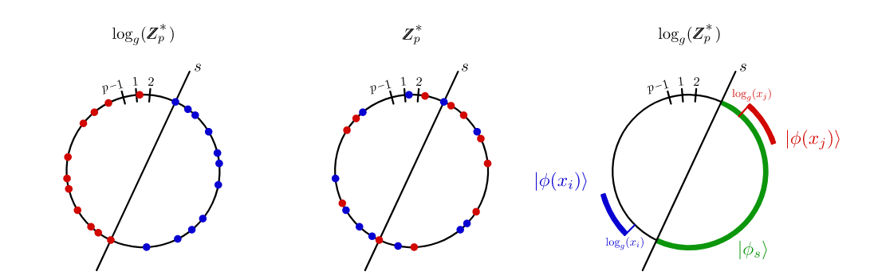
A known example of quantum speedup
Case study: supervised classification with quantum kernels and support vector machines
Result: quantum classifier achieves high accuracy for a classically hard classification problem
Learn C with a quantum feature map: exponential speed-up
“This quantum feature map creates a large margin, as the +1 labeled example (red interval) has high overlap with a separating hyperplane (green interval), while the −1 labeled example (blue interval) has zero overlap”
Liu, Y., Arunachalam, S. & Temme, K. A rigorous and robust quantum speed-up in supervised machine learning.
Nat. Phys. 17, 1013–1017 (2021).

Slide 25
Hybrid quantum-classical neural networks

Slide 26
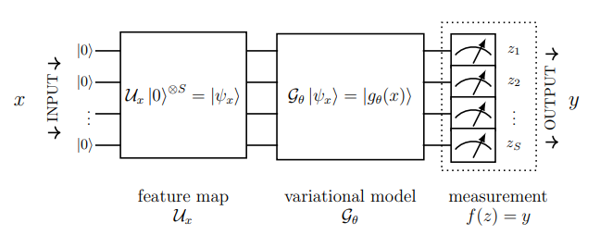
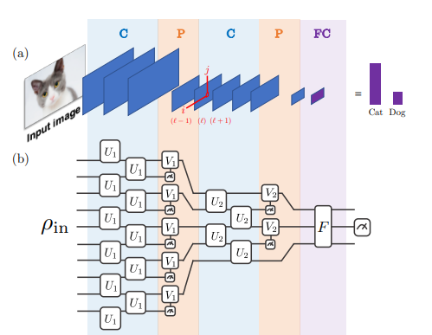
How does a QNN look like?
There are models more closely recalling the structure of the classical neural network:
Often what is referred to as Quantum Neural Network in QML literature is a more general variational model:
A cost function is determined by the problem at hand and parameters are optimized to minimize it
Quantum Convolutional
Neural Networks
TRAINING discussed in the next slide
Cong, I., Choi, S. & Lukin, M.D. Quantum convolutional neural networks. Nat. Phys. 15, 1273–1278 (2019)

Slide 27
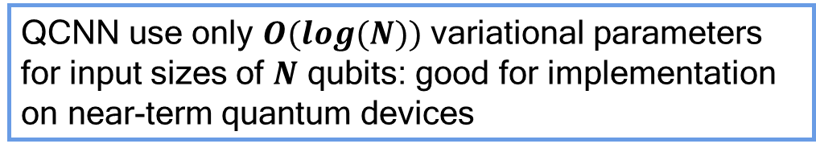
How does a QNN look like?
There are models more closely recalling the structure of the classical neural network:
Often what is referred to as Quantum Neural Network in QML literature is a more general variational model:
QCNN use only $O(log(N))$ variational parameters for input sizes of $N$ qubits: good for implementation on near-term quantum devices
Quantum Convolutional
Neural Networks
Cong, I., Choi, S. & Lukin, M.D. Quantum convolutional neural networks. Nat. Phys. 15, 1273–1278 (2019)

Slide 28
Getting better parameters through training
Main idea in machine learning is to learn the parameters through data until we have a good fit for the given problem.
In classical machine learning, this is typically acchieved using some gradient descent method: The parameters are gradually adjusted in a direction which reduces the loss.
How can we compute the gradient of a quantum circuit when already simulating it is intractable with a classical computer? Backpropagation is not possible as intermediate measuring will destroy the quantum state.

Slide 29
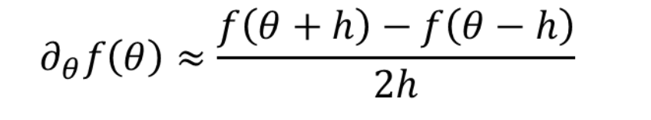
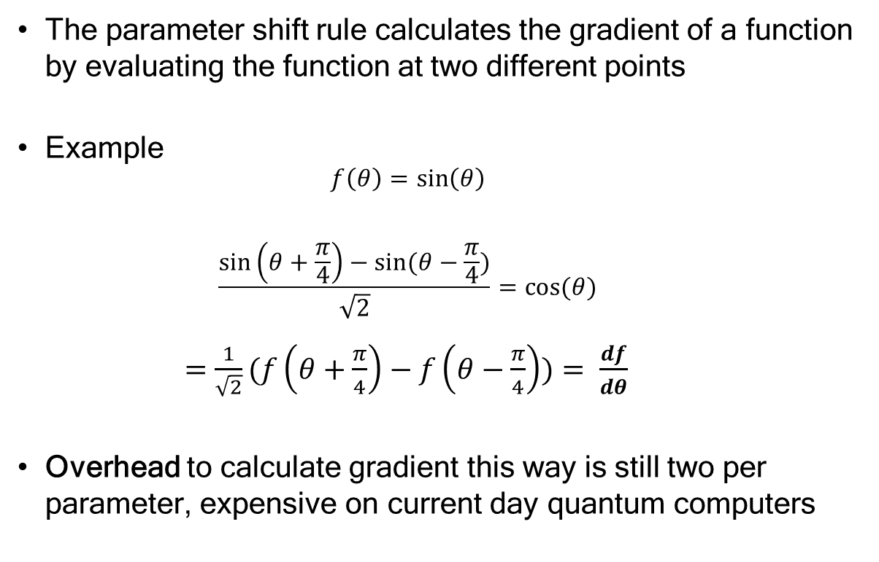
Calculating gradient using parameter shift rule
The parameter shift rule calculates the gradient of a function by evaluating the function at two different points
Example
$$f\left(θ\right)=\sin\left(θ\right)$$
$$\frac{\sin\left(θ+\frac{π}{4}\right)−sin⁡(θ−\frac{π}{4})}{\sqrt{2}}=\cos{(θ) }$$
$=\frac{1}{\sqrt{2}}⁡(f\left(θ+\frac{π}{4}\right)−f\left(θ−\frac{π}{4}\right))⁡= \frac{df}{dθ}$
Overhead to calculate gradient this way is still two per parameter, expensive on current day quantum computers
This is not finite difference!
Exact solution, not just an approximation
Points in parameter shift can be far apart, not infinitesimally close
Small differences could be more strongly influenced by noise
Maria Schuld et al. Evaluating analytic gradients on quantum hardware, Physical Review A 99, 032331 (2019)

Slide 30
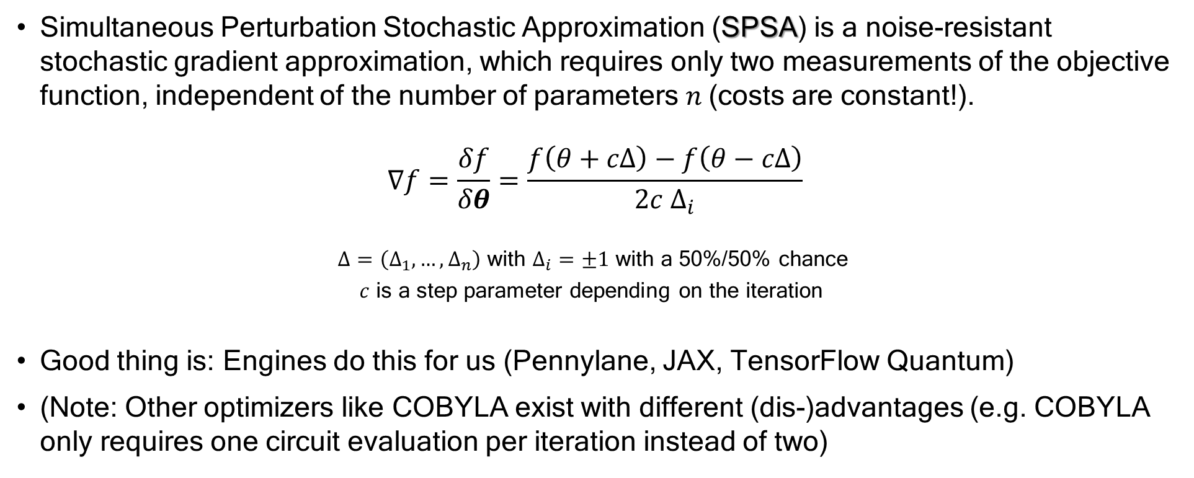
Calculating the gradient with SPSA
Simultaneous Perturbation Stochastic Approximation (SPSA) is a noise-resistant stochastic gradient approximation, which requires only two measurements of the objective function, independent of the number of parameters $n$(costs are constant!).
$$∇f=\frac{δf}{δθ}=\frac{f\left(θ+cΔ\right)−f\left(θ−cΔ\right)}{2c Δ_{i}}$$
$Δ=\left(Δ_{1}, …, Δ_{n}\right)$ with $Δ_{i}=±1$ with a 50%/50% chance
$c$ is a step parameter depending on the iteration
Good thing is: Engines do this for us (Pennylane, JAX, TensorFlow Quantum)
(Note: Other optimizers like COBYLA exist with different (dis-)advantages (e.g. COBYLA only requires one circuit evaluation per iteration instead of two)

Slide 31
4. Application: a classification task

Slide 32
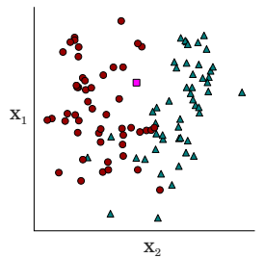
Classification problems
Classification tasks are one of the most common problems tackled with machine learning methods
The approach can be supervised or unsupervised (e.g., anomaly detection), and the problem can be binary or multi-class
Applications explored in the literature range from high-energy physics problems, to medical ones (breast cancer) or finance related ones, like fraud detection
Example: Supervised binary classification for two dimensional inputs. Given the red circle and blue triangle data points belonging to two different classes, guess the class of the new input (pink square).
Schuld et al., Phys. Rev. A 101, 032308 (2020)
Now it’s your turn!

Slide 33
Hands-on exercises
STEP 1: Toy dataset https://bit.ly/iqm-4
Goal: UNDERSTAND
Execute the notebook
Interpret the results
STEP 2: Iris dataset https://bit.ly/iqm-5
Goal: IMPROVE
Actively change the encoding, the ansatz etc.
Try to improve the performance of the model
Tip: Look at which rotations are used in the ansatz: do you recall what expressibility is?

Slide 34
5. What’s next?

Slide 35
Promising applications: generative QML
(Many) Generative Approaches: Compress high dimensional data distribution onto smaller,
“latent space”
1: Better fit with less resources.
x
or
x
x
x
x
x
x
x
x
x
Vs.
x
x
x
x
x
x
x
x
x
x
x
x
x
x
x
x
Quantum circuits produce latent space distributions which are difficult to learn and sample classically.
2: Different bias leads to novel data
Latent distribution is sampled; points are scaled up to create new data.
x
x
x
x
x
x
x
x
x
x
x
x
x
x
x
x
x
x
x
x
x
x
x
x
x
x
x
x
x
x
x
x
x
x
Notes:
So the idea behind this slide is the following: In general, generative models typically consist of two parts: Sampling at random from a low dimensional, abstract "latent" space, and then passing this sample through a (deterministic) transformation to transform that sample into a valid data point, which typically lives in a much larger dimensional space.
The effectiveness of this model relies on how well the latent space distribution captures the randomness of the true data distribution, and how well the (trained) deterministic layers map back to the data space. Since we know the quantum circuits can produce distributions that are classically difficult to produce samples from, replacing them as the latent space is a "natural" way to try to produce new models with a different bias.
The potential advantage of such a new model could show itself in two ways: Either the learned distribution is closer to the true data distribution ((e.g. the final KL-Divergence, or similar cost function, has a better value) ("a better fit"), OR the learned distribution is of similar performance metrices to other methods, but captures "a different part" of the data distribution - therefore when using it as a generative model we see new interesting examples we would not have seen with a classical model - the idea I would have in mind for this would be drug discovery.
Of course, that's all very optimistic, that's why I say "potential advantage".

Slide 36
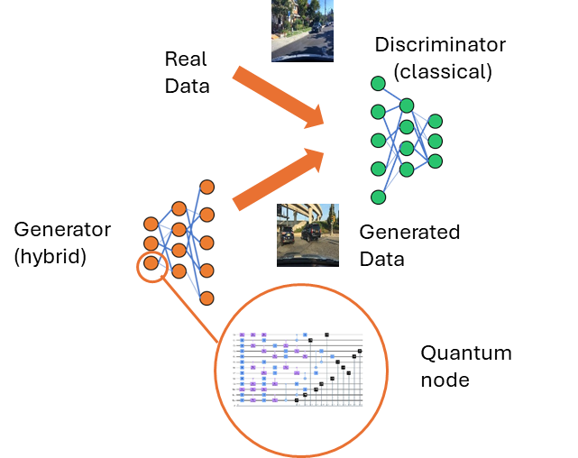
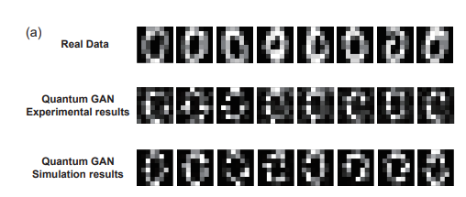
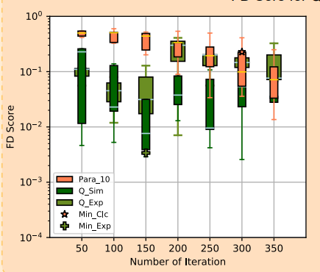
Example: Quantum GAN
“The results show that quantum GAN have a better performance than GAN-MLP and GAN-CNN with similar number of parameters.”
Huang et al., Phys. Rev. Applied 16, 024051 (2021)

Slide 37
The QQ section
What are the possible QUANTUM DATA that can be interesting for quantum machine learning?
Hamiltonian
Quantum states
Measurement
operators
Applications:
Quantum chemistry Quantum materials
Applications:
Quantum communication networks
Applications:
Quantum sensing
Quantum imaging

Slide 38
Conclusions
Quantum circuits can be used as a machine learning model (or part of it)
The way we encode data matters (data sets are large, current systems are small)
Proper feature encoding can make problems simpler in higher dimensional feature space
Circuits can be trained similarly to neural networks, i.e. with gradient-based methods
1-qubit gate
$$p_{1}$$
$$p_{3}$$
$$p_{2}$$
2-qubit gate

Slide 39
Conclusions
Quantum circuits can be used as a machine learning model (or part of it)
The way we encode data matters (data sets are large, current systems are small)
Proper feature encoding can make problems simpler in higher dimensional feature space
Circuits can be trained similarly to neural networks, i.e. with gradient-based methods
basis encoding
amplitude encoding
angle encoding

Slide 40
Conclusions
Quantum circuits can be used as a machine learning model (or part of it)
The way we encode data matters (data sets are large, current systems are small)
Proper feature encoding can make problems simpler in higher dimensional feature space
Circuits can be trained similarly to neural networks, i.e. with gradient-based methods

Slide 41
Conclusions
Quantum circuits can be used as a machine learning model (or part of it)
The way we encode data matters (data sets are large, current systems are small)
Proper feature encoding can make problems simpler in higher dimensional feature space
Circuits can be trained similarly to neural networks, i.e. with gradient-based methods
Optimize classically
1-qubit gate
$$p_{1}$$
$$p_{3}$$
$$p_{2}$$
2-qubit gate

