Slide 1







Variational quantum algorithms
A lecture series by IQM and HS RM
Authors: Stefan Seegerer, Nadia Milazzo
Last Updated 06/2025
www.meetiqm.com

Slide 2
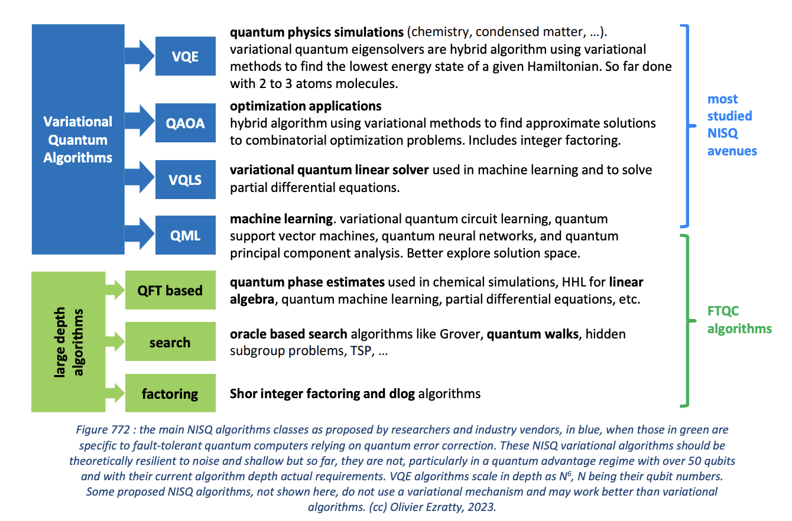
Source: Olivier Ezratty (2023, Understanding Quantum Technologies)

Slide 3
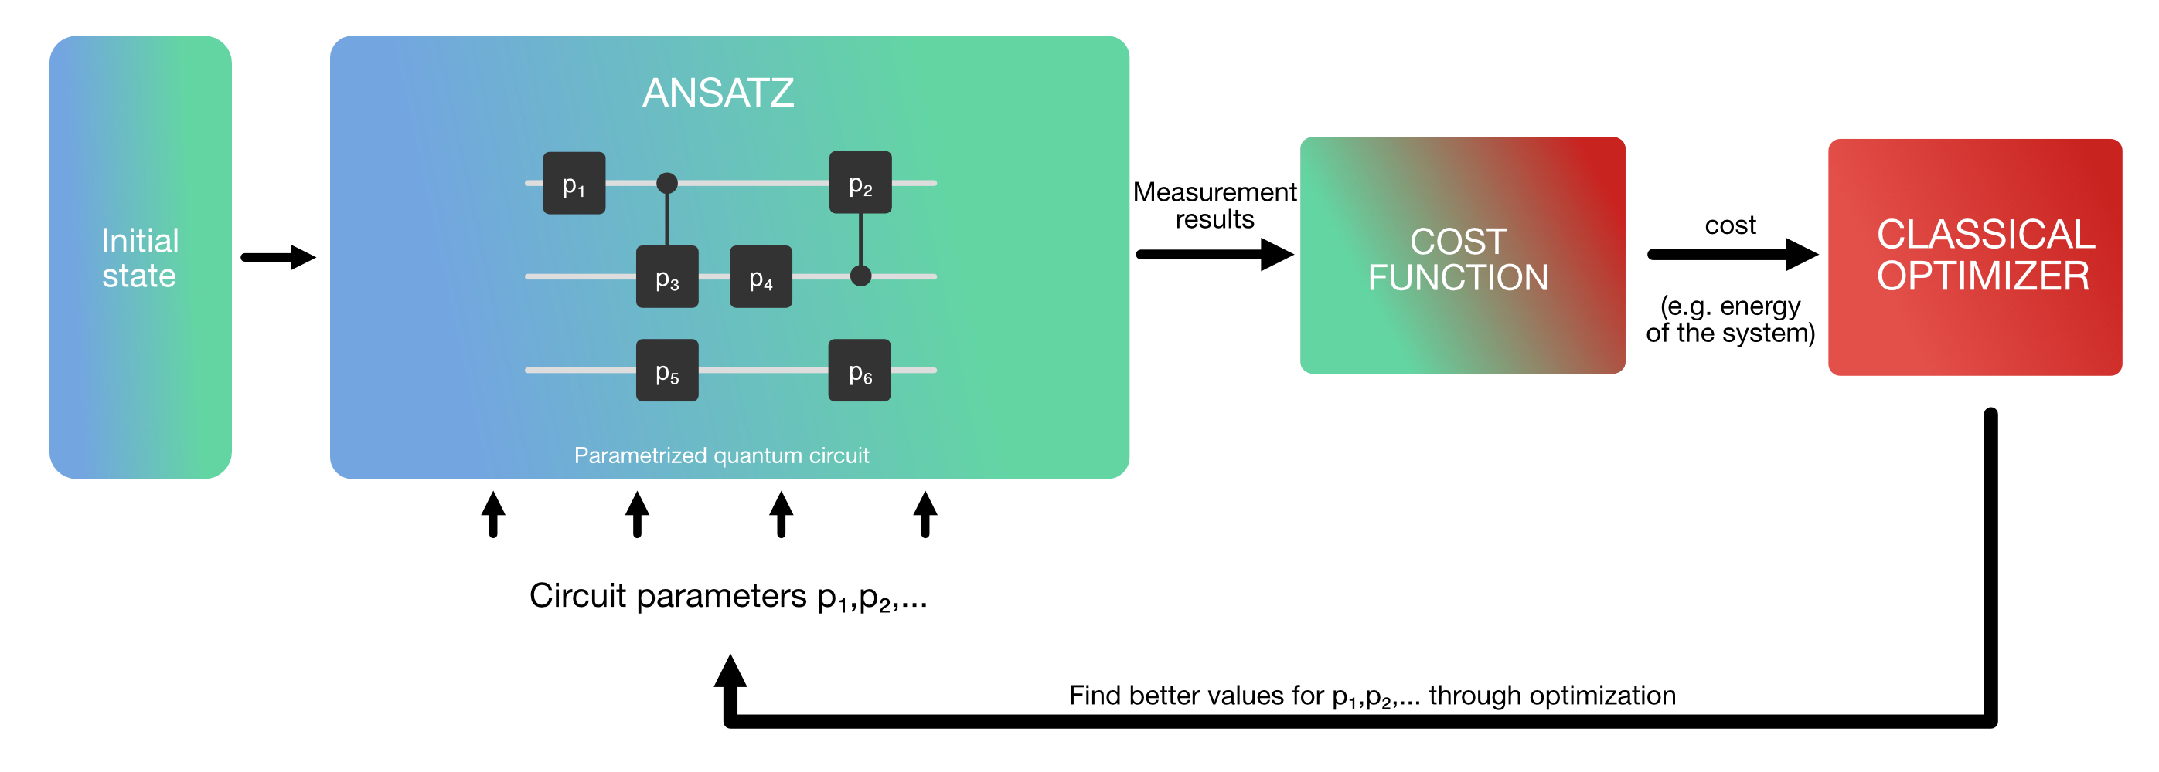
Variational algorithms are one way to do a hybrid algorithm
VERSATILE MODULAR STRUCTURE

Slide 4

How does it work?
Idea based on variational principle:
way to find the best possible approximation of the true solution of our problem.
Classical parameters
Quantum gates
Quantum state
Measurement
Quantum and classical information exchange
Why interesting for NISQ?
Hybrid computing resources
Noise-resilient

Slide 5
1. The Ansatz

Slide 6
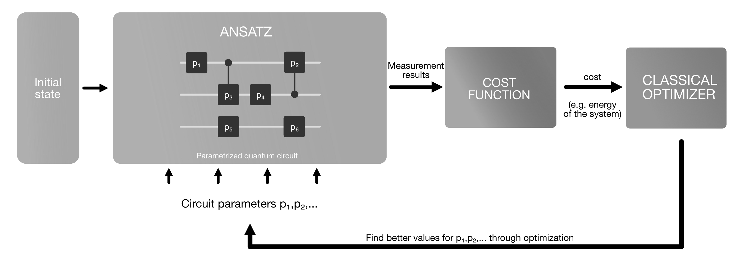
The Ansatz

Slide 7
Complete Hilbert space
ansatz A
ansatz B
solution

Slide 8

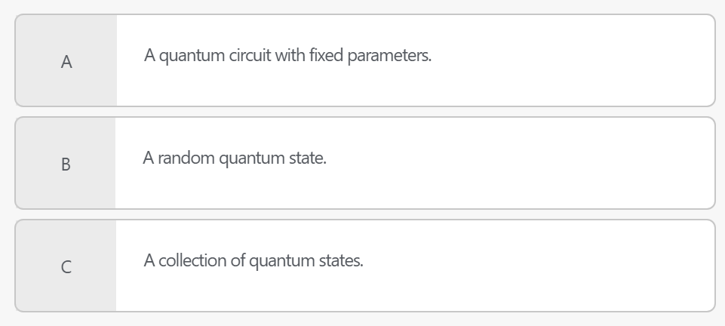
QUIZ TIME!
What does an Ansatz look like in the quantum case?

Slide 9
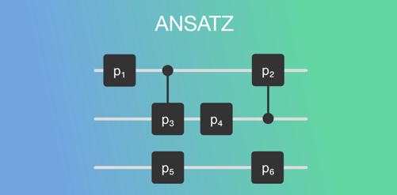
Explore the quantum states space
An Ansatz is a starting point to solve a problem
Example: a trial function to solve a differential equation
This initial guess can be random or informed
Analogy: a prior probability distribution in Bayesian statistics
Quantum case
We use parametrized quantum circuits to explore the space of quantum states.

Slide 10
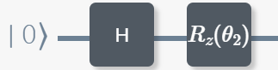
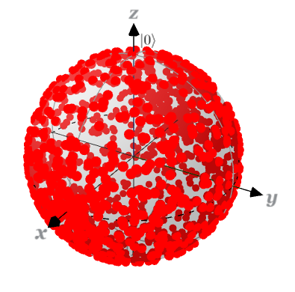
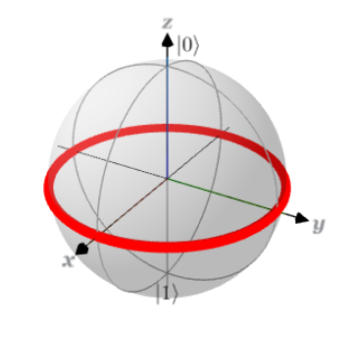
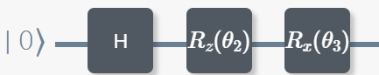
Correct answer
A collection of quantum states!
measure of the power of the circuit to generate states in the Hilbert space uniformly
Expressibility
the higher the expressibility,
the larger the set of accessible states
Open question:
helpful or not for VQA?

Slide 11

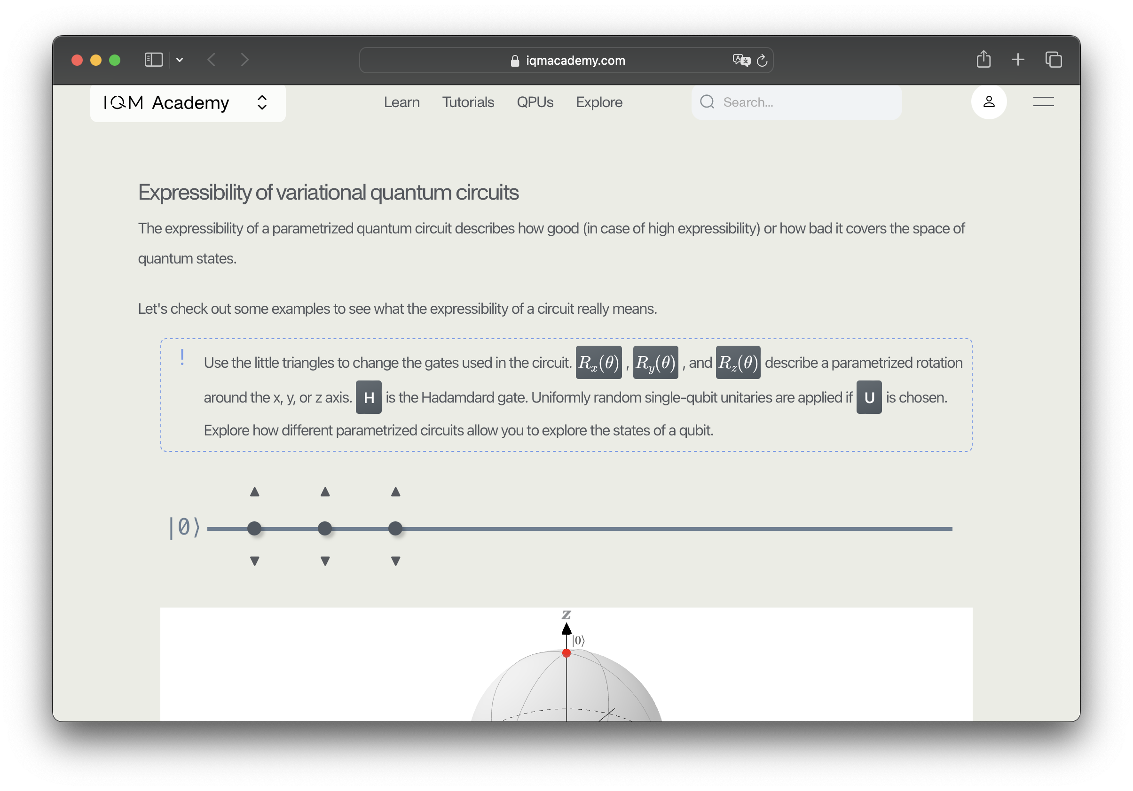
Try it out yourself
https://www.iqmacademy.com/play/expressibility

Slide 12

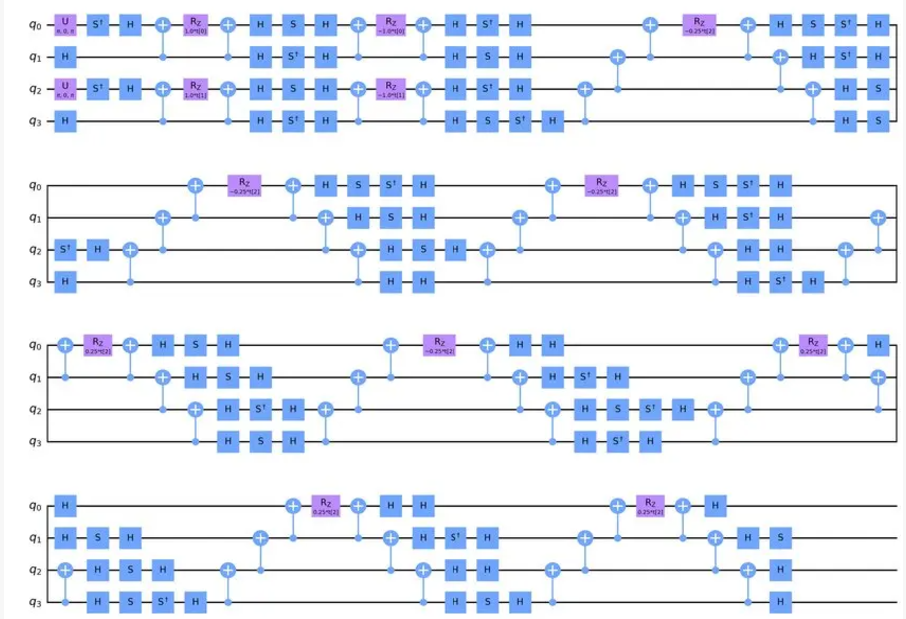
Types of Ansätze
Problem-inspired or problem-agnostic
Unitary Coupled Cluster
Hardware efficient
Quantum chemistry domain
Limit the depth
Use native gates
Take into account connectivity
Many-body systems including electronic correlation
Avoid overhead of transpilation

Slide 13
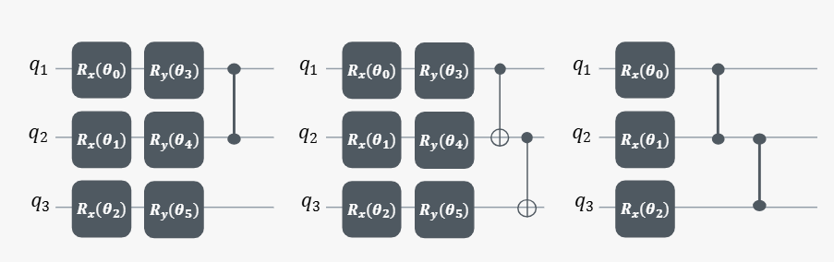
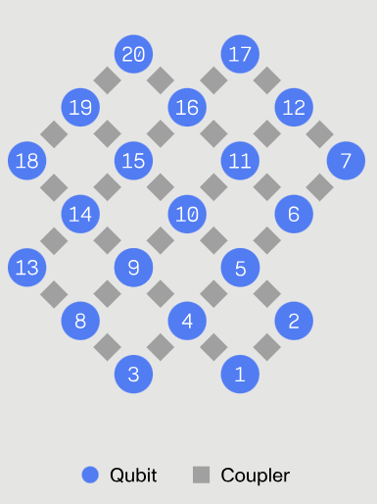
QUIZ TIME!
Which of the following circuits is hardware efficient for our Garnet QPU?
A B C

Slide 14
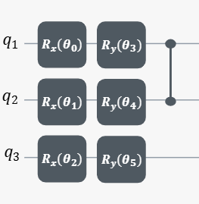

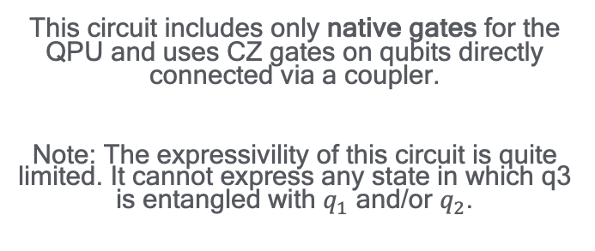

Correct answer
No special requirements
$${|\left.0\right\rangle }^{⊗N}$$
Reference state (e.g. Hartree-Fock)
Where to start?
Feature map (machine learning)
This circuit includes only native gates for the QPU and uses CZ gates on qubits directly connected via a coupler.
Note: The expressivility of this circuit is quite limited. It cannot express any state in which q3 is entangled with $q_{1}$ and/or $q_{2}$.

Slide 15
2. The cost function

Slide 16
The cost function

Slide 17


Encode the problem you want to solve
It maps the measurement outcomes associated with the current values of the parameters contained in the Ansatz to real numbers.
COST FUNCTION
Initial states
Ansatz
OBSERVABLES
Everything that can be observed (measured) about a quantum system.
Energy of the system
Hamiltonian

Slide 18
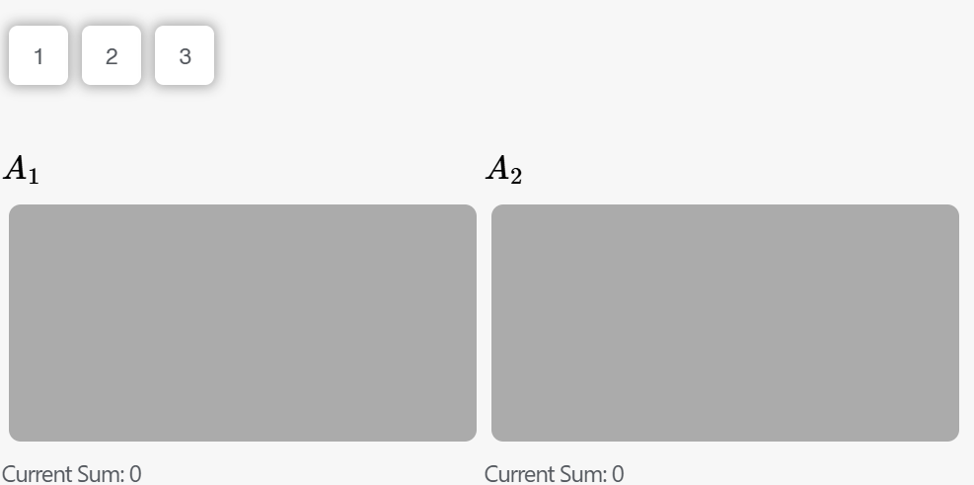
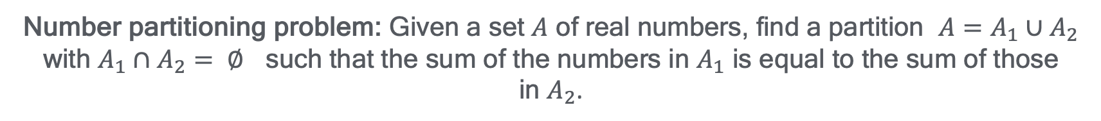
QUIZ TIME!
Number partitioning problem: Given a set $A$ of real numbers, find a partition $A=A_{1}∪A_{2}$ with $A_{1}∩A_{2}= ∅$ such that the sum of the numbers in $A_{1}$ is equal to the sum of those in $A_{2}$.

Slide 19
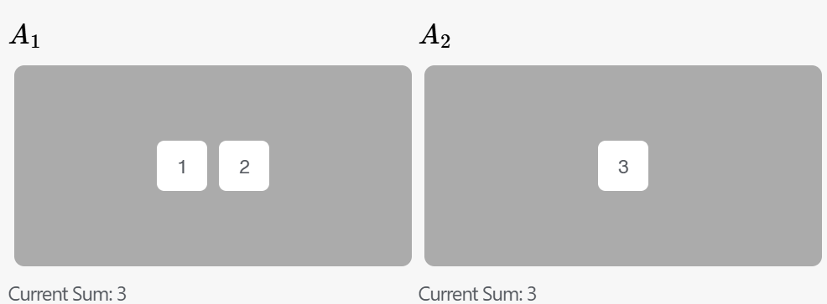
QUIZ TIME!
Number partitioning problem: Given a set $A$ of real numbers, find a partition $A=A_{1}∪A_{2}$ with $A_{1}∩A_{2}= ∅$ such that the sum of the numbers in $A_{1}$ is equal to the sum of those in $A_{2}$.

Slide 20
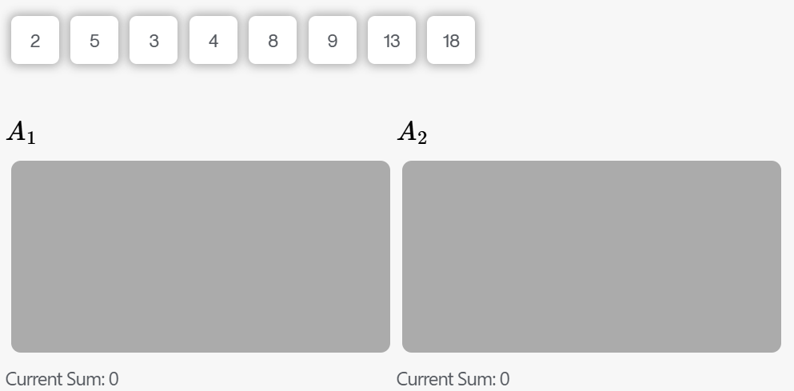
QUIZ TIME!
Number partitioning problem: Given a set $A$ of real numbers, find a partition $A=A_{1}∪A_{2}$ with $A_{1}∩A_{2}= ∅$ such that the sum of the numbers in $A_{1}$ is equal to the sum of those in $A_{2}$.

Slide 21
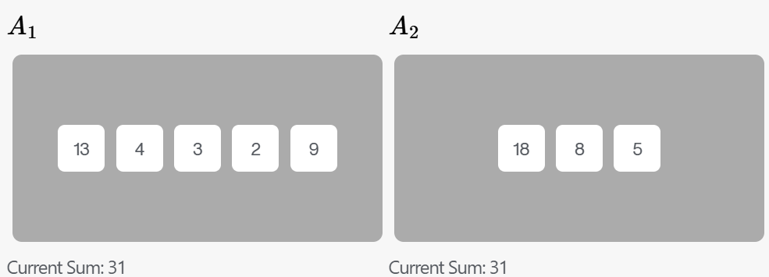


Correct answer
How much time did it take to solve it?
How do we encode NPP in a cost function for a VQA?
Quadratic Unconstrained Binary Optimization problem
RESOURCE ALLOCATION PROBLEM
Common features to all cost functions
Trainable: it is easy to move around the landscape of parameters
Efficiently computable on a quantum computer
Faithful: its minimum corresponds to the solution

Slide 22
3. The Optimizer

Slide 23
The Optimizer

Slide 24

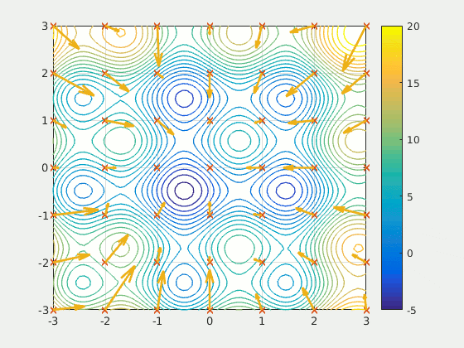


What is the role of the classical computer?
Find the optimal parameters!
Gradient-based or gradient-free
Source: Wikipedia
Analogy: going downhill from a mountain as fast as possible.
Gradients on quantum devices: parameter-shift rule
Example: particle swarm optimization

Slide 25
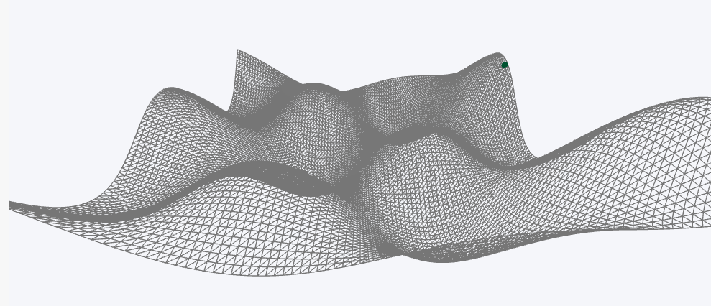
QUIZ TIME!
Would you use a gradient-based method for this landscape?

Slide 26
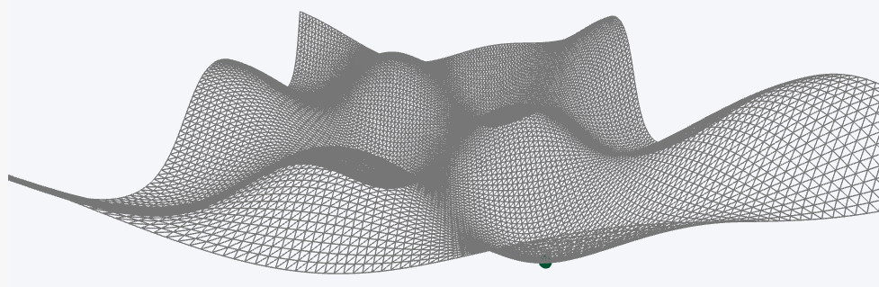

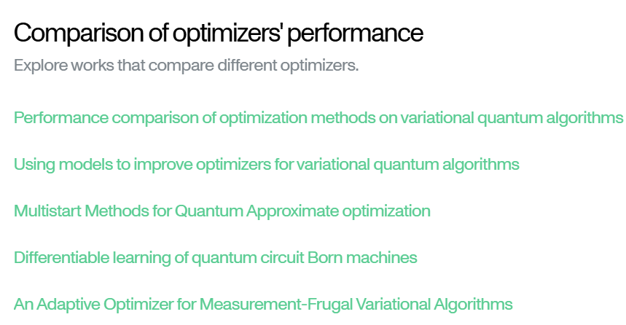
Correct answer
The choice of the right optimizer for your VQA can depend on what is more important to you: time, precision, cost... Everything depends on the method and no method can solve all problems!
CHECK THIS OUT ON
ACADEMY
(x, y, z) = (−1.428,0, -0.888)
It is possible to find the global minimum of this function with the gradient-descent method (even if it has many local minima, it is quite smooth).

Slide 27
A hybrid algorithm
VERSATILE MODULAR STRUCTURE

Slide 28
Calculating the gradient

Slide 29
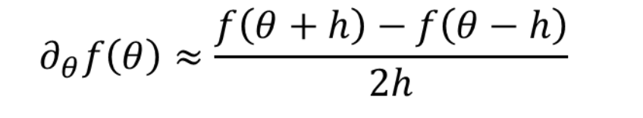
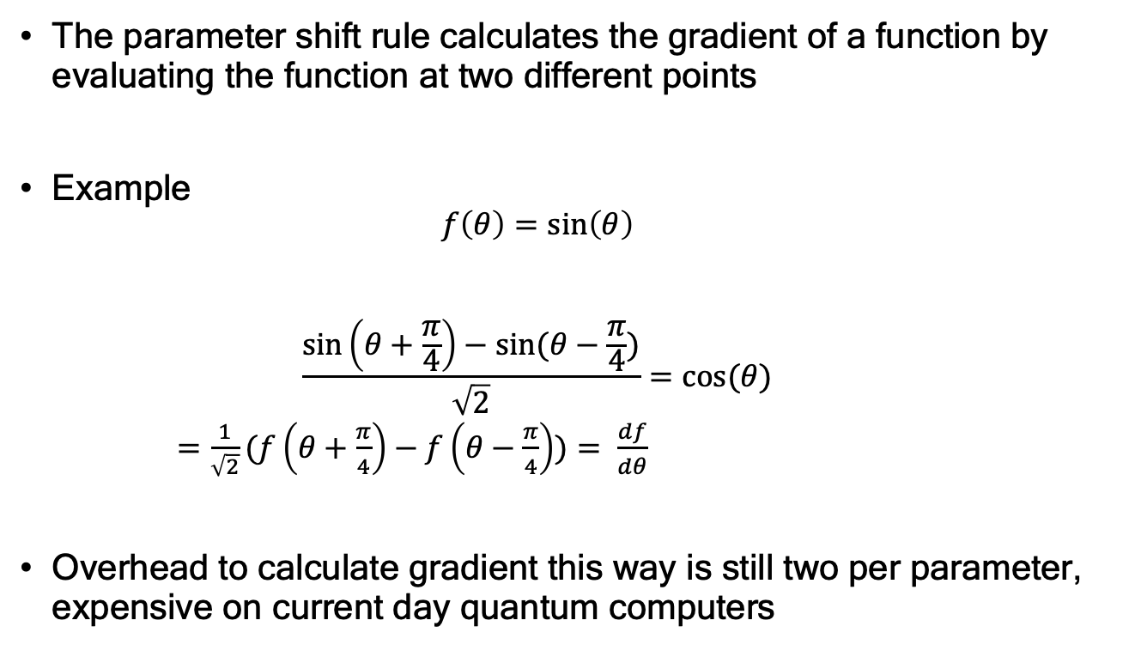
Idea: Calculating gradient using parameter shift rule
The parameter shift rule calculates the gradient of a function by evaluating the function at two different points
Example
  $$f\left(θ\right)=\sin\left(θ\right)$$
  $$\frac{\sin\left(θ+\frac{π}{4}\right)−sin⁡(θ−\frac{π}{4})}{\sqrt{2}}=\cos{(θ) }$$
  $=\frac{1}{\sqrt{2}}⁡(f\left(θ+\frac{π}{4}\right)−f\left(θ−\frac{π}{4}\right))⁡= \frac{df}{dθ}$
Overhead to calculate gradient this way is still two per parameter, expensive on current day quantum computers
This is not finite difference!
Exact solution, not just an approximation
Points in parameter shift can be far apart, not infinitesimally close
Small differences could be more strongly be influenced by noise
Maria Schuld, Ville Bergholm, Christian Gogolin, Josh Izaac and Nathan Killoran, Evaluating analytic
gradients on quantum hardware, Physical Review A 99, 032331 (2019), arXiv:1811.11184.

Slide 30
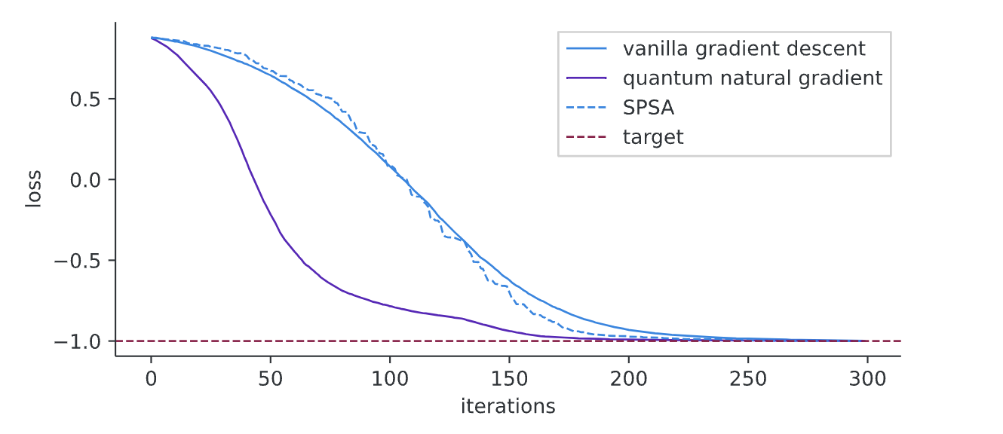
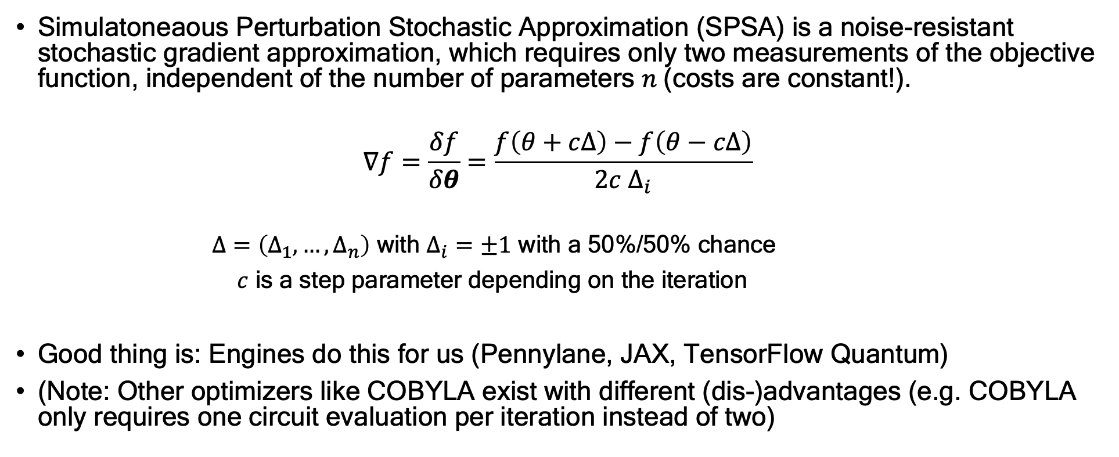
Calculating the gradient with SPSA
Simulatoneaous Perturbation Stochastic Approximation (SPSA) is a noise-resistant stochastic gradient approximation, which requires only two measurements of the objective function, independent of the number of parameters $n$(costs are constant!).
$$∇f=\frac{δf}{δθ}=\frac{f\left(θ+cΔ\right)−f\left(θ−cΔ\right)}{2c Δ_{i}}$$
$Δ=\left(Δ_{1}, …, Δ_{n}\right)$ with $Δ_{i}=±1$ with a 50%/50% chance
$c$ is a step parameter depending on the iteration
Good thing is: Engines do this for us (Pennylane, JAX, TensorFlow Quantum)
(Note: Other optimizers like COBYLA exist with different (dis-)advantages (e.g. COBYLA only requires one circuit evaluation per iteration instead of two)
Picture source: https://learn.qiskit.org/course/machine-learning/training-quantum-circuits

Slide 31
Well-known variational quantum algorithms

Slide 32
Variational quantum eigensolver (VQE)
Find the ground state energy of a quantum system (e.g. molecules, materials) by minimizing the expectation value of the Hamiltonian.
How It Works:
Hamiltonian Encoding: Express the problem’s Hamiltonian 𝐻 in qubit operators (e.g. via the so-called Jordan-Wigner transformation).
Parameterized Ansatz: Prepare a quantum state ∣𝜓(𝜃)⟩ using a variational circuit.
Measurement: Evaluate the expectation value ⟨𝜓(𝜃)∣𝐻∣𝜓(𝜃))⟩ on a quantum computer.
Classical Optimization: Update 𝜃 to minimize the energy.
Example applications
Molecular ground state energy estimation (e.g., H₂, LiH, BeH₂).
Material science and quantum chemistry.
Learn more in the exercises this week

Slide 33
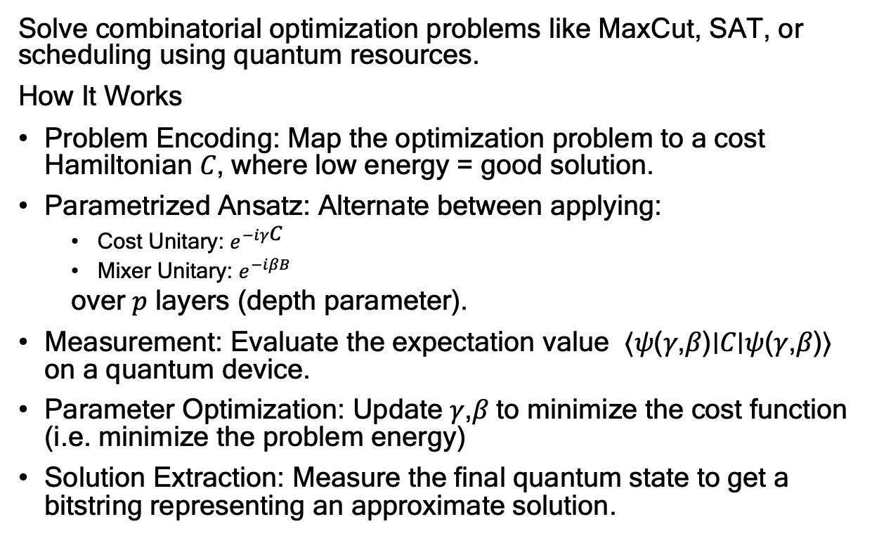
Quantum Approximate Optimization Algorithm (QAOA)
Solve combinatorial optimization problems like MaxCut, SAT, or scheduling using quantum resources.
How It Works
Problem Encoding: Map the optimization problem to a cost Hamiltonian 𝐶, where low energy = good solution.
Parametrized Ansatz: Alternate between applying:
  Cost Unitary: $e^{−iγ\text{C}}$
  Mixer Unitary: $e^{−iβB}$
  over 𝑝 layers (depth parameter).
Measurement: Evaluate the expectation value ⟨𝜓(𝛾,𝛽)∣𝐶∣𝜓(𝛾,𝛽)⟩ on a quantum device.
Parameter Optimization: Update 𝛾,𝛽 to minimize the cost function (i.e. minimize the problem energy)
Solution Extraction: Measure the final quantum state to get a bitstring representing an approximate solution.
Example applications
MaxCut (Maximum Cut problem)
Portfolio optimization
Scheduling
Learn more in the exercises this week

Slide 34
Conclusion

Slide 35
Conclusion: Variational quantum algorithms
Variational quantum algorithms are hybrid quantum-classical algorithms that use a parameterized quantum circuit (ansatz) and classical optimization to solve complex problems.
Key Components:
Quantum Circuit (Ansatz): Encodes the problem into a quantum state.
Cost Function: Represents the problem's objective, evaluated on a quantum computer.
Classical Optimizer: Updates parameters to minimize (or maximize) the cost function.
Popular Algorithms:
VQE (Variational Quantum Eigensolver): For finding ground states of Hamiltonians.
QAOA (Quantum Approximate Optimization Algorithm): For solving combinatorial optimization problems.
Variational Classifiers: For quantum machine learning tasks

