Slide 1
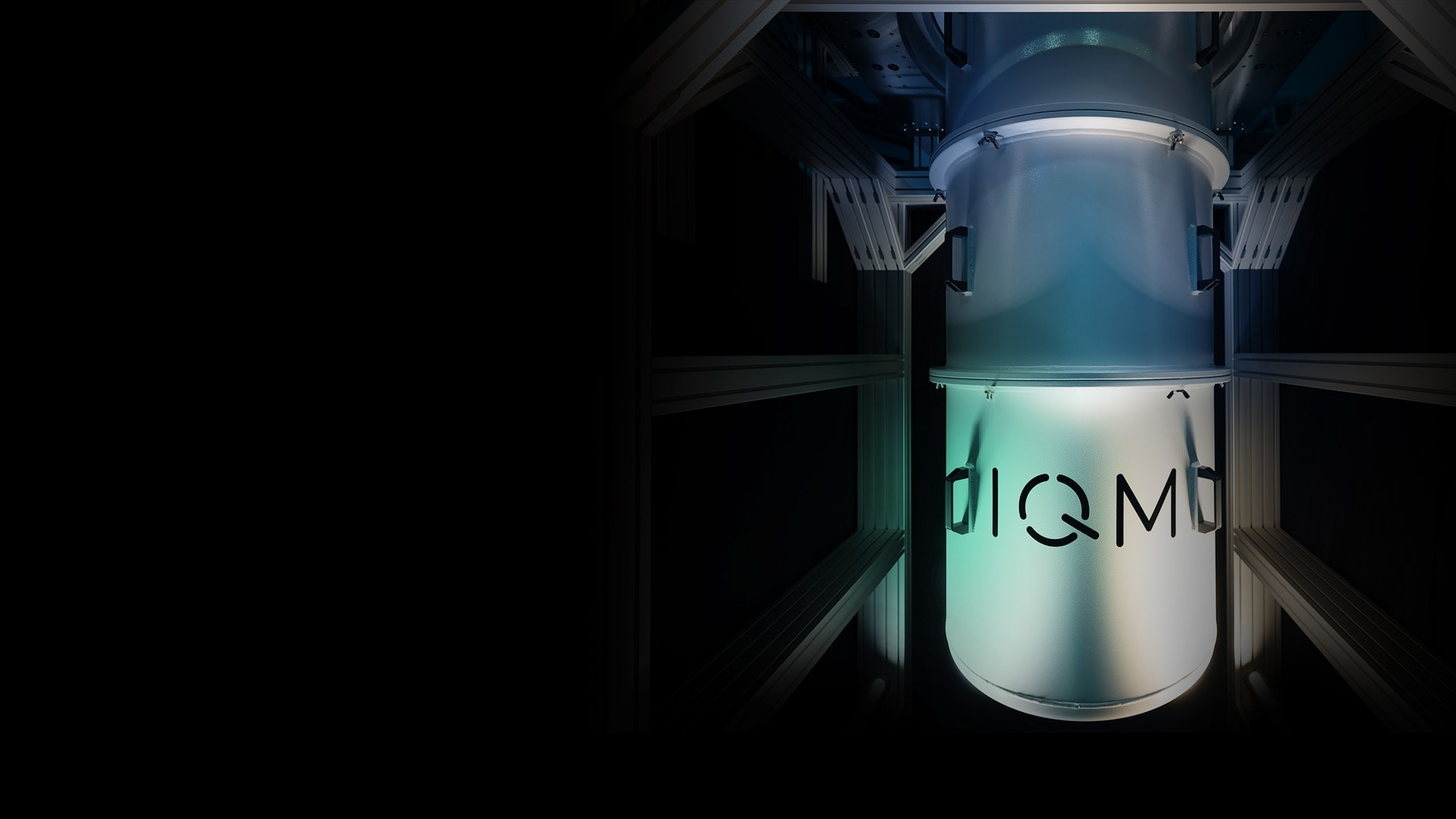






Grover’s Algorithm
A lecture series by IQM and HS RM
Authors: Stefan Seegerer, Mikio Nakahara
Last Updated 06/2025
www.meetiqm.com

Slide 2
In this session, we will learn Grover’s algorithm to solve 3SAT problem

Slide 3
Agenda
Searching for Answers: Table Seating Problem
Grover’s algorithm
3SAT Problem

Slide 4
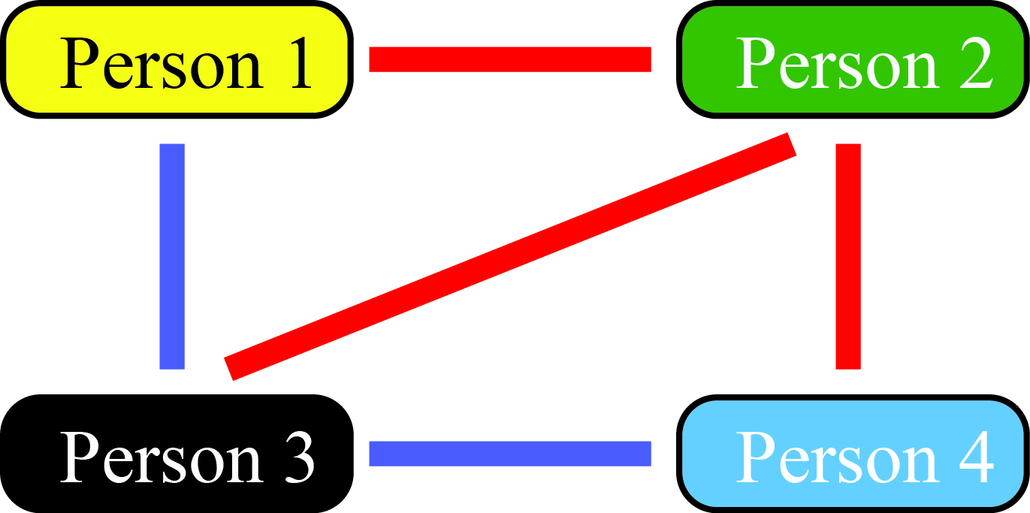
Searching for Answers: Table Seating Problem
Suppose 4 persons are invited to a party.
Their relations are subtle. Some people want to sit in the same table, while some want to avoid sitting in the same table.
Example: Blue line; they want to sit together,
Red line: they want to avoid sitting together
No line: they are neutral
Table Seating Problem: Suppose there are two tables. To arrange the seating of guests at tables in such a way that the guests are comfortable and enjoy the company of those they are seated with, while adhering to certain preferences and constraints.

Slide 5
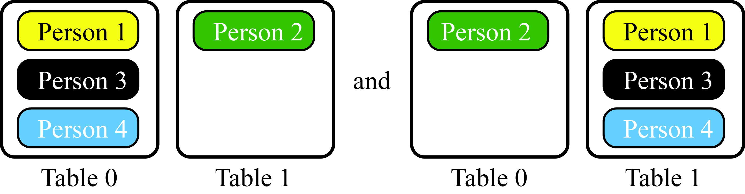
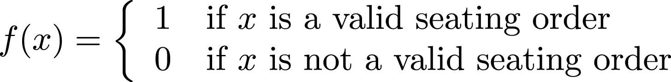
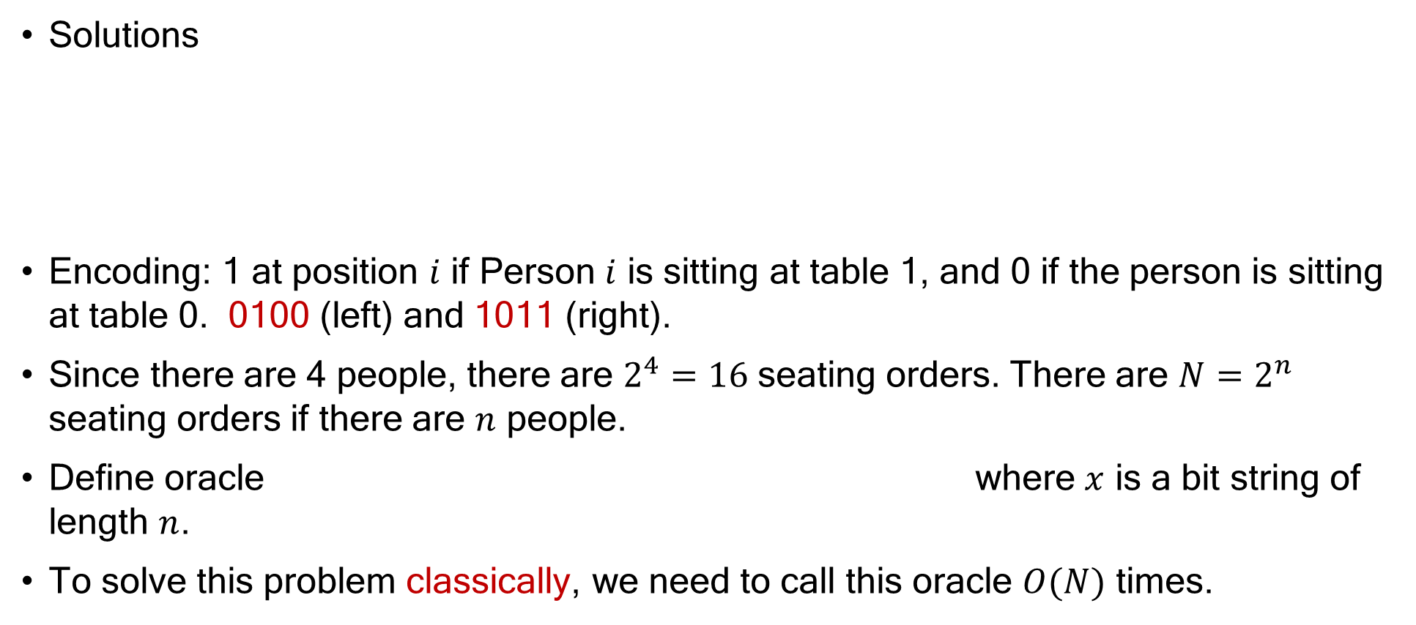
Searching for Answers: Table Seating Problem
Solutions
Encoding: 1 at position $i$ if Person $i$ is sitting at table 1, and 0 if the person is sitting at table 0. 0100 (left) and 1011 (right).
Since there are 4 people, there are $2^{4}=16$ seating orders. There are $N=2^{n}$ seating orders if there are $n$ people.
Define oracle where $x$ is a bit string of length $n$.
To solve this problem classically, we need to call this oracle $O(N)$ times.

Slide 6
Agenda
Searching for Answers: Table Seating Problem
Grover’s algorithm
3SAT Problem

Slide 7

Grover’s Algorithm
A quantum algorithm called Grover’s algorithm finds solutions by using the oracle $O(\sqrt{N})$times.
Assume that there is a unique $x$ that satisfies $f(x)=1$ for simplicity.

Slide 8
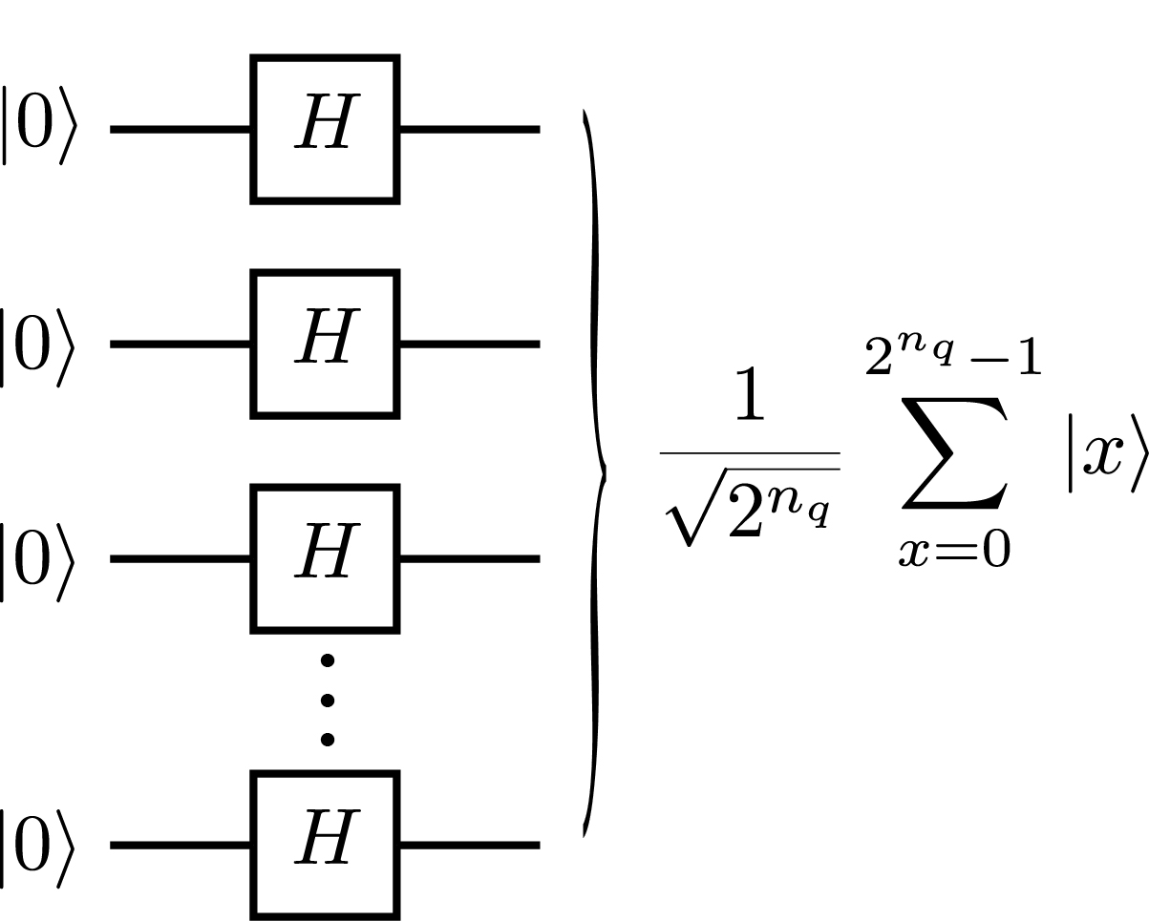
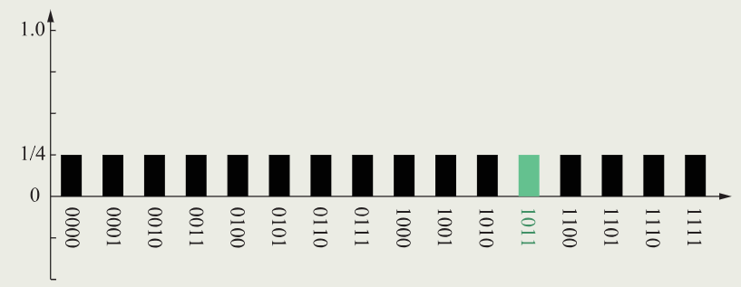
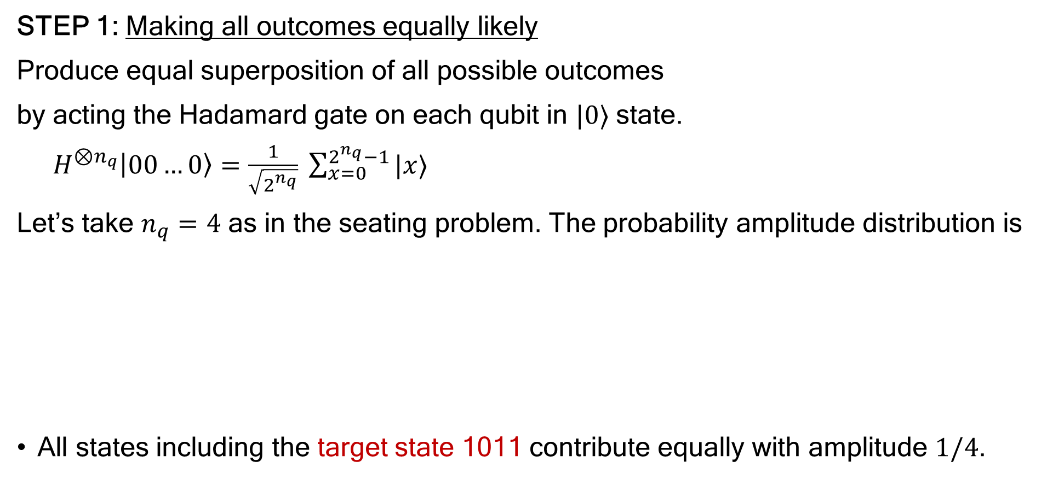
Grover’s Algorithm
STEP 1: Making all outcomes equally likely
Produce equal superposition of all possible outcomes
by acting the Hadamard gate on each qubit in $|0⟩$ state.
$H^{⊗n_{q}}\left|00…0\right\rangle =\frac{1}{\sqrt{2^{n_{q}}}} \sum_{x=0}^{2^{n_{q}}−1}{|x⟩}$
Let’s take $n_{q}=4$ as in the seating problem. The probability amplitude distribution is
All states including the target state 1011 contribute equally with amplitude $1/4$.

Slide 9
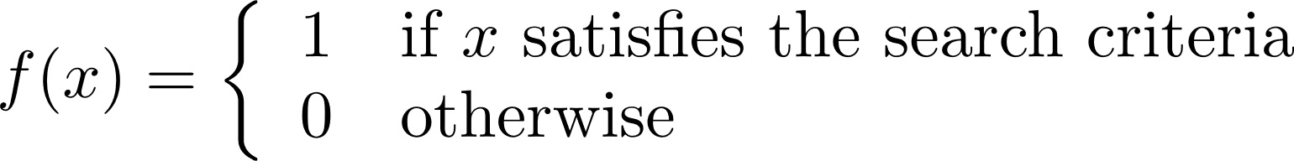
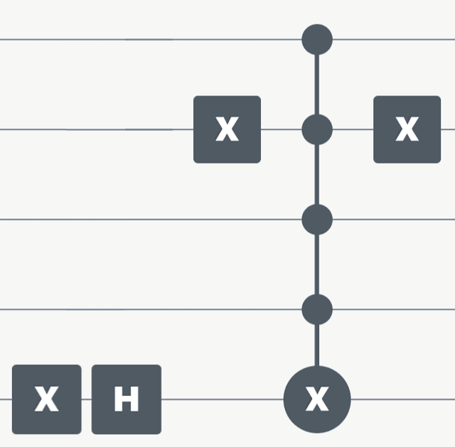
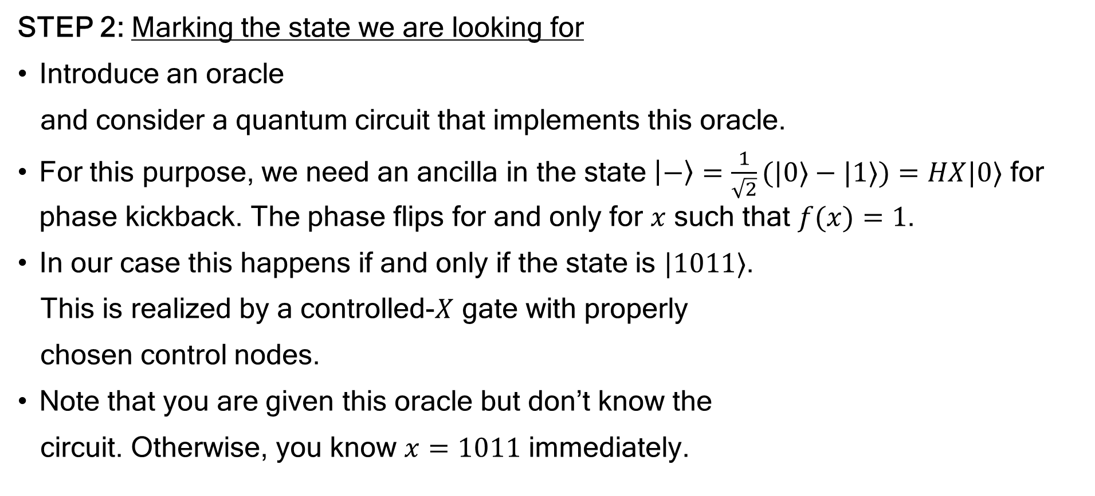
Grover’s Algorithm
STEP 2: Marking the state we are looking for
Introduce an oracle
and consider a quantum circuit that implements this oracle.
For this purpose, we need an ancilla in the state $\left|−\right\rangle =\frac{1}{\sqrt{2}}(|0⟩−|1⟩)=HX|0⟩$ for phase kickback. The phase flips for and only for $x$ such that $f(x)=1$.
In our case this happens if and only if the state is $|1011⟩$.
This is realized by a controlled-$X$ gate with properly
chosen control nodes.
Note that you are given this oracle but don’t know the
circuit. Otherwise, you know $x=1011$ immediately.

Slide 10
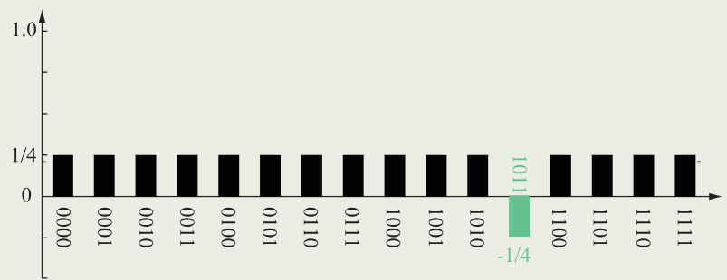
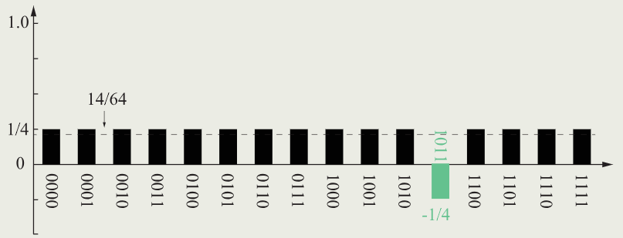
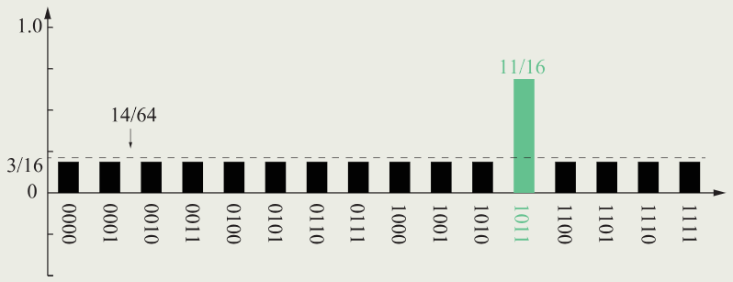


Grover’s Algorithm
The output of this circuit is $→$
Observe that the amplitude
of 1011 flipped the sign.
STEP 3: Increase likelihood of measuring this state
The marking does not change the likelihood of measuring 1011. To amplify the probability, each amplitude is inverted with respect to the mean of amplitudes (dashed line) as
$$\frac{1}{4}→\frac{3}{16},−\frac{1}{4}→\frac{11}{16}$$

Slide 11
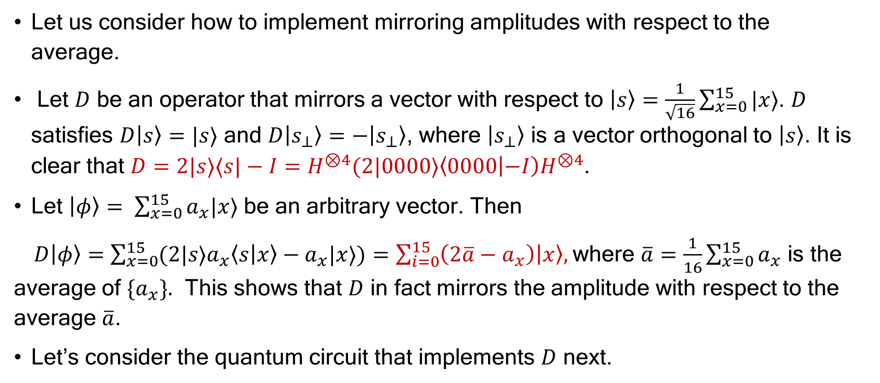
Grover’s Algorithm
Let us consider how to implement mirroring amplitudes with respect to the average.
Let $D$ be an operator that mirrors a vector with respect to $\left|s\right\rangle =\frac{1}{\sqrt{16}}\sum_{x=0}^{15}{|x⟩}$. $D$ satisfies $D\left|s\right\rangle =|s⟩$ and $D\left|s_{⊥}\right\rangle =−\left|s_{⊥}\right\rangle$, where $\left|s_{⊥}\right\rangle$ is a vector orthogonal to $\left|s\right\rangle$. It is clear that $D=2|s⟩⟨s|−I=H^{⊗4}(2|0000⟩\left\langle 0000 | −I\right)H^{⊗4}$.
Let $\left|φ\right\rangle = \sum_{x=0}^{15}{a_{x}|x⟩}$ be an arbitrary vector. Then
$D\left|φ\right\rangle =$ $\sum_{x=0}^{15}{{(2|s⟩a}_{x}\left\langle s | x\right\rangle −a_{x}|x⟩)=\sum_{i=0}^{15}{\left(2\overline{a}−a_{x}\right)\left|x\right\rangle , }}$where $\overline{a}=\frac{1}{16}\sum_{x=0}^{15}{a_{x}}$ is the average of $\{a_{x}\}.$ This shows that $D$ in fact mirrors the amplitude with respect to the average $\overline{a}$.
Let’s consider the quantum circuit that implements $D$ next.

Slide 12
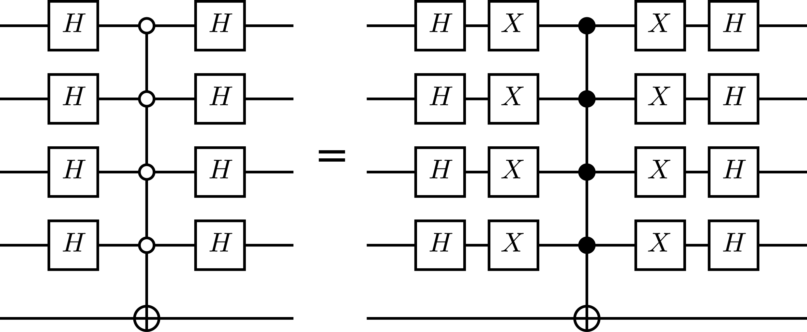

Grover’s Algorithm
In fact, we have already encountered a similar circuit previously for our oracle, which flips the sign of ancilla when the input state is $\left|1011\right\rangle ,$ which is replaced with $\left|0000\right\rangle$ here. (Never mind the phase, which is irrelevant in quantum theory.) Then the control nodes are sandwiched by $H^{⊗4}$ as
Here we used the identity $|0⟩⟨0\left|=X\right|1⟩⟨1|X$ to arrive at the second circuit.

Slide 13
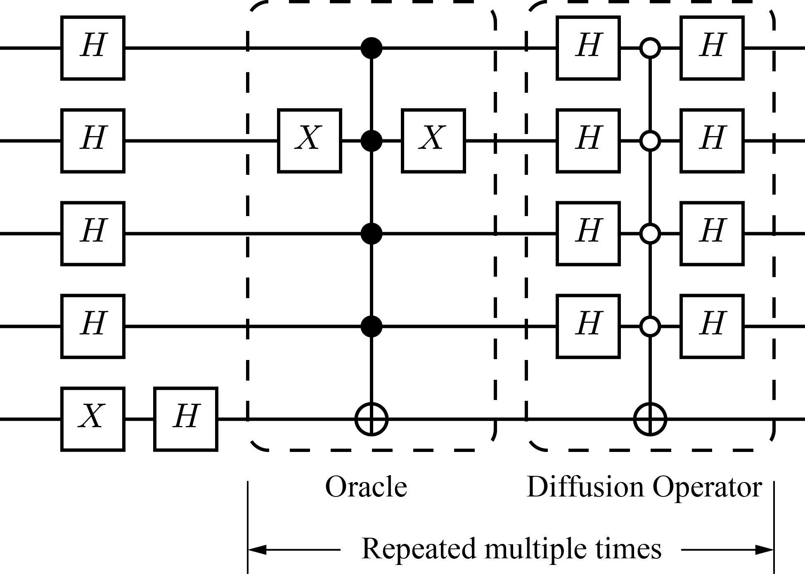

Grover’s Algorithm
STEP 4: Do it all over again and again
Now the oracle followed by the diffusion operator $D$ looks like
Let’s check the probability of getting 1011 is enhanced.

Slide 14
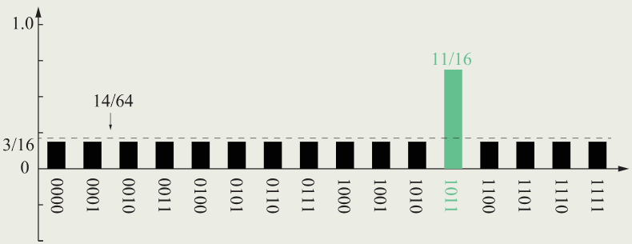
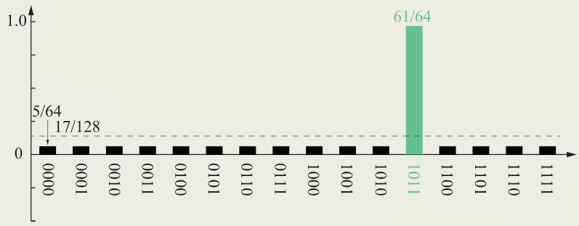
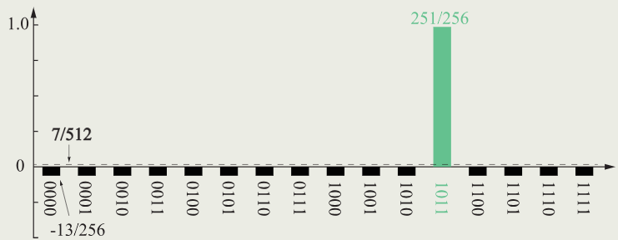




Grover’s Algorithm
$${\left(\frac{11}{16}\right)}^{2}∼0.473$$
The amplitude of 1011 has changed from
-1/4 to 11/16. The probability has changed
from ${\left(\frac{1}{4}\right)}^{2}=0.0625$ to ${\left(\frac{11}{16}\right)}^{2}∼$0.473.
The probability is further enhanced if the
oracle+diffusion operator is applied again
and again.
$${\left(\frac{61}{64}\right)}^{2}∼0.908$$
$${\left(\frac{251}{256}\right)}^{2}∼0.961$$

Slide 15
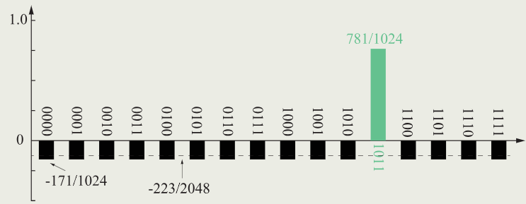
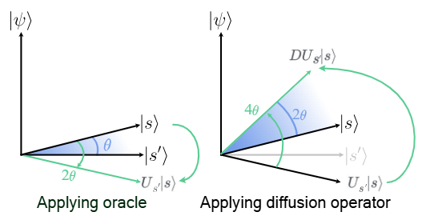
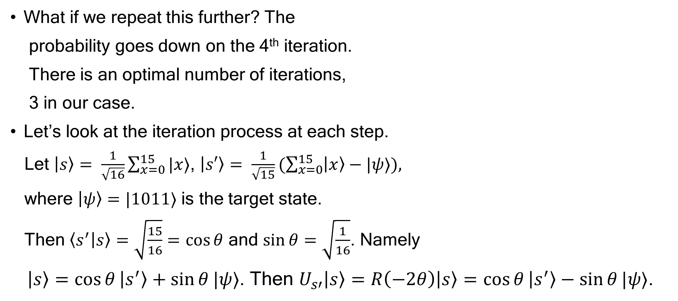

Grover’s Algorithm
What if we repeat this further? The
probability goes down on the 4th iteration.
There is an optimal number of iterations,
3 in our case.
Let’s look at the iteration process at each step.
Let $\left|s\right\rangle = \frac{1}{\sqrt{16}}\sum_{x=0}^{15}{|x⟩}$, $\left|s′\right\rangle = \frac{1}{\sqrt{15}}(\sum_{x=0}^{15}{\left|x\right\rangle −|ψ⟩), }$
where $\left|ψ\right\rangle =|1011⟩$ is the target state.
Then $\left\langle s^{′} | s\right\rangle =\sqrt{\frac{15}{16}}=\cos{θ}$ and $\sin{θ}=\sqrt{\frac{1}{16}}$. Namely
$\left|s\right\rangle =\cos{θ}\left|s^{′}\right\rangle +\sin{θ}|ψ⟩$. Then $U_{s′}\left|s\right\rangle =R\left(−2θ\right)\left|s\right\rangle =$ $\cos{θ}\left|s^{′}\right\rangle −\sin{θ}|ψ⟩$.
$${\left(\frac{781}{1024}\right)}^{2}∼0.582$$

Slide 16
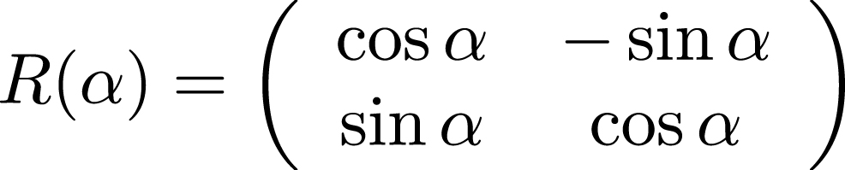
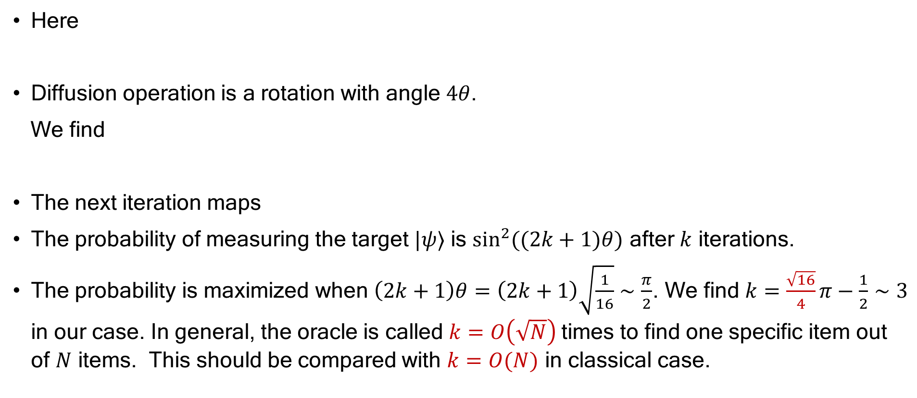
Grover’s Algorithm
Here
Diffusion operation is a rotation with angle $4θ$.
We find
The next iteration maps
The probability of measuring the target $|ψ⟩$ is $\sin^{2}((2k+1)θ)$ after $k$ iterations.
The probability is maximized when $\left(2k+1\right)θ=\left(2k+1\right)\sqrt{\frac{1}{16}}∼\frac{π}{2}$. We find $k=\frac{\sqrt{16}}{4}π−\frac{1}{2}∼3$ in our case. In general, the oracle is called $k=O\left(\sqrt{N}\right)$times to find one specific item out of $N$ items. This should be compared with $k=O(N)$ in classical case.

Slide 17
Agenda
Searching for Answers: Table Seating Problem
Grover’s algorithm
3SAT Problem

Slide 18
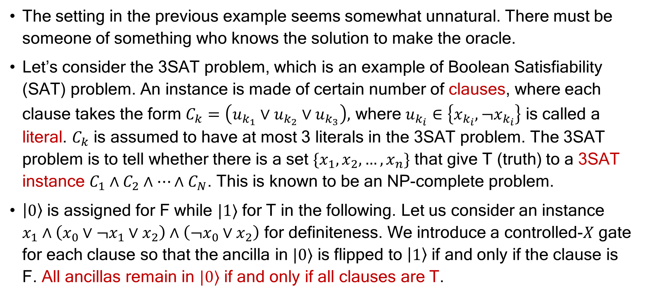
3SAT Problem
The setting in the previous example seems somewhat unnatural. There must be someone of something who knows the solution to make the oracle.
Let’s consider the 3SAT problem, which is an example of Boolean Satisfiability (SAT) problem. An instance is made of certain number of clauses, where each clause takes the form $C_{k}=\left(u_{k_{1}}∨u_{k_{2}}∨u_{k_{3}}\right),$ where $u_{k_{i}}∈\left\{x_{k_{i}}, ¬x_{k_{i}}\right\}$ is called a literal. $C_{k}$ is assumed to have at most 3 literals in the 3SAT problem. The 3SAT problem is to tell whether there is a set $\{x_{1},x_{2},…,x_{n}\}$ that give T (truth) to a 3SAT instance $C_{1}∧C_{2}∧…∧C_{N}$. This is known to be an NP-complete problem.
$\left|0\right\rangle$ is assigned for F while $|1⟩$ for T in the following. Let us consider an instance $x_{1}∧\left(x_{0}∨¬x_{1}∨x_{2}\right)∧\left(¬x_{0}∨x_{2}\right)$ for definiteness. We introduce a controlled-$X$ gate for each clause so that the ancilla in $|0⟩$ is flipped to $\left|1\right\rangle$ if and only if the clause is F. All ancillas remain in $|0⟩$ if and only if all clauses are T.

Slide 19
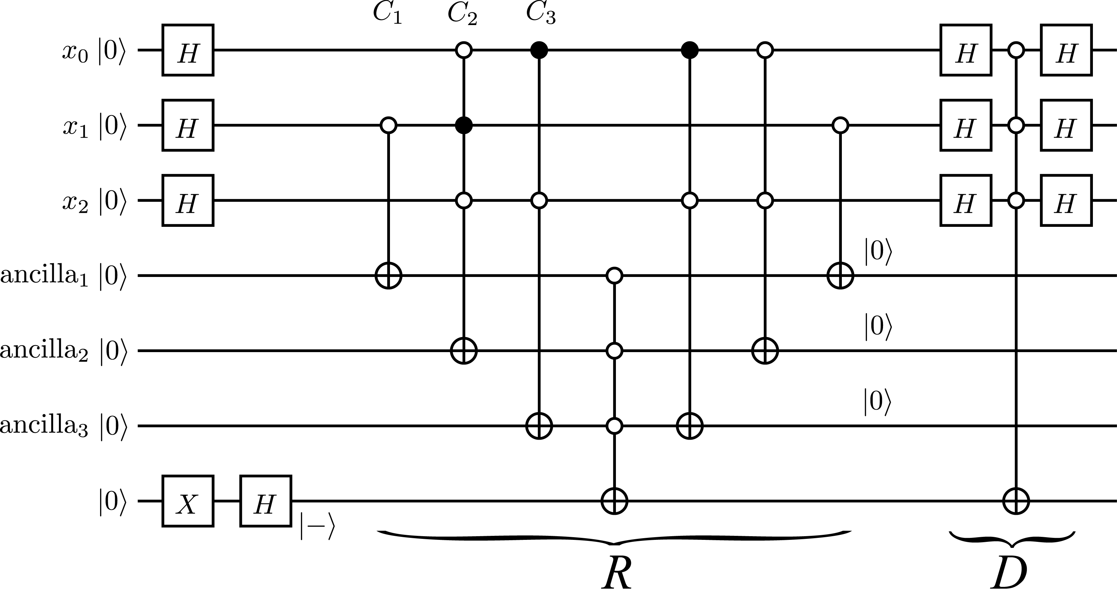

3SAT Problem
Ancilla is flipped from $|0⟩$ to $|1⟩$ if and only if a clause is F. If all clauses are T, the control qubits of the control gate acting on the bottom qubit remain in $|0⟩$ and flips the phase of the bottom qubit.
$R$ flips the sign of the
basis vector(s) for which
the instance is T.
$D$ is the diffusion
operator.
$\left(x_{1},x_{2},x_{3}\right)=(1,1,1)$ is
obtained with a good
probability after 3 iterations.

Slide 20

Summary
Suppose one wants to pick up one specific item out of unstructured $N$ items. In classical search, it takes $O\left(N\right)$ steps to find the item. The number of steps is reduced to $k∼O\left(\sqrt{N}\right)$ if Grover’s algorithm is employed.
We introduced examples of seating problem and 3SAT problem to demonstrate the advantage of Grover’s algorithm over classical counterpart.

