Slide 1
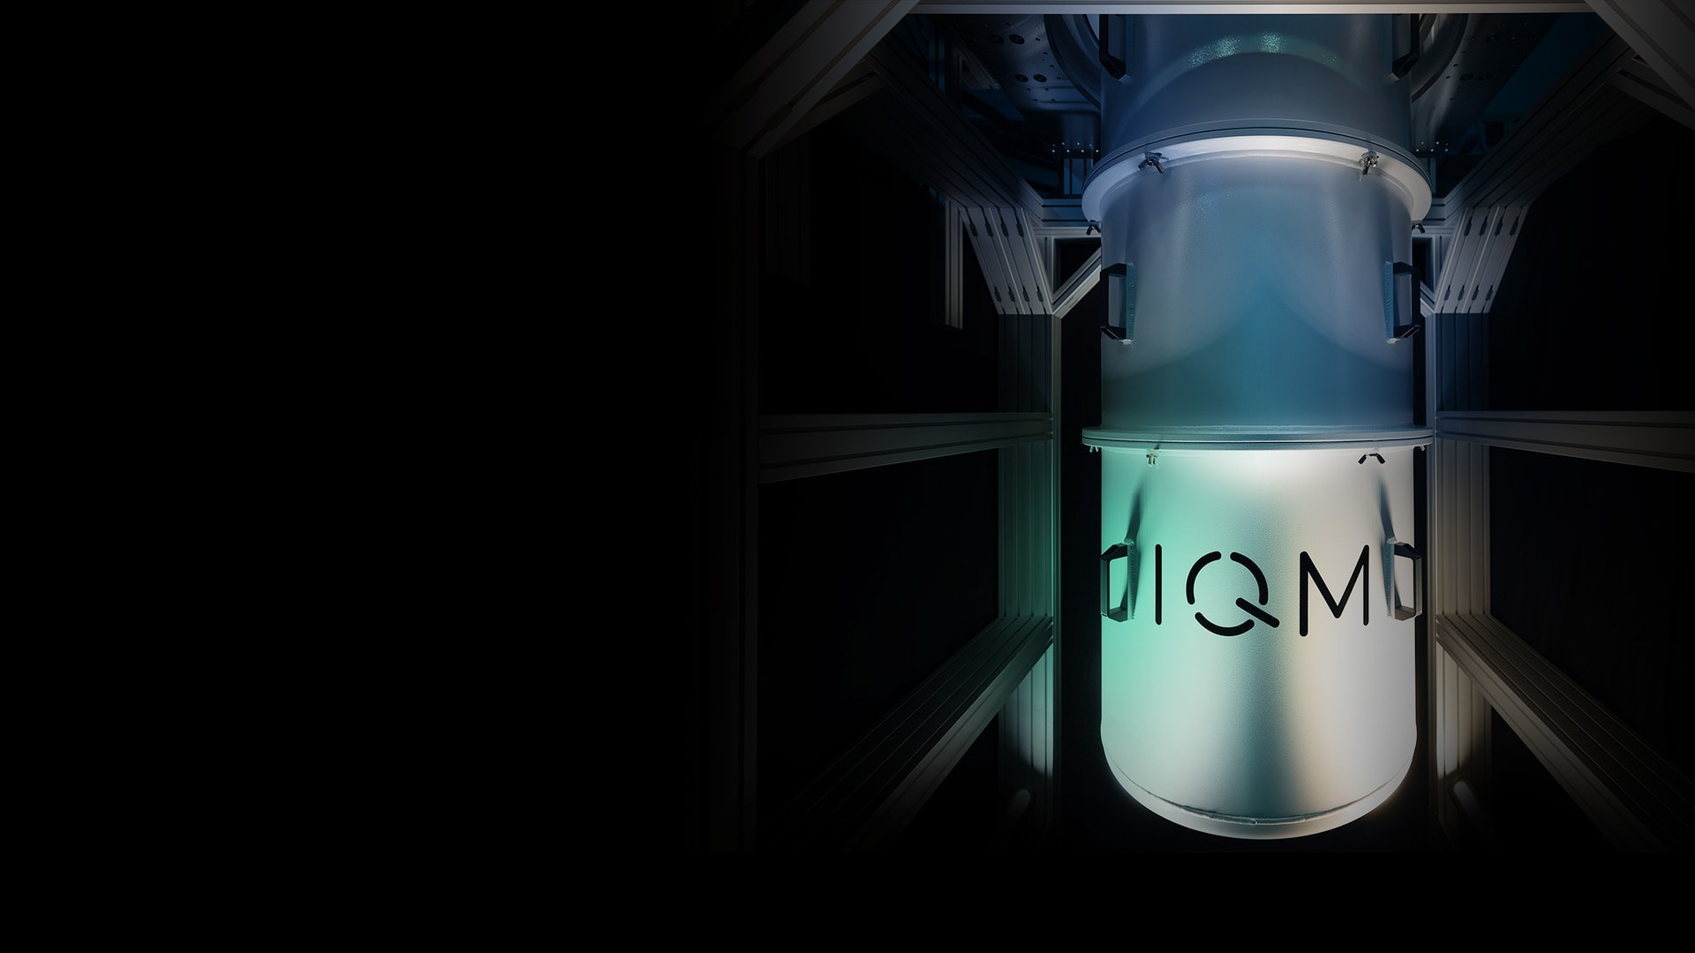






Transpiling, compiling and optimizing quantum circuits
A lecture series by IQM and HS RM
Authors: Stefan Seegerer, Jami Rönkkö, Ivan Takmakov and Nadia Milazzo
Last Updated 07/2025
www.meetiqm.com

Slide 2
How do we run quantum circuits on real quantum computers?

Slide 3

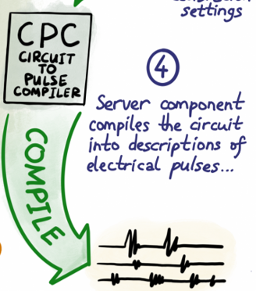
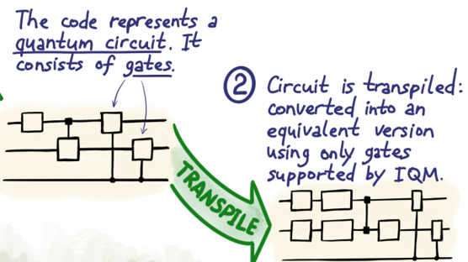

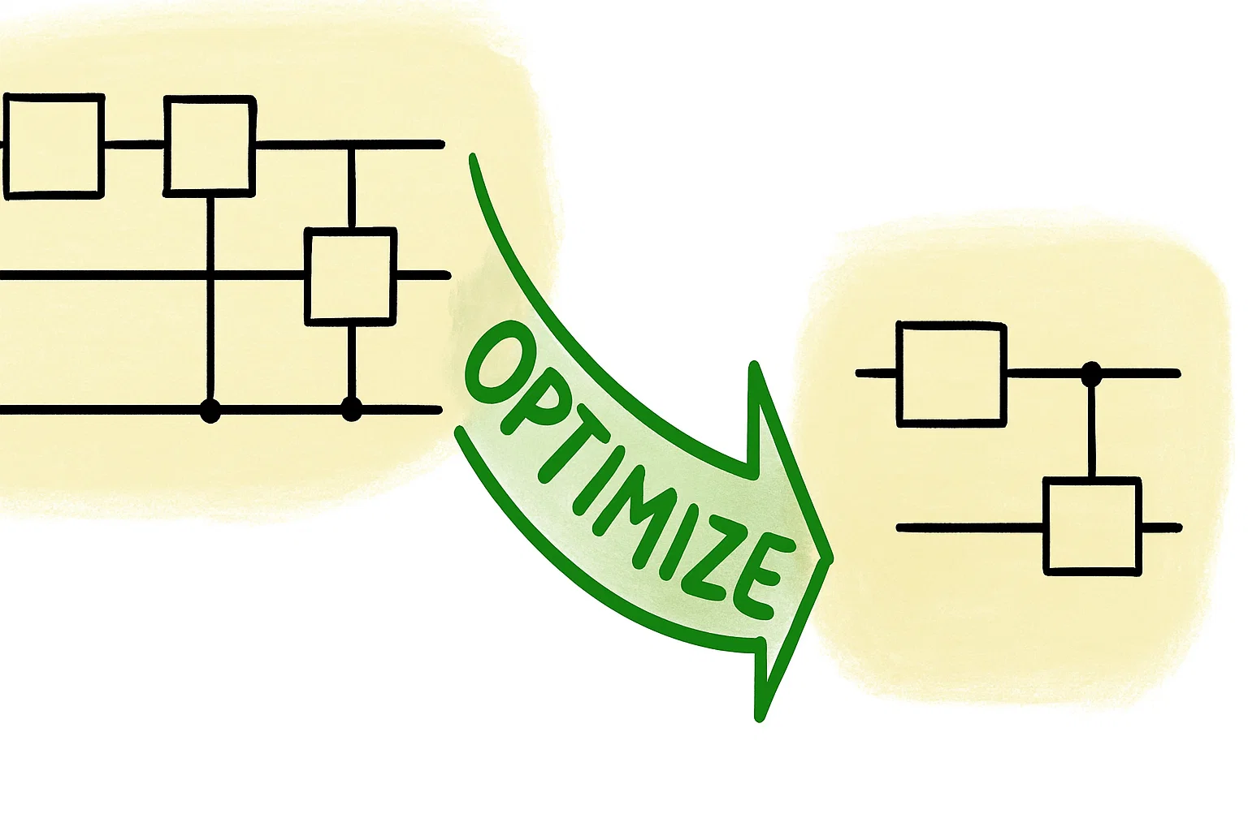
Three steps
TRANSPILATION
COMPILATION
OPTIMIZATION

Slide 4
Transpiling = circuit routing + gate decomposition

Slide 5
Transpilation
Transpiling describes the process of converting a quantum circuit into an equivalent quantum circuit that is compatible with a specific quantum hardware's constraints and gate set.

Slide 6
Circuit routing

Slide 7
Routing (= solving QPU connectivity constraints)
Algorithm’s connectivity
  Quantum algorithms assume arbitrary, even all-to-all connectivity

Slide 8
Routing (= solving QPU connectivity constraints)
Algorithm’s connectivity
  Quantum algorithms assume arbitrary, even all-to-all connectivity
  Connectivities of QPU’s are usually limited to nearest neighbor graphs
QPU’s connectivity

Slide 9
Routing (= solving QPU connectivity constraints)
Algorithm’s connectivity
  Quantum algorithms assume arbitrary, even all-to-all connectivity
  Connectivities of QPU’s are usually limited to nearest neighbor graphs
  Solution: dynamically remap logical qubits to the graph of physical qubits with SWAP gates
QPU’s connectivity
Dynamical remapping

Slide 10
Routing (= solving QPU connectivity constraints)
Algorithm’s connectivity
  Quantum algorithms assume arbitrary, even all-to-all connectivity
  Connectivities of QPU’s are usually limited to nearest neighbor graphs
  Solution: dynamically remap the qubits used in the algorithm to the graph of physical qubits with SWAP gates
QPU’s connectivity
Dynamical remapping

Slide 11





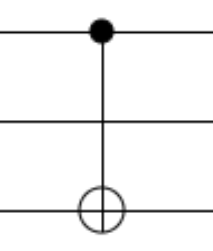


Routing example
Consider the following connectivity:
Routing incompatible operation

Slide 12
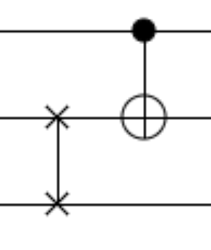
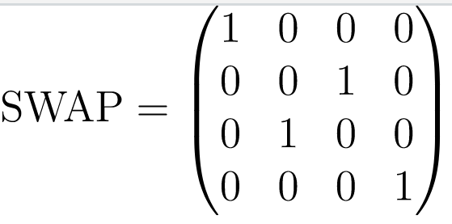
Routing example
Consider the following connectivity:
Routing incompatible operation

Slide 13
Gate decomposition

Slide 14
Universal gate set
We need a way of implementing any possible unitary operations needed in quantum algorithms on a quantum computer

Slide 15
Universal gate set
We need a way of implementing any possible unitary operations needed in quantum algorithms on a quantum computer
A universal gate set is what we need!

Slide 16
Universal gate set
We need a way of implementing any possible unitary operations needed in quantum algorithms on a quantum computer
What is that?

Slide 17
Universal gate set
We need a way of implementing any possible unitary operations needed in quantum algorithms on a quantum computer
What is that?
A set of gates S is said to be universal if any unitary operation can be approximated to a desired precision by composing only the gates in the set S.

Slide 18
Universal gate set
We need a way of implementing any possible unitary operations needed in quantum algorithms on a quantum computer
What are the properties of such a set?

Slide 19
Universal gate set
We need a way of implementing any possible unitary operations needed in quantum algorithms on a quantum computer
What are the properties of such a set?
A universal set of gates for quantum computing can:
Create superposition of states
Create entangled states
Contains gates with real AND complex entries
Contains more than the Clifford group

Slide 20
Universal gate set
We need a way of implementing any possible unitary operations needed in quantum algorithms on a quantum computer
Is the universal set for quantum computing unique?

Slide 21







Universal gate set
We need a way of implementing any possible unitary operations needed in quantum algorithms on a quantum computer
Is the universal set for quantum computing unique?
No, there exist different universal gate sets, such as:
$$\left\{CNOT, H, S, T\right\}$$
$$\left\{CNOT, R_{x}, R_{y}, R_{z}, P\right\}$$
$$\left\{H, T\right\}$$
$S=$ phase gate
$T=$ Toffoli gate
$P=$ phase shift gate
$H=$ Hadamard gate

Slide 22
Universal gate set
We need a way of implementing any possible unitary operations needed in quantum algorithms on a quantum computer
The set of gates used on a specific quantum device is called the native gate set of the device.
IQM systems are calibrated to support arbitrary X and Y rotations as the native single-qubit gate and CZ as the native two-qubit gate.

Slide 23
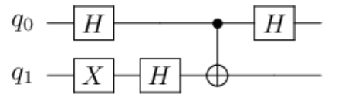
Decomposing (= writing a gate as a series of other gates)
Circuit for Deutsch’s algorithm with CNOT as the oracle
  Circuits of quantum algorithms usually use ’intuitive’ gates like CNOT, X, H, PH, SWAP

Slide 24
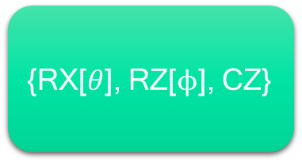
Decomposing (= writing a gate as a series of other gates)
Circuit for Deutsch’s algorithm with CNOT as the oracle
  Circuits of quantum algorithms usually use ’intuitive’ gates like CNOT, X, H, PH, SWAP
  Real QPU’s use only few native, hardware friendly gates to process their qubits
Example QPU native gates
{RX[$θ$], RZ[$ϕ$], CZ}

Slide 25
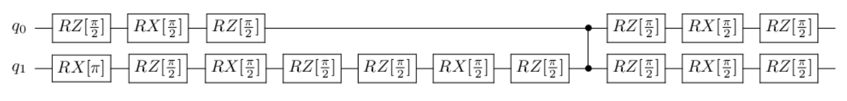
Decomposing (= writing a gate as a series of other gates)
Circuit for Deutsch’s algorithm with CNOT as the oracle
  Circuits of quantum algorithms usually use ’intuitive’ gates like CNOT, X, H, PH, SWAP
  Real QPU’s use only few native, hardware friendly gates to process their qubits
  Solution: gate identities can convert the algorithm’s circuit to equivalent circuit suitable for given QPU
Example QPU native gates
{RX[$θ$], RZ[$ϕ$], CZ}

Slide 26
Decomposing (= writing a gate as a series of other gates)
Circuit for Deutsch’s algorithm with CNOT as the oracle
  Circuits of quantum algorithms usually use ’intuitive’ gates like CNOT, X, H, PH, SWAP
  Real QPU’s use only few native, hardware friendly gates to process their qubits
  Solution: gate identities can convert the algorithm’s circuit to equivalent circuit suitable for given QPU
Example QPU native gates
{RX[$θ$], RZ[$ϕ$], CZ}
CNOT
H
X

Slide 27
How do we decompose single qubit gates?

Slide 28
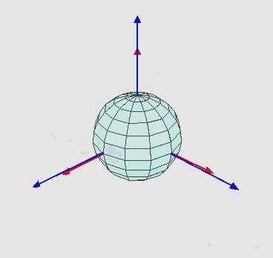
Euler angle decomposition
  Any rotation can be achieved with three elementary rotations, whose angles are the called Euler angles
z-x’-z’’ Euler sequence
Image source: https://https://en.wikipedia.org/wiki/Euler_angles

Slide 29
Euler angle decomposition
  Any rotation can be achieved with three elementary rotations, whose angles are the called Euler angles
  The possible sequences of rotation axes for proper Euler angles are:
  z-x-z, x-y-x, y-z-y, z-y-z, x-z-x and y-x-y
z-x’-z’’ Euler sequence
Image source: https://https://en.wikipedia.org/wiki/Euler_angles

Slide 30
Euler angle decomposition
  Any rotation can be achieved with three elementary rotations, whose angles are the called Euler angles
  The possible sequences of rotation axes for proper Euler angles are:
  z-x-z, x-y-x, y-z-y, z-y-z, x-z-x and y-x-y
  State of a single qubit can be described as a vector in a Bloch sphere and gates as rotations of this vector
z-x’-z’’ Euler sequence
Image source: https://https://en.wikipedia.org/wiki/Euler_angles

Slide 31
Euler angle decomposition
  Any rotation can be achieved with three elementary rotations, whose angles are the called Euler angles
  The possible sequences of rotation axes for proper Euler angles are:
  z-x-z, x-y-x, y-z-y, z-y-z, x-z-x and y-x-y
  State of a single qubit can be described as a vector in a Bloch sphere and gates as rotations of this vector
  We can decompose any single-qubit gate (rotation) into sequence of RX, RY, RZ gates (elementary rotations)
z-x’-z’’ Euler sequence
Image source: https://https://en.wikipedia.org/wiki/Euler_angles

Slide 32
Redefining more precisely…
Transpiling = routing circuit to connectivity of a QPU and decomposing gates to its native gates

Slide 33
Compiling = pulse schedule representation

Slide 34
Compilation
A quantum compiler translates high-level quantum programs into operation that a quantum processor can execute at the lower level of the physical qubits.

Slide 35

Compilation for superconducting QPU
Control of superconducting transmon qubits
driven by microwave pulses
qubit frequency
drive amplitude
drive frequency
constant precession around the Z-axis on the Bloch sphere
Rabi oscillation between |0⟩ and |1⟩
phase of the pulse
Hamiltonian describing the interaction between the transmon and the pulse (lab frame)
ϕ = 0 leads to a rotation around the X-axis
ϕ = π/2 leads to a rotation around the Y-axis
Hamiltonian describing the interaction between the transmon and the pulse (qubit frame)

Slide 36


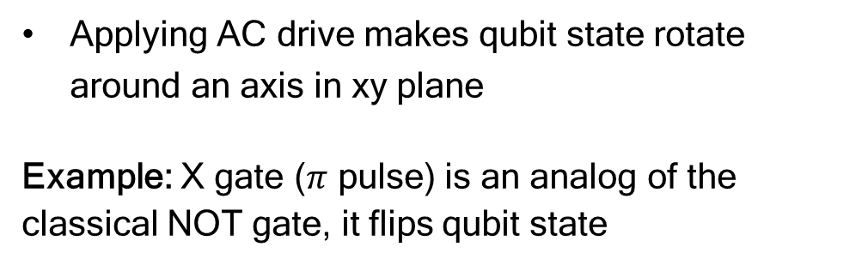
Single qubit gates
$$|0⟩$$
Applying AC drive makes qubit state rotate around an axis in xy plane
Example: X gate ($π$ pulse) is an analog of the classical NOT gate, it flips qubit state
y
x
$$|1⟩$$

Slide 37
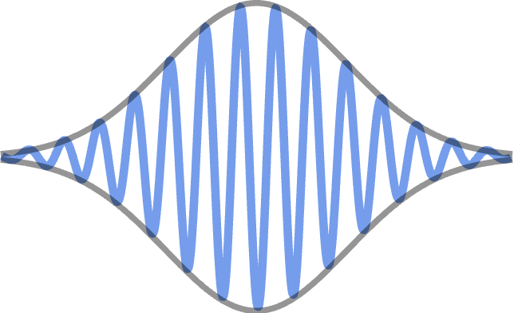
Single qubit gates
$$|0⟩$$
Applying AC drive makes qubit state rotate around an axis in xy plane
Example: X gate ($π$ pulse) is an analog of the classical NOT gate, it flips qubit state
y
x
$$|1⟩$$
We can realize a single qubit gate by applying AC pulse of fixed amplitude and length

Slide 38
Single qubit gates
$$|0⟩$$
Applying AC drive makes qubit state rotate around an axis in xy plane
Example: X gate ($π$ pulse) is an analog of the classical NOT gate, it flips qubit state
y
x
$$|1⟩$$
We can realize a single qubit gate by applying AC pulse of fixed amplitude and length
Z gate
  virtual – by adding a phase (what we use in IQM)
  ‘real’ – by changing qubit frequency
With X and Z gates, we can do any rotation!

Slide 39
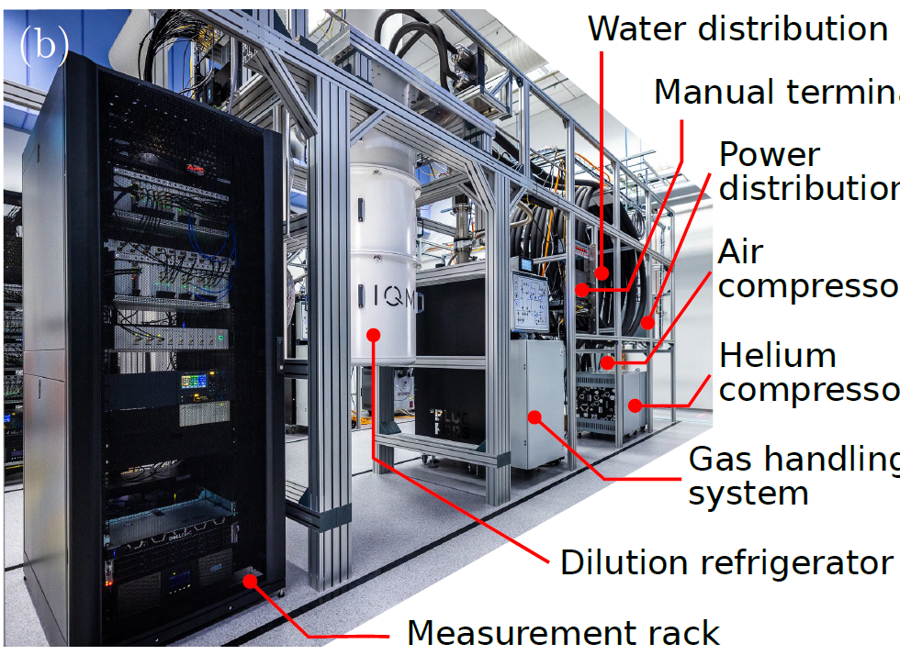
When you want to run a quantum circuit:
Your request is compiled by a server into a sequence of pulses
Electronics rack

Slide 40
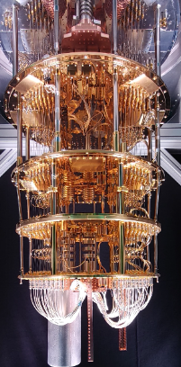
When you want to run a quantum circuit:
Your request is compiled by a server into a sequence of pulses
Control and readout pulses are generated in the electronics rack and sent into the refrigerator
Electronics rack

Slide 41
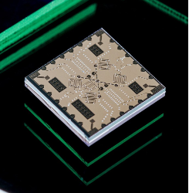
When you want to run a quantum circuit:
Your request is compiled by a server into a sequence of pulses
Control and readout pulses are generated in the electronics rack and sent into the refrigerator
The pulses interact with the QPU
After that, the measurement device “reads” the results, and you can analyze them on your PC.
Electronics rack

Slide 42
Standard stages of compilation in IQM devices
CIRCUIT VALIDATION
CIRCUIT RESOLUTION
If no custom implementation is specified, the default implementation for each gate are selected automatically.
The circuit is converted to Timeboxes:
containers for instruction schedule fragments, to be scheduled according to a given scheduling strategy.
TIMEBOX LEVEL
TIMEBOX RESOLUTION
The timeboxes corresponding to the measurement instructions in the circuit are added.
All relative timings between pulses are resolved and fixed. The different timeboxes are assembled in a single schedule.

Slide 43
Standard stages of compilation in IQM devices
After these main compilation stages, before executing the circuit, one can do a couple of extra passes if wanted/needed:
DYNAMICAL DECOUPLING
Dynamical decoupling pulse sequences are inserted to replace Wait instructions. This is an error suppression technique.
MOVE GATES
This pass applies calibrated phase corrections if MOVE gates are used (only applicable to QCs with computational resonator, i.e. IQM Star Architecture).

Slide 44
Standard stages of compilation in IQM devices
After these main compilation stages, before executing the circuit, one can do a couple of extra passes if wanted/needed:
DYNAMICAL DECOUPLING
Dynamical decoupling pulse sequences are inserted to replace Wait instructions. This is an error suppression technique.
MOVE GATES
This pass applies calibrated phase corrections if MOVE gates are used (only applicable to QCs with computational resonator, i.e. IQM Star Architecture).
What is a MOVE operation?

Slide 45
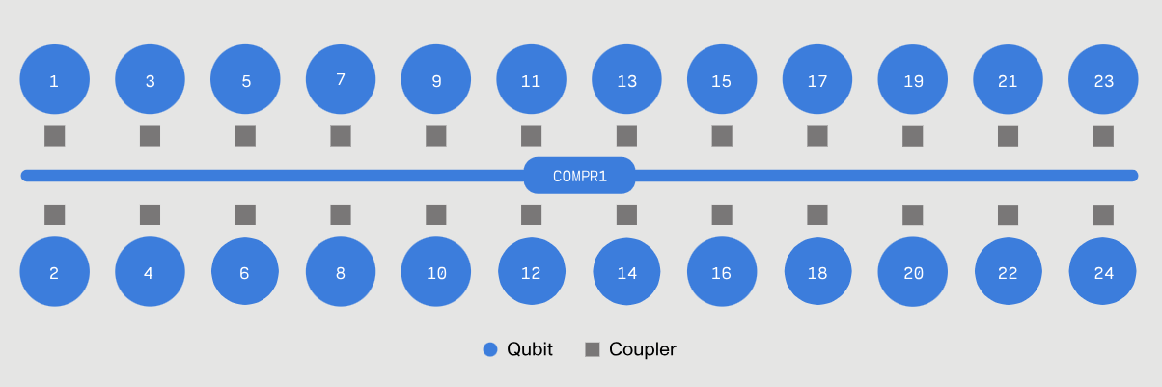
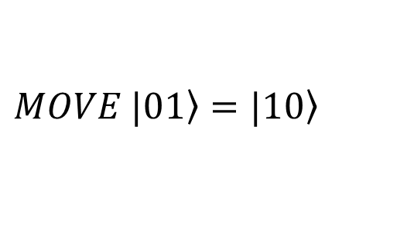
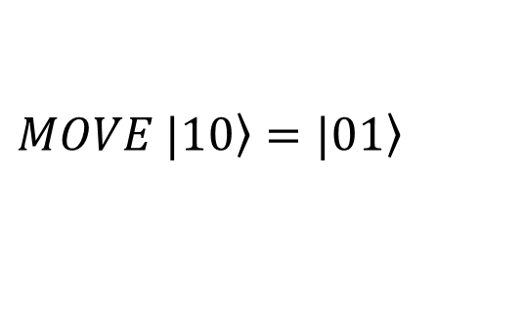
The MOVE operation
IQM QPUs come in two topologies: Crystal and Star.
In the Star topology the qubits are connected to a central computational resonator.
The qubits interact with the central resonator through two types of operations:
the qubit-resonator CZ, and the MOVE operation, that shuttles a single excitation between the qubit and the resonator.
$$MOVE \left.|01\right\rangle =\left.|10\right\rangle$$
$$MOVE \left.|10\right\rangle =\left.|01\right\rangle$$
Similar to SWAP

Slide 46
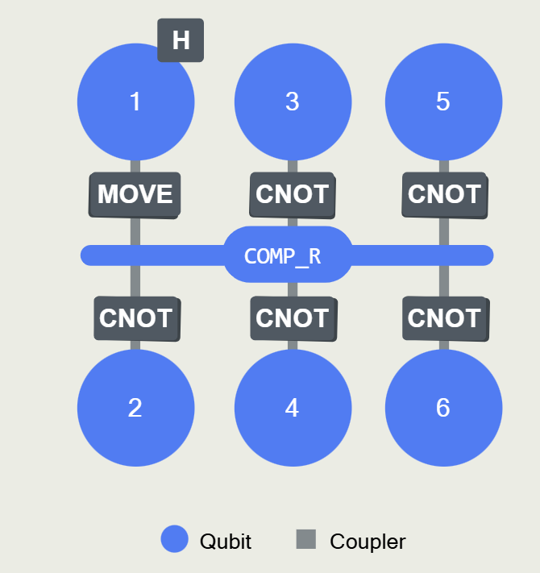
Explore the MOVE operation
Understand better how the MOVE operation acts using the tutorial below:
MOVE operation
You will learn:
How to create a Bell state with this device using the MOVE gate
How the MOVE operation behaves when the resonator is populated

Slide 47
Optimization = reduce noise

Slide 48
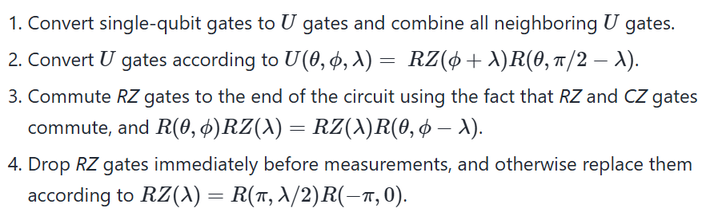
Optimization
To get the best results when running circuits on quantum computers, few considerations can be done in the transpilation and compilation process, e.g., the dynamical decoupling step seen above.
1. Optimize single qubit gates and reduce their count:
*
*Generic single-qubit rotation gate with 3 Euler angles.

Slide 49
Optimization
To get the best results when running circuits on quantum computers, few considerations can be done in the transpilation and compilation process, e.g., the dynamical decoupling step seen above.
1. Optimize single qubit gates and reduce their count:
Put an exercise where we transpile a circuit with and without this function

Slide 50
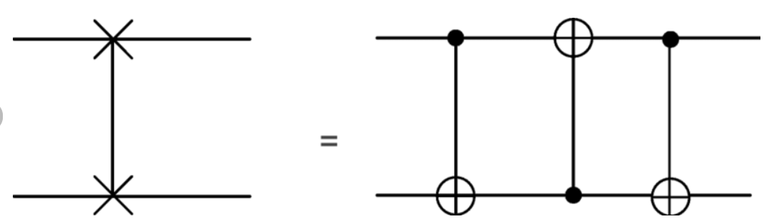
Optimization
To get the best results when running circuits on quantum computers, few considerations can be done in the transpilation and compilation process, e.g., the dynamical decoupling step seen above.
2. Reduce the count of SWAP gates
We need to maximize the number of already existing connections to reduce the depth of the circuit!
Two qubit gates are the noisiest ones, thus reducing their count is even more impactful than single qubit one.
The SWAP gate is one of the most common two qubit gates appearing after transpilation, because of circuit routing.
Each SWAP gate translates into three CNOTs!
Remember that CNOT is also not a native gate for IQM computers!

Slide 51
Optimization
To get the best results when running circuits on quantum computers, few considerations can be done in the transpilation and compilation process, e.g., the dynamical decoupling step seen above.
2. Reduce the count of SWAP gates
Put an exercise where we transpile a circuit with and without choosing the best layout for 2q gates. Show also SWAP decomposition in terms of native IQM gates.

Slide 52
Conclusions

Slide 53
Conclusions
Running circuits on real quantum computers needs few extra steps that we usually neglect when writing high-level quantum programs.
Transpilation takes care of adapting the circuit to the connectivity of the QPU and of decomposing complex unitaries into known gates to the QPU.
Compilation is hardware dependent. For superconducting qubits, we need to translate all circuits into a sequence of microwave pulses to drive the physical qubits.
Running circuits on noisy quantum computers can be improved by dynamically suppressing errors at the physical level or optimizing at best the gate count in the circuit.

