Slide 1
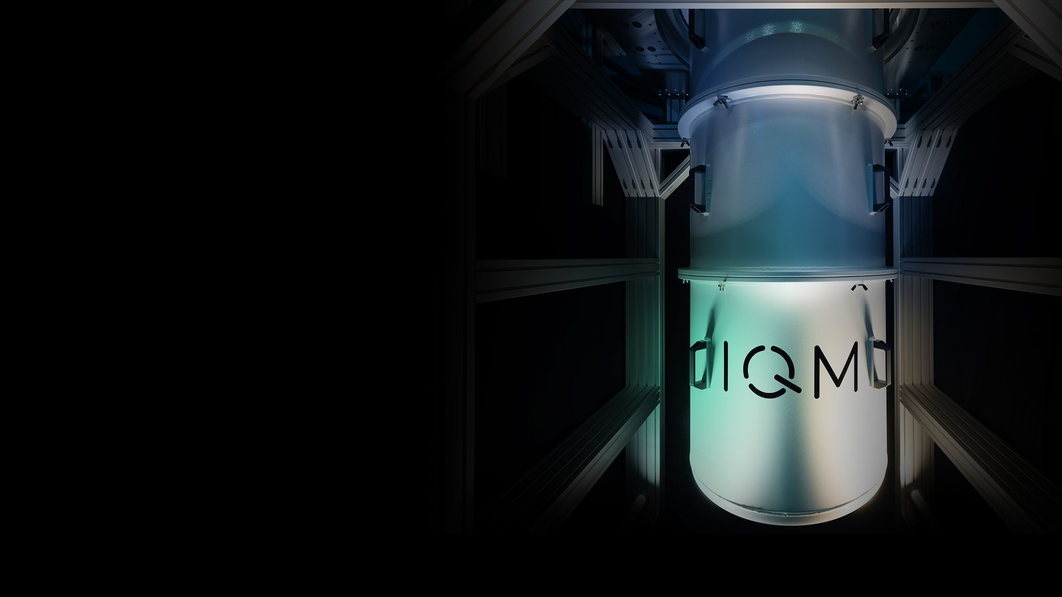






Introduction to Quantum Algorithms
A lecture series by IQM and HS RM
Authors: Stefan Seegerer
Last Updated 06/2025
www.meetiqm.com

Slide 2
Quantum computing: algorithms
Prepare initial state
Quantum algorithm
Measurement outcomes
1-qubit gate
2-qubit gate
Use interference to make wanted outcomes more likely
Prepare initial quantum state
Measure multiple times

Slide 3
Quantum computing: algorithms
Quantum algorithms vs.
Classical algorithms
Quantum algorithms leverage superposition and entanglement to enable new algorithms and manipulate qubits via quantum operations (or gates).
Quantum algorithms explore a superposition of solution paths simultaneously.
Quantum algorithms use interference to enhance the likelihood of measuring correct solutions.
Quantum algorithms can provide up to exponential speedup for certain tasks in domains like simulation, optimization, or machine learning.
Quantum operations
Measurement outcomes
1-qubit gate
Quantum computers do not speed up existing algorithms but allow new types of algorithms
2-qubit gate
Notes:
Classical algorithms typically operate sequentially, one step at a time, which can be less efficient for certain problems.

Slide 4



Near-term quantum computing applications compass three main areas
Quantum simulation
Material science, pharmacy, biology, chemistry, high energy physics
Optimization
Logistics, processes, portfolios, risks
Artificial intelligence
/ machine learning
Model training, pattern recognition
Notes:
Shors algorithm and partial differential equation solvers are not part of these but applications

Slide 5
Simple Quantum Algorithms: Bernstein Vazirani

Slide 6









Problem
Given: A secret (but unknown) code
Given: A black box, that flips the answer bit for every 1 bit in the secret code (0 → 1, 1 → 0)
Goal: identify secret code
Guess
$$z_{0}$$
$$z_{0}$$
$$z_{1}$$
$$z_{1}$$
GUESS (3BIT)
$$z_{3}$$
$$z_{3}$$
$$0$$
$$output$$
ANSWER
Notes:
Quantenfahrradschloss
Notes:
In classical case, n trials (so here 3)
In quantum case, just one, we will learn how

Slide 7


















Example
secret code = 110
$$1$$
$$1$$
$$0$$
$$0$$
$$1$$
$$1$$
$$1$$
GUESS (3BIT)
$$1$$
$$1$$
GUESS (3BIT)
$$1$$
$$1$$
GUESS (3BIT)
$$1$$
$$0$$
$$0$$
$$1$$
$$1$$
$$1$$
$$1$$
$$0$$
$$0$$
$$0$$
$$1$$
$$0$$
?
ANSWER
ANSWER
ANSWER
Notes:
Ask: What is the answer in the third case with secret code 110? 1 (three CNOT’s)

Slide 8

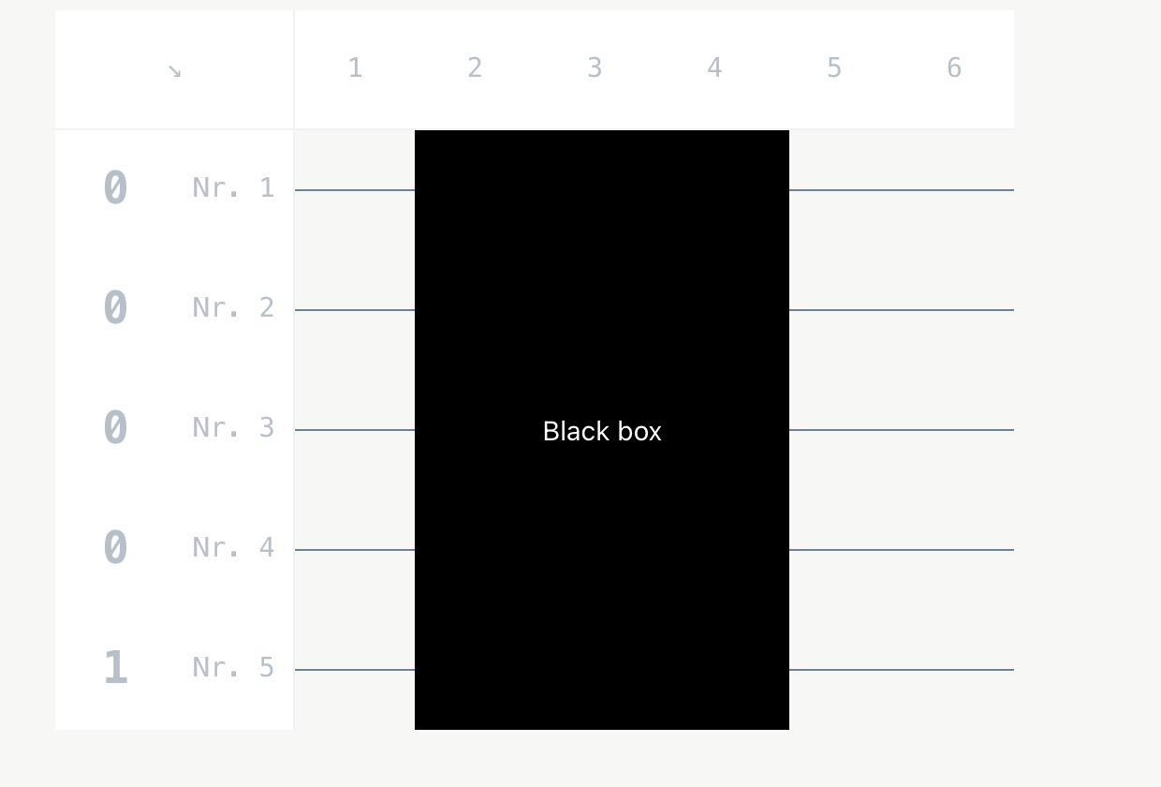
QUIZ TIME!
Develop a strategy for the given problem. How many attempts do you need? Describe your approach.
Notes:
Wir wollen uns aber erst einmal ein sehr leichtes Problem ansehen

Slide 9





Easy solution
Set all inputs except one to 0
$$1$$
$$\left.\left|1\right.\right\rangle$$
$$0$$
$$\left.\left|0\right.\right\rangle$$
GUESS (3BIT)
$$0$$
$$\left.\left|0\right.\right\rangle$$
$$0$$
$$\left.\left|1\right.\right\rangle$$
ANSWER
Notes:
In this case, the code would be “101”

Slide 10


Easy solution
Set all inputs except one to 0
The last qubit indicates if there is a 0 or 1 on this position
$$1$$
$$1$$
$$0$$
$$0$$
GUESS (3BIT)
$$0$$
$$0$$
$$0$$
$$1$$
ANSWER
Notes:
In this case, the code would be “101”

Slide 11







Easy solution
Set all inputs except one to 0
The last qubit indicates if there is a 0 or 1 on this position in the secret code
Repeat for every digit in the secret code
$$1$$
$$1$$
$$0$$
$$0$$
$$0$$
Bernstein-Vazirani-Black-Box
$$0$$
$$0$$
$$0$$
$$1$$
$$1$$
$$0$$
GUESS (3BIT)
$$0$$
GUESS (3BIT)
GUESS (3BIT)
GUESS (3BIT)
$$0$$
$$0$$
$$0$$
$$0$$
$$1$$
$$1$$
$$0$$
$$1$$
$$0$$
$$0$$
$$0$$
ANSWER
$$1$$
ANSWER
ANSWER
ANSWER
Secret code is: 101 !
Notes:
In this case, the code would be “101”

Slide 12
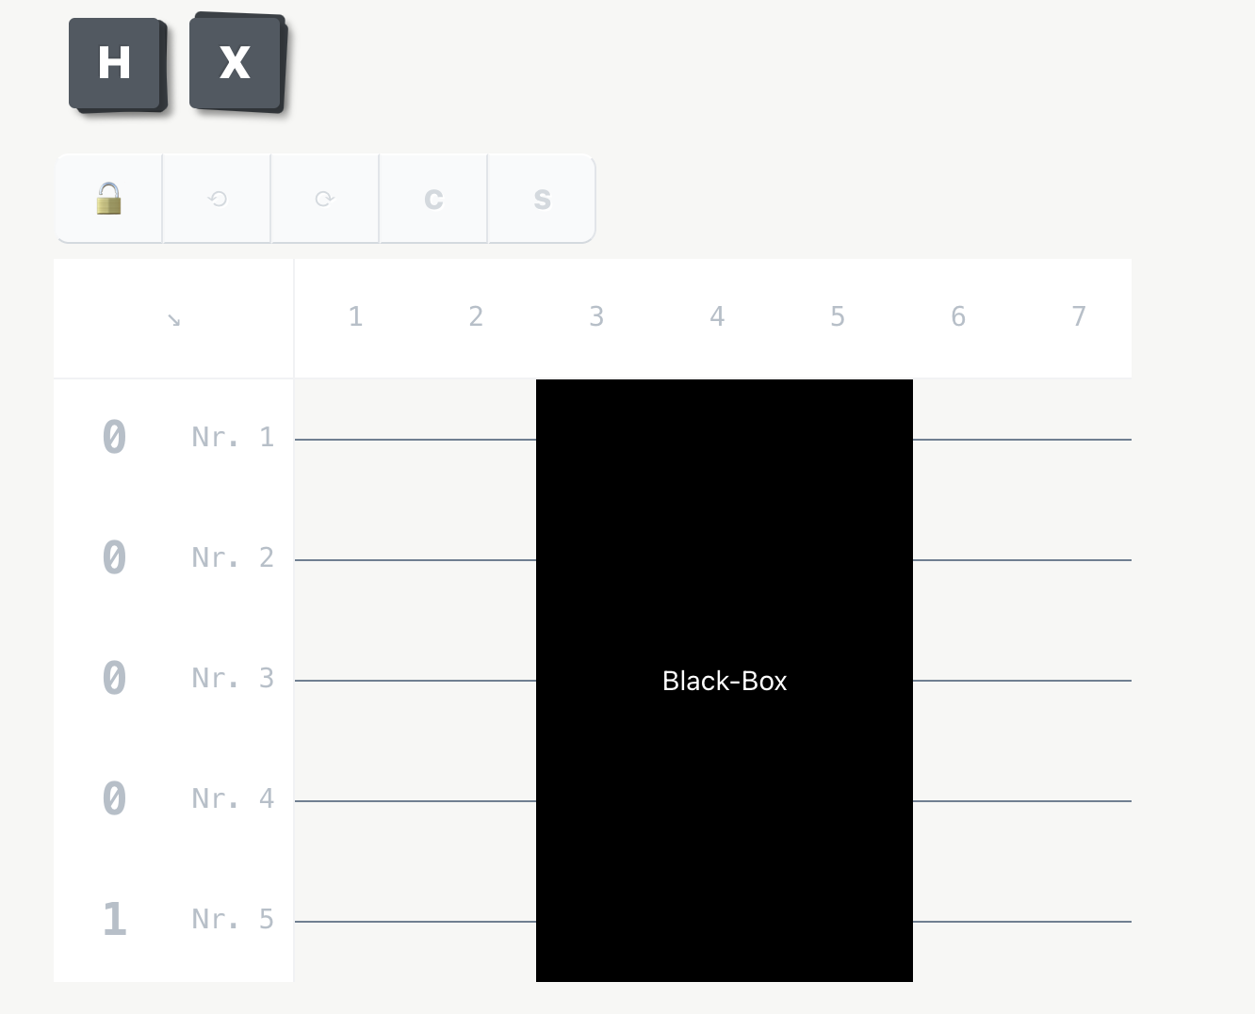
QUIZ TIME!
To find out the secret 4-digit code of this black box, prepare an equal superposition of all 5 qubits. Apply a set of H also after the black box.
Afterward, open the black box and check how you can retrieve the secret code from the measurement outcomes.
Notes:
Wir wollen uns aber erst einmal ein sehr leichtes Problem ansehen

Slide 13




Quantum solution
Initialize GUESS Qubits with 0, answer qubit with 1
$$0$$
$$0$$
GUESS (3BIT)
$$0$$
$$1$$
ANSWER
Notes:
In this case, the code would be “101”

Slide 14
Quantum solution
Initialize GUESS Qubits with 0, answer qubit with 1
Apply H gates before and after the black box
$$0$$
H
H
$$0$$
H
H
GUESS (3BIT)
$$0$$
H
H
$$1$$
H
ANSWER
H
Notes:
In this case, the code would be “101”

Slide 15



Quantum solution
Initialize GUESS Qubits with 0, answer qubit with 1
Apply H gates before and after the black box
Output of GUESS qubits is the secret code 🤩
$$0$$
H
H
$$1$$
$$0$$
H
H
$$0$$
GUESS (3BIT)
$$0$$
H
H
$$1$$
$$1$$
H
ANSWER
H
$$1$$
Notes:
In this case, the code would be “101”

Slide 16
Quantum solution
Initialize GUESS Qubits with 0, answer qubit with 1
Apply H gates before and after the black box
Output of GUESS qubits is the secret code 🤩
Such a black box is called an oracle and it may be regarded as a subroutine encoded by a friend of ours.
$$0$$
H
H
$$1$$
$$0$$
H
H
$$0$$
GUESS (3BIT)
$$0$$
H
H
$$1$$
$$1$$
H
ANSWER
H
$$1$$
Notes:
In this case, the code would be “101”

Slide 17
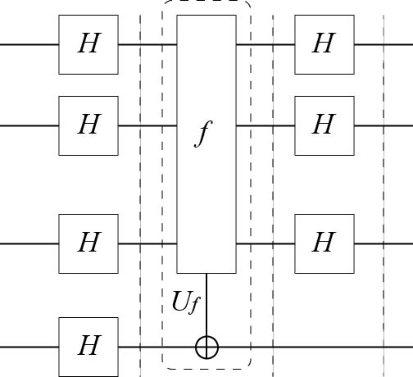

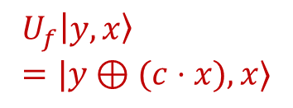

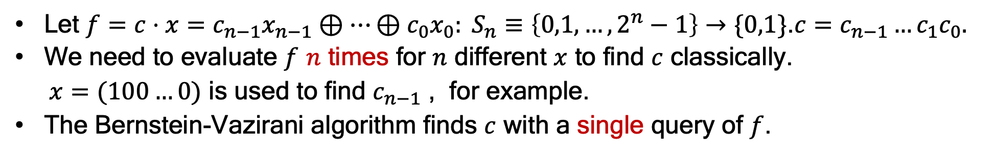
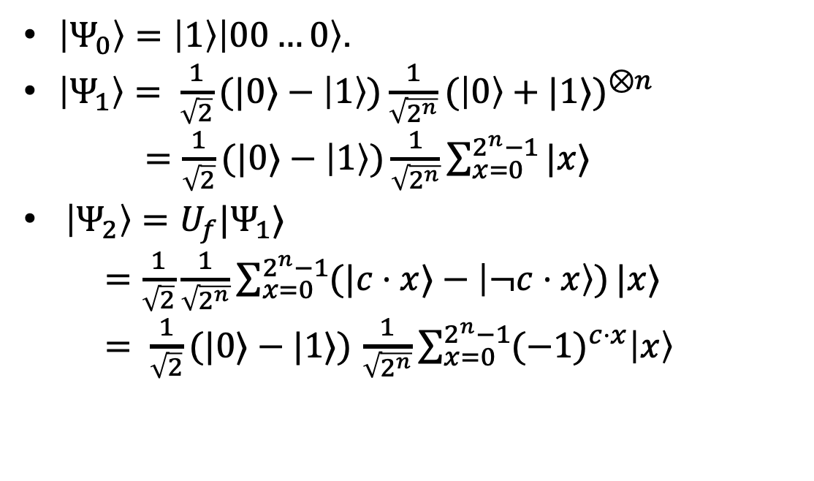






Bernstein-Vazirani algorithm expressed mathematically
Let $f=c⋅x=c_{n−1}x_{n−1}⊕…⊕c_{0}x_{0}: S_{n}≡\left\{0,1,…,2^{n}−1\right\}→\{0,1\}$.$c=c_{n−1}…c_{1}c_{0}.$
We need to evaluate $f$ $n$ times for $n$ different $x$ to find $c$ classically.
$x=(100…0)$ is used to find $c_{n−1}$ , for example.
The Bernstein-Vazirani algorithm finds $c$ with a single query of $f$.
$$|0⟩$$
$\left|Ψ_{0}\right\rangle =\left|1\right\rangle \left|00…0\right\rangle$.
$\left|Ψ_{1}\right\rangle = \frac{1}{\sqrt{2}}(|0⟩−\left|1\right\rangle )\frac{1}{\sqrt{2^{n}}}{(\left|0\right\rangle +|1⟩)}^{⊗n}$
$=\frac{1}{\sqrt{2}}(|0⟩−\left|1\right\rangle )\frac{1}{\sqrt{2^{n}}}\sum_{x=0}^{2^{n}−1}{|x⟩}$
$\left|Ψ_{2}\right\rangle =U_{f}|Ψ_{1}⟩$
$=\frac{1}{\sqrt{2}}\frac{1}{\sqrt{2^{n}}}\sum_{x=0}^{2^{n}−1}{(|c⋅x⟩−\left|¬c⋅x\right\rangle )}|x⟩$
$= \frac{1}{\sqrt{2}}(|0⟩−|1⟩)$ $\frac{1}{\sqrt{2^{n}}}\sum_{x=0}^{2^{n}−1}{{(−1)}^{c⋅x}\left|x\right\rangle }$
$$|0⟩$$
$$|0⟩$$
$$U_{f}\left|y,x\right\rangle =|y⊕(c⋅x),x⟩$$
$$|1⟩$$
$$\left|Ψ_{0}\right\rangle$$
$$\left|Ψ_{1}\right\rangle$$
$$\left|Ψ_{2}\right\rangle$$
$$\left|Ψ_{3}\right\rangle$$

Slide 18


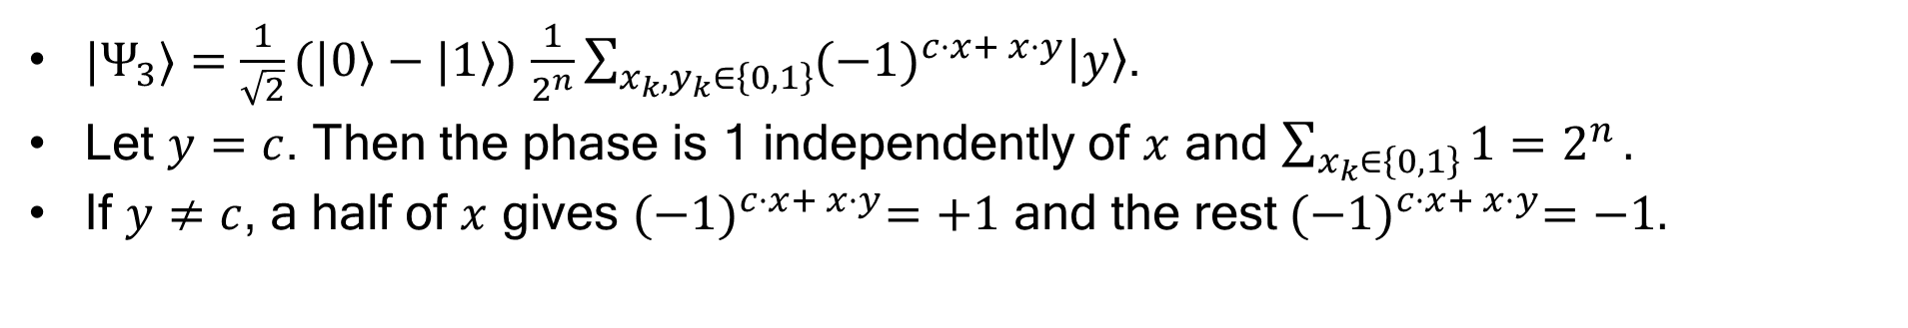
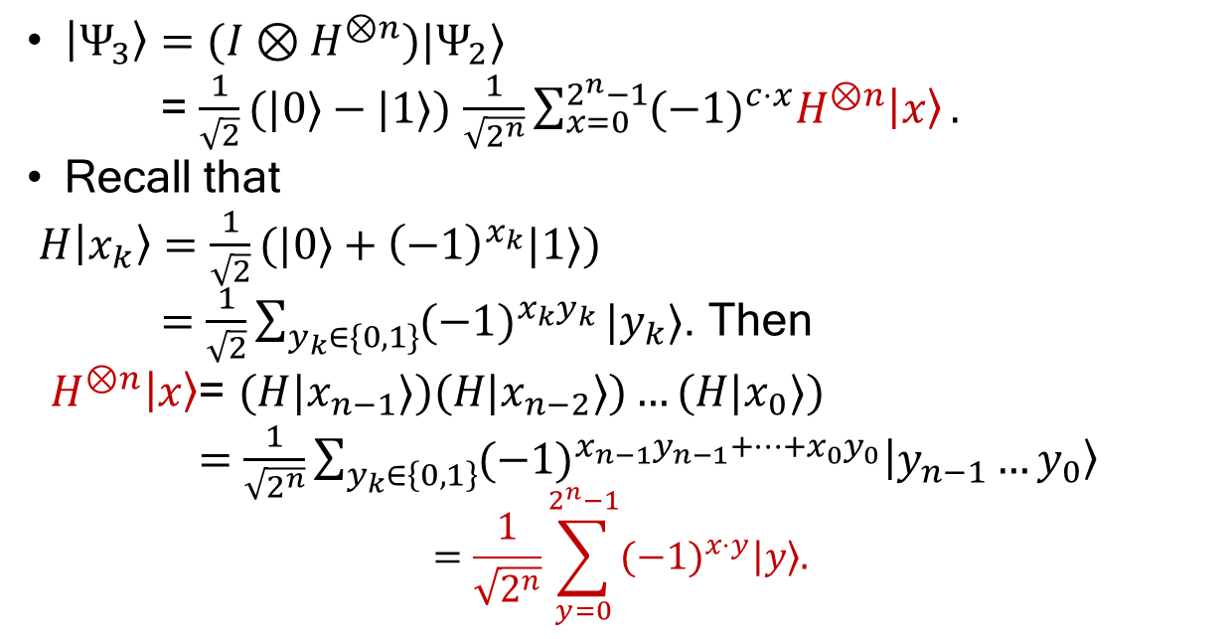






Bernstein-Vazirani algorithm
$\left|Ψ_{3}\right\rangle ={(I⊗H}^{⊗n})|Ψ_{2}⟩$
= $\frac{1}{\sqrt{2}}(|0⟩−|1⟩)$ $\frac{1}{\sqrt{2^{n}}}\sum_{x=0}^{2^{n}−1}{{(−1)}^{c⋅x}H^{⊗n}\left|x\right\rangle }.$
Recall that
$H\left|x_{k}\right\rangle =\frac{1}{\sqrt{2}}(|0⟩+{\left(−1\right)}^{x_{k}}|1⟩)$
$=\frac{1}{\sqrt{2}}\sum_{y_{k}∈\{0,1\}}{{(−1)}^{x_{k}y_{k}}}|y_{k}⟩$. Then
$H^{⊗n}\left|x\right\rangle$= $(H|x_{n−1}⟩)(H|x_{n−2}⟩)…(H|x_{0}⟩)$
$=$ $\frac{1}{\sqrt{2^{n}}}\sum_{y_{k}∈\left\{0,1\right\}}{{(−1)}^{x_{n−1}y_{n−1}+…{+x}_{0}y_{0}}\left|y_{n−1}…y_{0}\right\rangle }$
$$=\frac{1}{\sqrt{2^{n}}}\sum_{y=0}^{2^{n}−1}{{(−1)}^{x⋅y}\left|y\right\rangle .}$$
$$|0⟩$$
$$|0⟩$$
$$|0⟩$$
$$|1⟩$$
$$\left|Ψ_{0}\right\rangle$$
$$\left|Ψ_{1}\right\rangle$$
$$\left|Ψ_{2}\right\rangle$$
$$\left|Ψ_{3}\right\rangle$$
${|Ψ}_{3}⟩=$ $\frac{1}{\sqrt{2}}(|0⟩−|1⟩)$ $\frac{1}{2^{n}}\sum_{{x_{k},y}_{k}∈\left\{0,1\right\}}{{(−1)}^{c⋅x+ x⋅y}\left|y\right\rangle }$.
Let $y=c$. Then the phase is 1 independently of $x$ and $\sum_{x_{k}∈\left\{0,1\right\}}{1=2^{n}}.$
If $y≠c$, a half of $x$ gives ${(−1)}^{c⋅x+ x⋅y}=+1$ and the rest${(−1)}^{c⋅x+ x⋅y}=−1.$

Slide 19


Bernstein-Vazirani algorithm
$\left|Ψ_{3}\right\rangle =\frac{1}{\sqrt{2}}(|0⟩−\left|1\right\rangle )|c⟩$.
A single measurement of the $n$ qubits reveals
$c=c_{n−1}c_{n−2}…c_{1}c_{0}.$
$$|0⟩$$
$$|0⟩$$
$$|0⟩$$
$$|1⟩$$
$$\left|Ψ_{0}\right\rangle$$
$$\left|Ψ_{1}\right\rangle$$
$$\left|Ψ_{2}\right\rangle$$
$$\left|Ψ_{3}\right\rangle$$

Slide 20
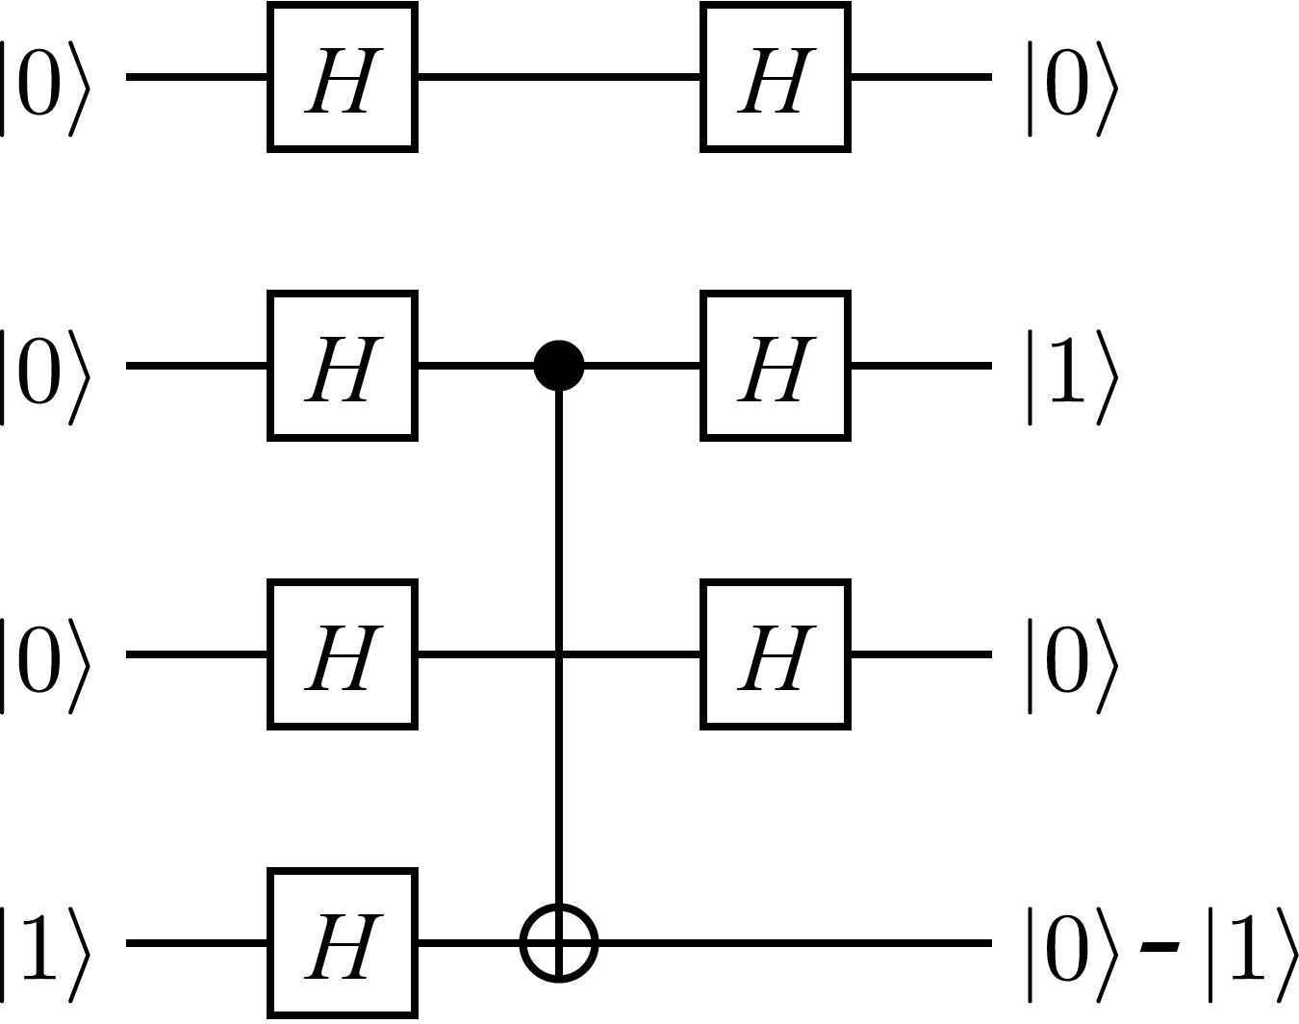
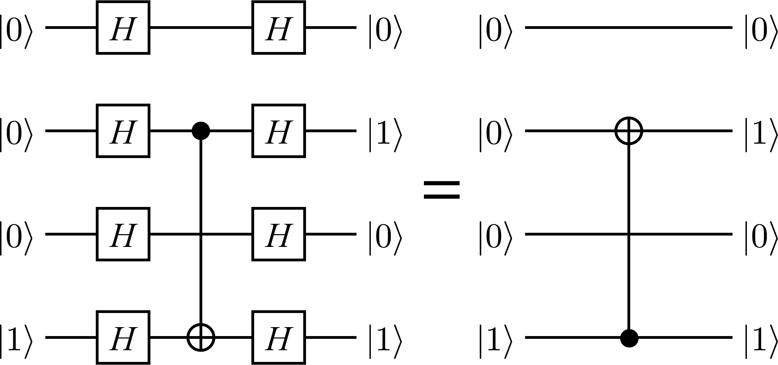
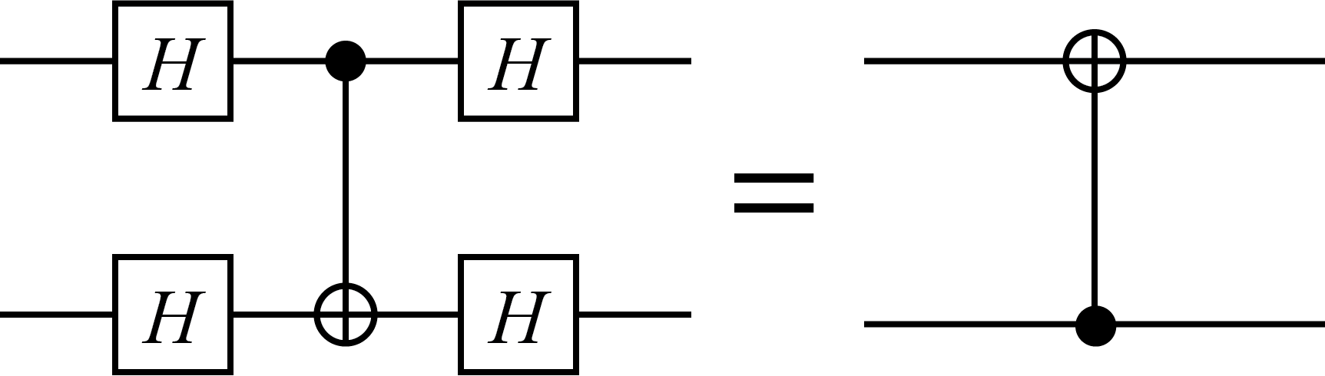

Bernstein-Vazirani algorithm
Another example:
Let us consider $U_{f}$ for $c=010$ for example.
Exercise: Show that

Slide 21
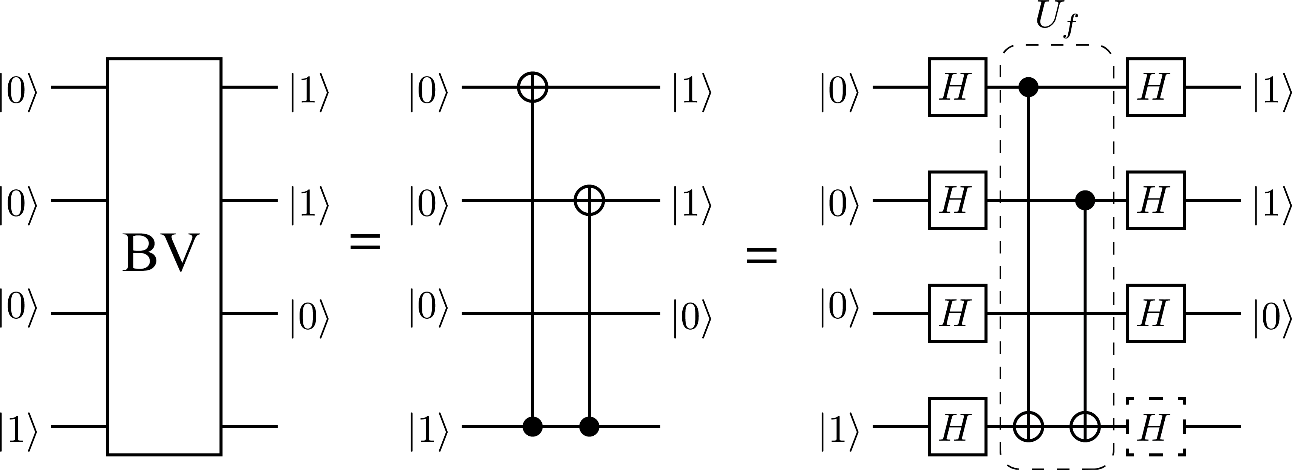

Exercise
Find the oracle $U_{f}$ for $c=110$.

Slide 22
Conclusion: Quantum algorithms
Superposition: Qubits leverage superposition to represent and process multiple states concurrently.
Parallel Exploration: This superposition, combined with entanglement, allows quantum algorithms to explore many possible solutions or paths in parallel within a single computation step.
Interference: Quantum interference patterns are exploited to amplify correct solutions and suppress incorrect ones.
Computational Efficiency: Enabling speedups compared to classical solutions.

