Slide 1
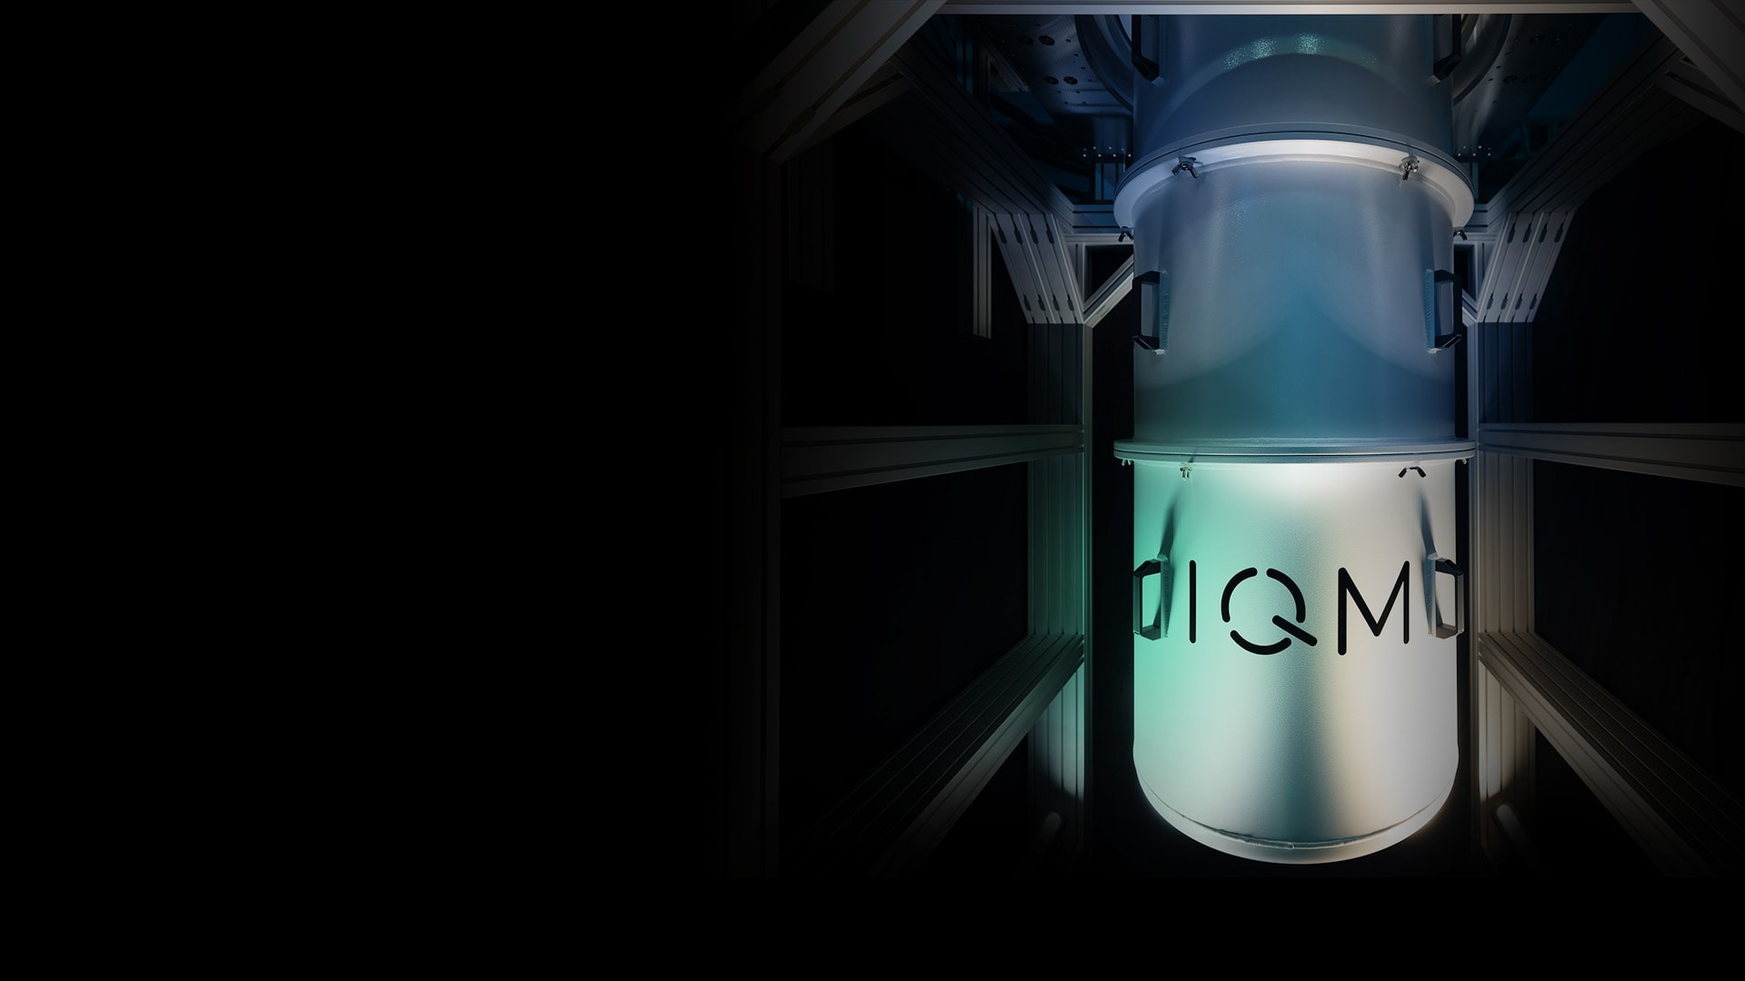






Quantum Operations continued
A lecture series by IQM and HS RM
Authors: Stefan Seegerer, Mikio Nakahara
Last Updated 06/2025
www.meetiqm.com

Slide 2
In this session, we will dive deeper into the single- and two-qubit gates we have discovered last time

Slide 3
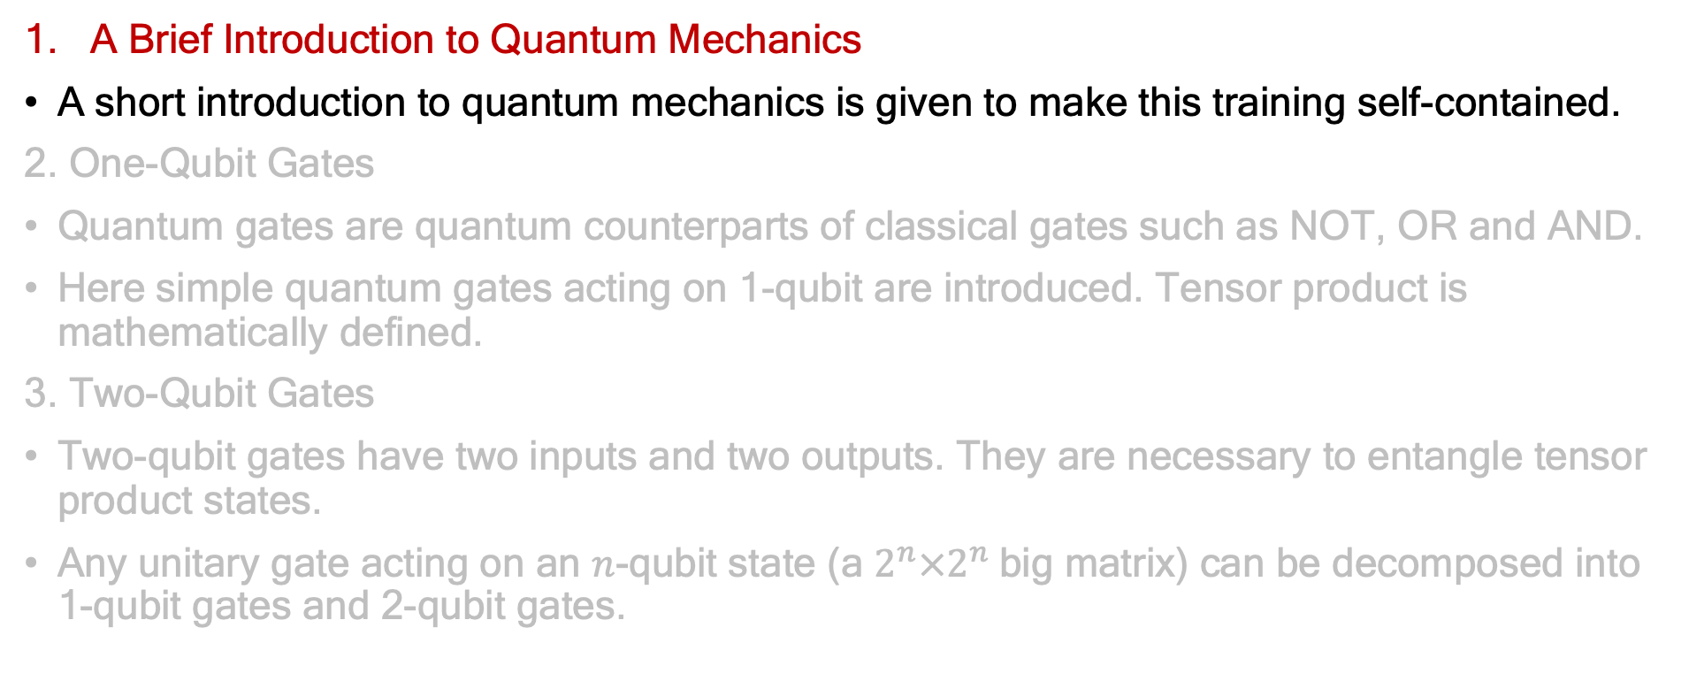
Agenda
A Brief Introduction to Quantum Mechanics
A short introduction to quantum mechanics is given to make this training self-contained.
2. One-Qubit Gates
Quantum gates are quantum counterparts of classical gates such as NOT, OR and AND.
Here simple quantum gates acting on 1-qubit are introduced. Tensor product is mathematically defined.
3. Two-Qubit Gates
Two-qubit gates have two inputs and two outputs. They are necessary to entangle tensor product states.
Any unitary gate acting on an $n$-qubit state (a $2^{n}×2^{n}$big matrix) can be decomposed into 1-qubit gates and 2-qubit gates.

Slide 4
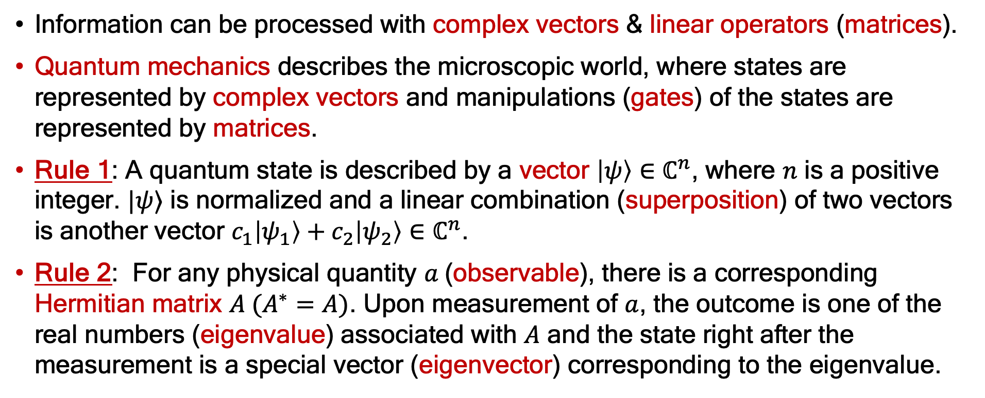
A Brief Introduction to Quantum Mechanics
Information can be processed with complex vectors & linear operators (matrices).
Quantum mechanics describes the microscopic world, where states are represented by complex vectors and manipulations (gates) of the states are represented by matrices.
Rule 1: A quantum state is described by a vector $\left|ψ\right\rangle ∈$ $ℂ^{n}$, where $n$ is a positive integer. $|ψ⟩$ is normalized and a linear combination (superposition) of two vectors is another vector $c_{1}\left|ψ_{1}\right\rangle +c_{2}\left|ψ_{2}\right\rangle ∈ℂ^{n}$.
Rule 2: For any physical quantity $a$(observable), there is a corresponding Hermitian matrix $A (A^{∗}=A)$. Upon measurement of $a$, the outcome is one of the real numbers (eigenvalue) associated with $A$ and the state right after the measurement is a special vector (eigenvector) corresponding to the eigenvalue.

Slide 5
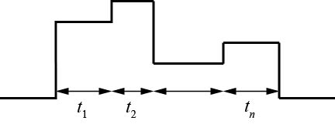
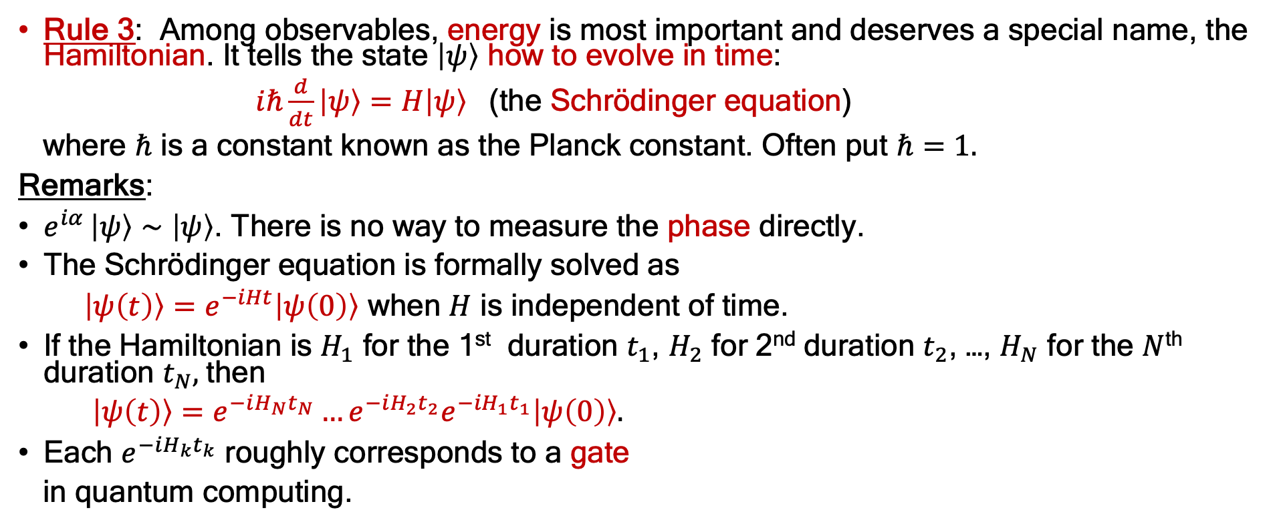
1. A Brief Introduction to Quantum Mechanics
Rule 3: Among observables, energy is most important and deserves a special name, the Hamiltonian. It tells the state $\left|ψ\right\rangle$ how to evolve in time:
$iℏ\frac{d}{dt}\left|ψ\right\rangle =H\left|ψ\right\rangle$ (the Schrödinger equation)
where $ℏ$ is a constant known as the Planck constant. Often put $ℏ=1.$
Remarks:
$e^{iα }\left|ψ\right\rangle ∼\left|ψ\right\rangle$. There is no way to measure the phase directly.
The Schrödinger equation is formally solved as
$\left|ψ\left(t\right)\right\rangle =e^{−iHt}\left|ψ\left(0\right)\right\rangle$ when $H$ is independent of time.
If the Hamiltonian is $H_{1}$ for the 1st duration $t_{1}$, $H_{2}$ for 2nd duration $t_{2}$, …, $H_{N}$ for the $N$^{th} duration $t_{N},$then
$\left|ψ\left(t\right)\right\rangle =e^{−iH_{N}t_{N}}…e^{−iH_{2}t_{2}}e^{−{iH}_{1}t_{1}}\left|ψ\left(0\right)\right\rangle .$
Each $e^{−iH_{k}t_{k}}$ roughly corresponds to a gate
in quantum computing.
$$H_{1}$$
$$H_{2}$$
$$H_{n}$$

Slide 6
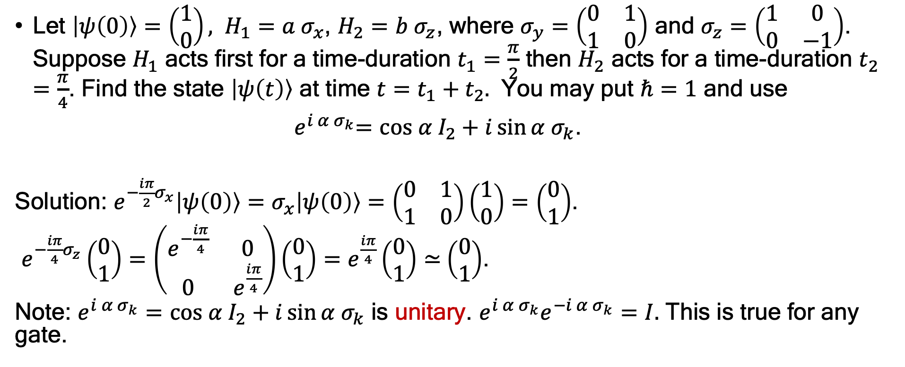
Exercise
Let $\left|ψ\left(0\right)\right\rangle =\left(\begin{matrix}1 \\ 0\end{matrix}\right),$ $H_{1}=a σ_{x}$, $H_{2}=b σ_{z}$, where $σ_{y}=\left(\begin{matrix}0 & 1 \\ 1 & 0\end{matrix}\right)$ and $σ_{z}=\left(\begin{matrix}1 & 0 \\ 0 & −1\end{matrix}\right)$. Suppose $H_{1}$ acts first for a time-duration $t_{1}=\frac{π}{2}$ then $H_{2}$ acts for a time-duration $t_{2}=\frac{π}{4}$. Find the state $\left|ψ\left(t\right)\right\rangle$ at time $t=t_{1}+t_{2}.$ You may put $ℏ=1$ and use
${ e}^{i α σ_{k}}=cos α{ I}_{2}+i\sin{α σ_{k}}$.
Solution: $e^{−\frac{iπ}{2}σ_{x}}\left|ψ\left(0\right)\right\rangle =σ_{x}\left|ψ\left(0\right)\right\rangle =\left(\begin{matrix}0 & 1 \\ 1 & 0\end{matrix}\right)\left(\begin{matrix}1 \\ 0\end{matrix}\right)=\left(\begin{matrix}0 \\ 1\end{matrix}\right)$.
$e^{−\frac{iπ}{4}σ_{z}}\left(\begin{matrix}0 \\ 1\end{matrix}\right)=\left(\begin{matrix}e^{−\frac{iπ}{4}} & 0 \\ 0 & e^{\frac{iπ}{4}}\end{matrix}\right)\left(\begin{matrix}0 \\ 1\end{matrix}\right)=e^{\frac{iπ}{4}}\left(\begin{matrix}0 \\ 1\end{matrix}\right)≃$ $\left(\begin{matrix}0 \\ 1\end{matrix}\right)$.
Note: $e^{i α σ_{k}}=cos α{ I}_{2}+i\sin{α σ_{k}}$ is unitary. ${e^{i α σ_{k}}e}^{−i α σ_{k}}=I.$ This is true for any gate.

Slide 7
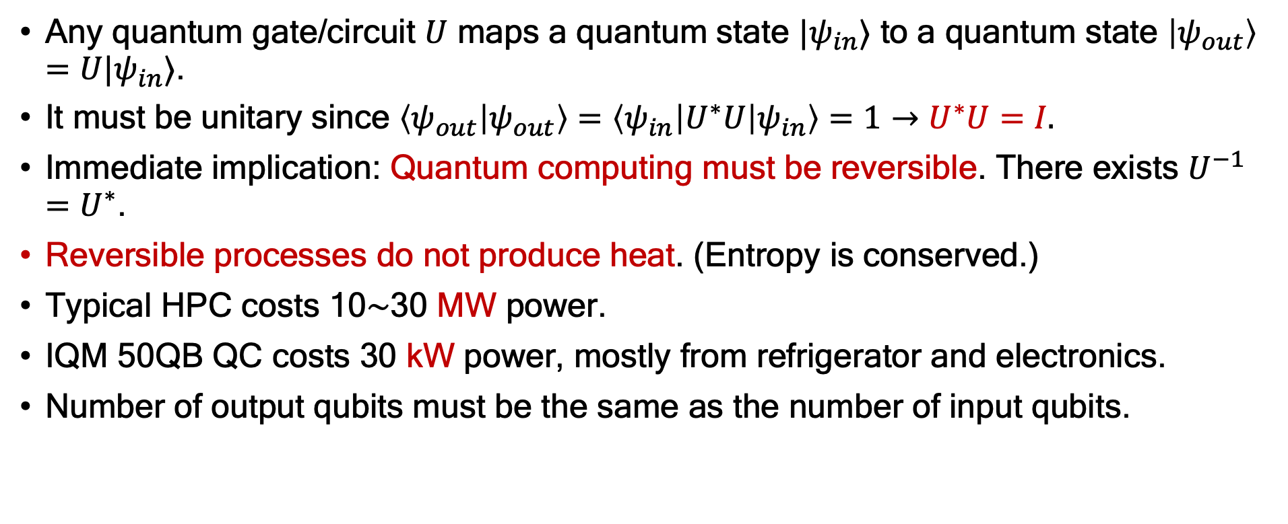
Qubit Gates and Quantum Circuit
Any quantum gate/circuit $U$ maps a quantum state $|ψ_{in}⟩$ to a quantum state $\left|ψ_{out}\right\rangle =U|ψ_{in}⟩$.
It must be unitary since $\left\langle ψ_{out} | ψ_{out}\right\rangle =\left\langle ψ_{in}\left|U^{∗}U\right|ψ_{in}\right\rangle =1→U^{∗}U=I.$
Immediate implication: Quantum computing must be reversible. There exists $U^{−1}=U^{∗}$.
Reversible processes do not produce heat. (Entropy is conserved.)
Typical HPC costs 10$∼$30 MW power.
IQM 50QB QC costs 30 kW power, mostly from refrigerator and electronics.
Number of output qubits must be the same as the number of input qubits.

Slide 8
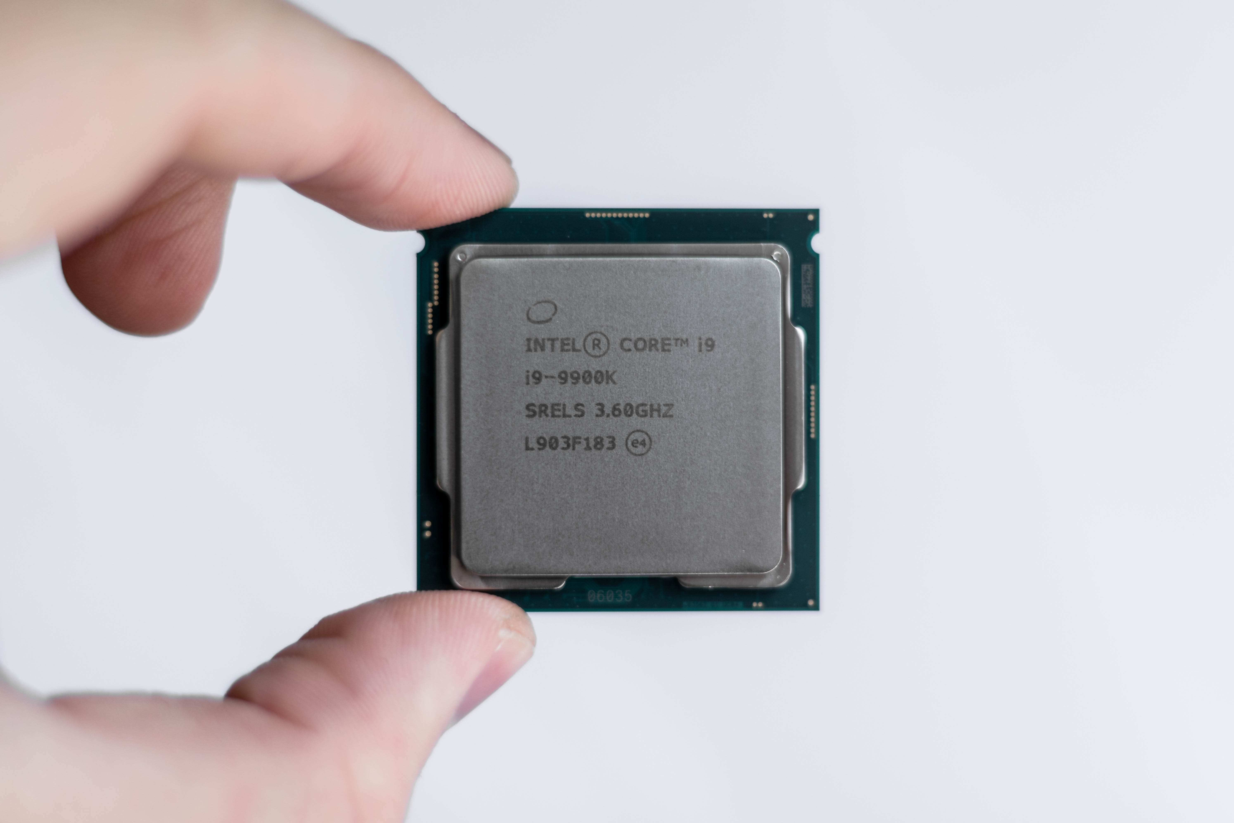
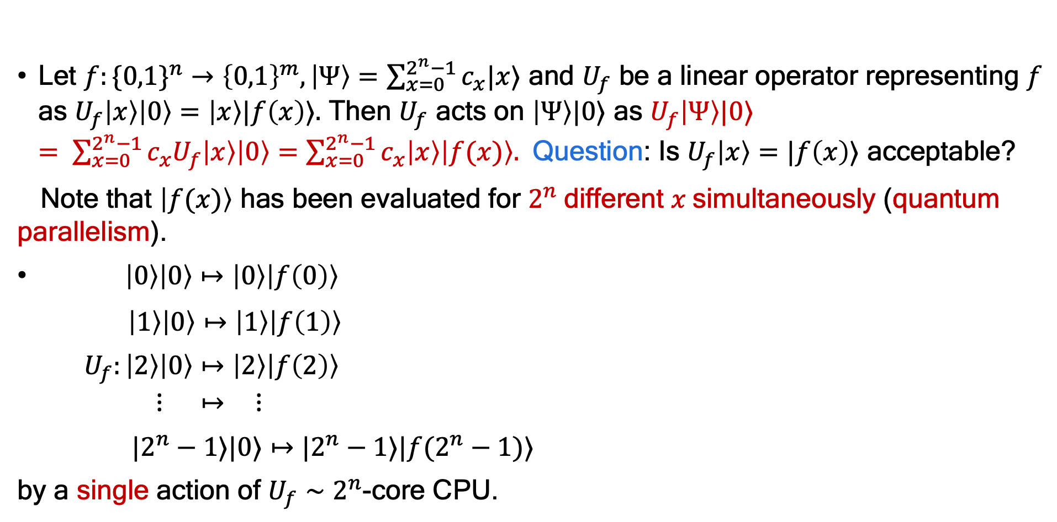
Quantum Parallelism
Let $f:\{0,1\}^{n}→{\left\{0,1\right\}}^{m}, \left|Ψ\right\rangle =\sum_{x=0}^{2^{n}−1}{c_{x}|x⟩}$ and $U_{f}$ be a linear operator representing $f$ as $U_{f}\left|x\right\rangle \left|0\right\rangle =\left|x\right\rangle |f\left(x\right)⟩.$ Then $U_{f}$ acts on $\left|Ψ\right\rangle |0⟩$ as $U_{f}\left|Ψ\right\rangle |0⟩ = \sum_{x=0}^{2^{n}−1}{c_{x}U_{f}\left|x\right\rangle \left|0\right\rangle =\sum_{x=0}^{2^{n}−1}{c_{x}\left|x\right\rangle \left|f(x)\right\rangle . }}$ Question: Is $U_{f}\left|x\right\rangle =|f\left(x\right)⟩$ acceptable?
Note that $\left|f(x)\right\rangle$ has been evaluated for $2^{n}$different $x$simultaneously (quantum parallelism).
$\left|0\right\rangle \left|0\right\rangle ↦$ $\left|0\right\rangle \left|f\left(0\right)\right\rangle$
$\left|1\right\rangle \left|0\right\rangle ↦$ $\left|1\right\rangle \left|f\left(1\right)\right\rangle$
${ U}_{f}:\left|2\right\rangle \left|0\right\rangle ↦$ $\left|2\right\rangle \left|f\left(2\right)\right\rangle$
$$⋮ ↦ ⋮$$
$|2^{n}−1⟩|0⟩↦|2^{n}−1⟩|f(2^{n}−1)⟩$
by a single action of $U_{f}∼2^{n}$-core CPU.

Slide 9
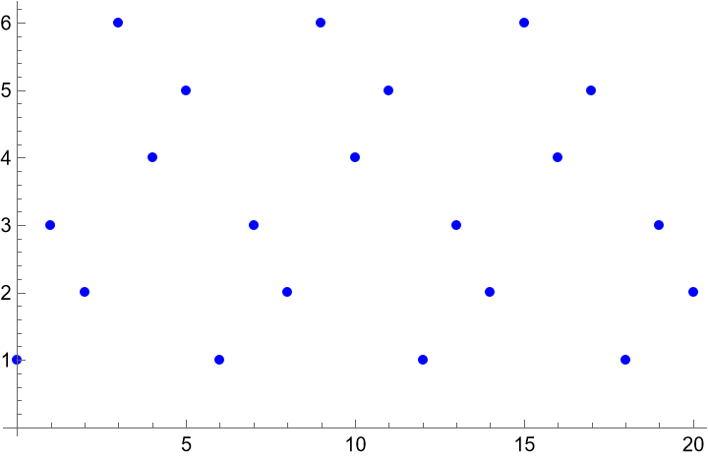
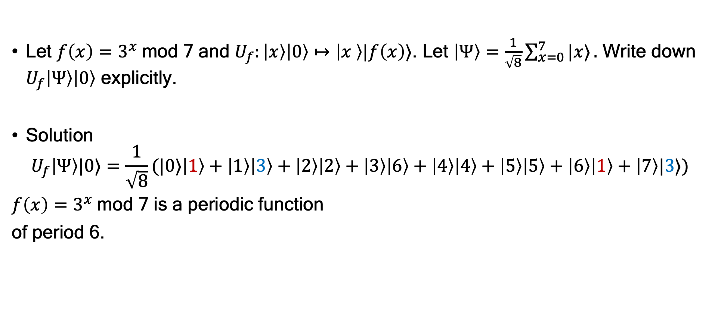
Exercise
Let $f\left(x\right)=3^{x}$mod 7 and $U_{f}:\left|x\right\rangle \left|0\right\rangle ↦\left|x \right\rangle |f\left(x\right)⟩$. Let $\left|Ψ\right\rangle =\frac{1}{\sqrt{8}}\sum_{x=0}^{7}{|x⟩}.$ Write down $U_{f}\left|Ψ\right\rangle \left|0\right\rangle$ explicitly.
Solution
$$U_{f}\left|Ψ\right\rangle |0⟩=\frac{1}{\sqrt{8}}(|0⟩\left|1\right\rangle +\left|1\right\rangle \left|3\right\rangle +\left|2\right\rangle \left|2\right\rangle +\left|3\right\rangle \left|6\right\rangle +\left|4\right\rangle \left|4\right\rangle +\left|5\right\rangle \left|5\right\rangle +\left|6\right\rangle \left|1\right\rangle +\left|7\right\rangle |3⟩)$$
$f\left(x\right)=3^{x}$mod 7 is a periodic function
of period 6.

Slide 10
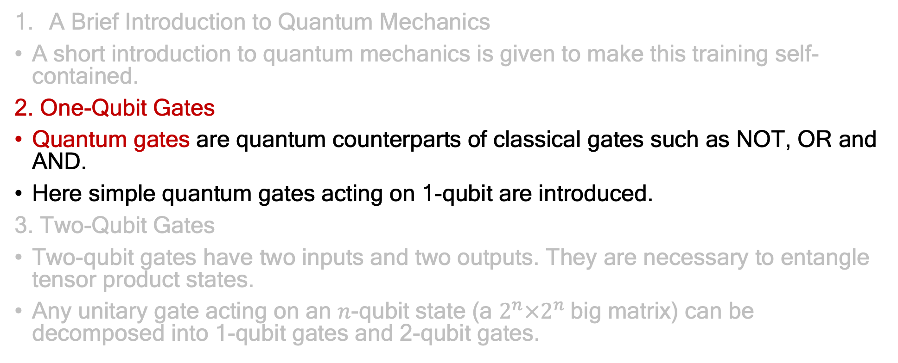
Agenda
A Brief Introduction to Quantum Mechanics
A short introduction to quantum mechanics is given to make this training self-contained.
2. One-Qubit Gates
Quantum gates are quantum counterparts of classical gates such as NOT, OR and AND.
Here simple quantum gates acting on 1-qubit are introduced.
3. Two-Qubit Gates
Two-qubit gates have two inputs and two outputs. They are necessary to entangle tensor product states.
Any unitary gate acting on an $n$-qubit state (a $2^{n}×2^{n}$big matrix) can be decomposed into 1-qubit gates and 2-qubit gates.

Slide 11



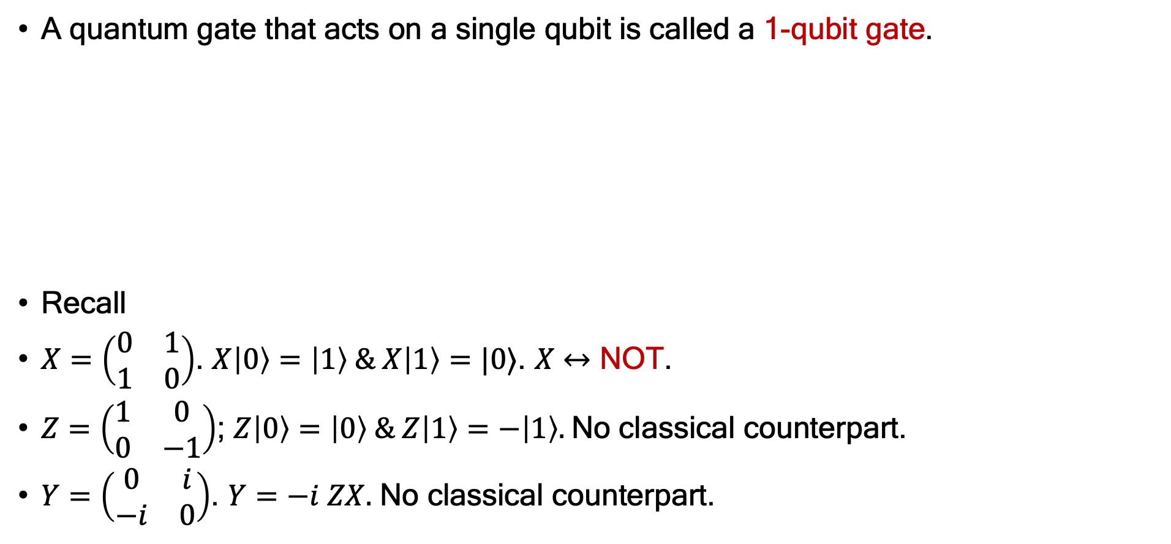
One-Qubit Gates
A quantum gate that acts on a single qubit is called a 1-qubit gate.
Recall
$X=\left(\begin{matrix}0 & 1 \\ 1 & 0\end{matrix}\right)$. $X\left|0\right\rangle =\left|1\right\rangle \& X\left|1\right\rangle =|0⟩$. $X$ $↔$ NOT.
$Z=\left(\begin{matrix}1 & 0 \\ 0 & −1\end{matrix}\right)$; $Z\left|0\right\rangle =\left|0\right\rangle \& Z\left|1\right\rangle =−\left|1\right\rangle .$No classical counterpart.
$Y=\left(\begin{matrix}0 & i \\ −i & 0\end{matrix}\right)$. $Y=−i ZX.$ No classical counterpart.
The line denotes a qubit. Time flies from left to right.
|${ψin⟩}_{ }$
|${ψout⟩}_{ }$
$$=U|ψin⟩$$
$$\left|ψout\right\rangle =U_{2}U_{1}|ψin⟩$$
|${ψin⟩}_{ }$
$\left|0\right\rangle = \left({1 \atop 0}\right)$ and $\left|1\right\rangle = \left({0 \atop 1}\right)$
This is how it looked last time

Slide 12

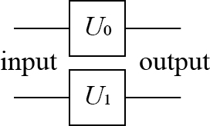
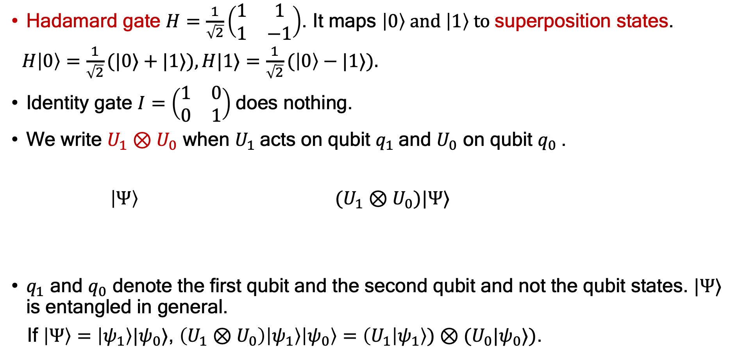
Hadamard gate $H=\frac{1}{\sqrt{2}}\left(\begin{matrix}1 & 1 \\ 1 & −1\end{matrix}\right)$. It maps $\left|0\right\rangle and \left|1\right\rangle to$superposition states.
$H\left|0\right\rangle =\frac{1}{\sqrt{2}}(|0⟩+|1⟩), H|1⟩=\frac{1}{\sqrt{2}}(\left|0\right\rangle −|1⟩).$
Identity gate $I=\left(\begin{matrix}1 & 0 \\ 0 & 1\end{matrix}\right)$does nothing.
We write $U_{1}⊗U_{0}$ when $U_{1}$acts on qubit $q_{1}$and $U_{0}$ on qubit $q_{0}$.
$\left|Ψ\right\rangle (U_{1}⊗U_{0})|Ψ⟩$
$q_{1}$ and $q_{0}$ denote the first qubit and the second qubit and not the qubit states. $|Ψ⟩$ is entangled in general.
If $\left|Ψ\right\rangle =\left|ψ_{1}\right\rangle |ψ_{0}⟩$, $\left(U_{1}⊗U_{0}\right)\left|ψ_{1}\right\rangle \left|ψ_{0}\right\rangle =\left(U_{1} | ψ_{1}\right\rangle )⊗(U_{0}|ψ_{0}⟩)$.
$$q_{0}$$
$$q_{1}$$

Slide 13
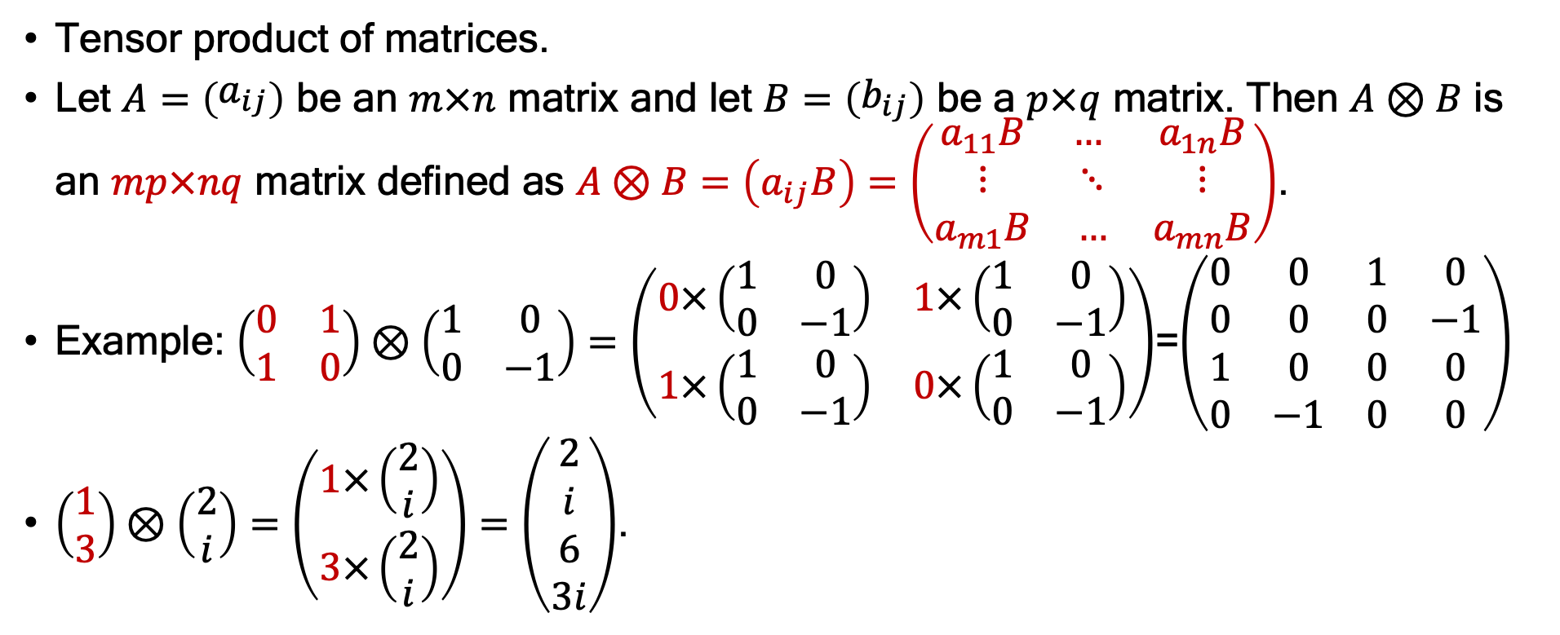
Tensor Product
Tensor product of matrices.
Let $A=\left(\begin{matrix}a_{ij}\end{matrix}\right)$ be an $m×n$ matrix and let $B=\left(\begin{matrix}b_{ij}\end{matrix}\right)$ be a $p×q$ matrix. Then $A⊗B$ is an $mp×nq$ matrix defined as $A⊗B=\left(a_{ij}B\right)=\left(\begin{matrix}a_{11}B & … & a_{1n}B \\ ⋮ & ⋱ & ⋮ \\ a_{m1}B & … & a_{mn}B\end{matrix}\right)$.
Example: $\left(\begin{matrix}0 & 1 \\ 1 & 0\end{matrix}\right)⊗\left(\begin{matrix}1 & 0 \\ 0 & −1\end{matrix}\right)=\left(\begin{matrix}0×\left(\begin{matrix}1 & 0 \\ 0 & −1\end{matrix}\right) & 1×\left(\begin{matrix}1 & 0 \\ 0 & −1\end{matrix}\right) \\ 1×\left(\begin{matrix}1 & 0 \\ 0 & −1\end{matrix}\right) & 0×\left(\begin{matrix}1 & 0 \\ 0 & −1\end{matrix}\right)\end{matrix}\right)$=$\left(\begin{matrix}0 & 0 & 1 & 0 \\ 0 & 0 & 0 & −1 \\ 1 & 0 & 0 & 0 \\ 0 & −1 & 0 & 0\end{matrix}\right)$
$\left(\begin{matrix}1 \\ 3\end{matrix}\right)⊗\left(\begin{matrix}2 \\ i\end{matrix}\right)=\left(\begin{matrix}1×\left(\begin{matrix}2 \\ i\end{matrix}\right) \\ 3×\left(\begin{matrix}2 \\ i\end{matrix}\right)\end{matrix}\right)=\left(\begin{matrix}2 \\ i \\ 6 \\ 3i\end{matrix}\right)$.

Slide 14
[$\left(\begin{matrix}0 & 1 \\ 1 & 0\end{matrix}\right)⊗\left(\begin{matrix}1 & 0 \\ 0 & −1\end{matrix}\right)]⋅[\left(\begin{matrix}1 \\ 3\end{matrix}\right)⊗\left(\begin{matrix}2 \\ i\end{matrix}\right)]$= $\left(\begin{matrix}0 & 0 & 1 & 0 \\ 0 & 0 & 0 & −1 \\ 1 & 0 & 0 & 0 \\ 0 & −1 & 0 & 0\end{matrix}\right)⋅\left(\begin{matrix}2 \\ i \\ 6 \\ 3i\end{matrix}\right)$= $\left(\begin{matrix}6 \\ −3i \\ 2 \\ −i\end{matrix}\right)$.
Note that $\left(\begin{matrix}0 & 1 \\ 1 & 0\end{matrix}\right)⋅\left(\begin{matrix}1 \\ 3\end{matrix}\right)=\left(\begin{matrix}3 \\ 1\end{matrix}\right)$, $\left(\begin{matrix}1 & 0 \\ 0 & −1\end{matrix}\right)⋅$ $\left(\begin{matrix}2 \\ i\end{matrix}\right)=\left(\begin{matrix}2 \\ −i\end{matrix}\right)$ and $\left(\begin{matrix}3 \\ 1\end{matrix}\right)⊗$ $\left(\begin{matrix}2 \\ −i\end{matrix}\right)=$ $\left(\begin{matrix}6 \\ −3i \\ 2 \\ −i\end{matrix}\right)$.
$\left(A⊗B\right)⋅(|u⟩⊗|v⟩)=(A|u⟩)⊗(B|v⟩)$.
$\left(A⊗B\right)⋅(C⊗D)=(A⋅C)⊗\left(B⋅D\right)$ in general whenever the matrix product is well defined.
Exercise: Evaluate $\frac{1}{\sqrt{2}}\left(\begin{matrix}1 & 1 \\ 1 & −1\end{matrix}\right)⊗\left(\begin{matrix}1 & −1 \\ −1 & 1\end{matrix}\right)$ and $\frac{1}{\sqrt{2}}\left(\begin{matrix}1 \\ −1\end{matrix}\right)⊗\frac{1}{\sqrt{2}}\left(\begin{matrix}1 \\ −i\end{matrix}\right)$.

Slide 15
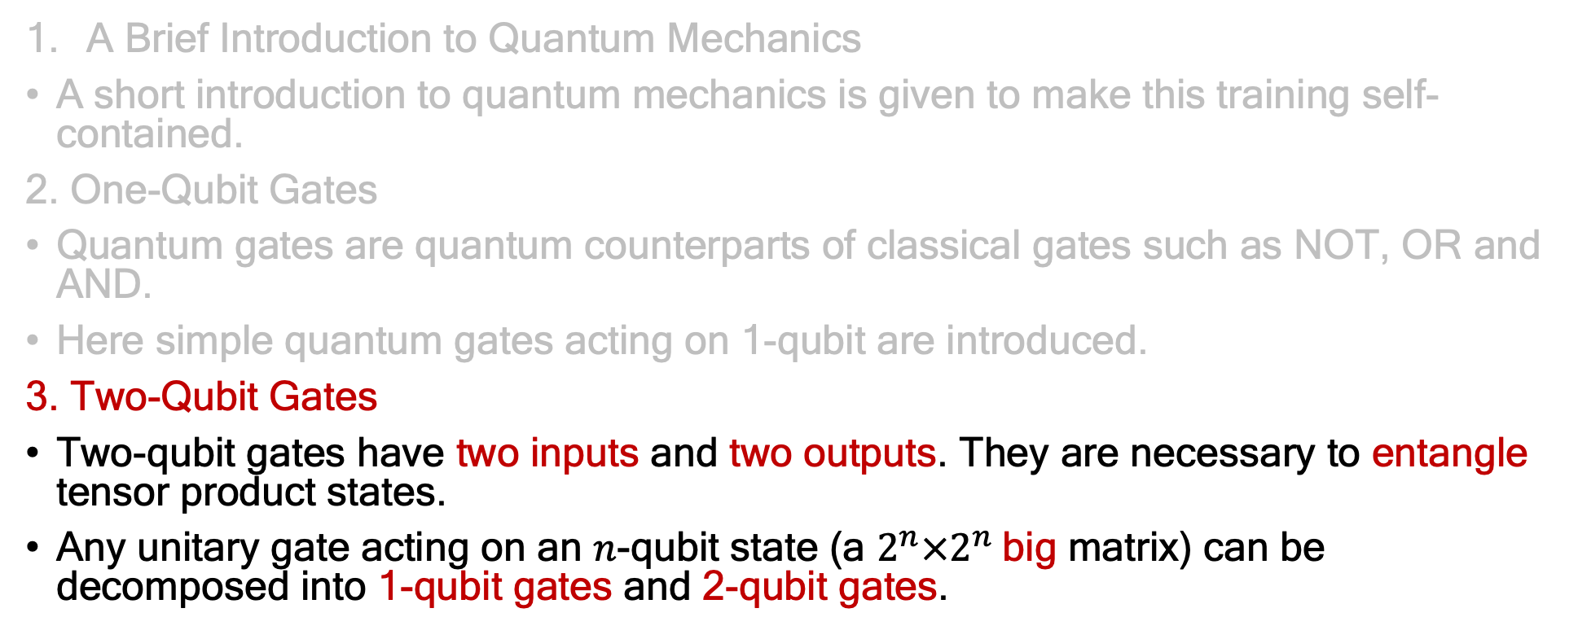
Agenda
A Brief Introduction to Quantum Mechanics
A short introduction to quantum mechanics is given to make this training self-contained.
2. One-Qubit Gates
Quantum gates are quantum counterparts of classical gates such as NOT, OR and AND.
Here simple quantum gates acting on 1-qubit are introduced.
3. Two-Qubit Gates
Two-qubit gates have two inputs and two outputs. They are necessary to entangle tensor product states.
Any unitary gate acting on an $n$-qubit state (a $2^{n}×2^{n}$big matrix) can be decomposed into 1-qubit gates and 2-qubit gates.

Slide 16

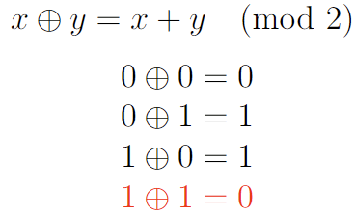

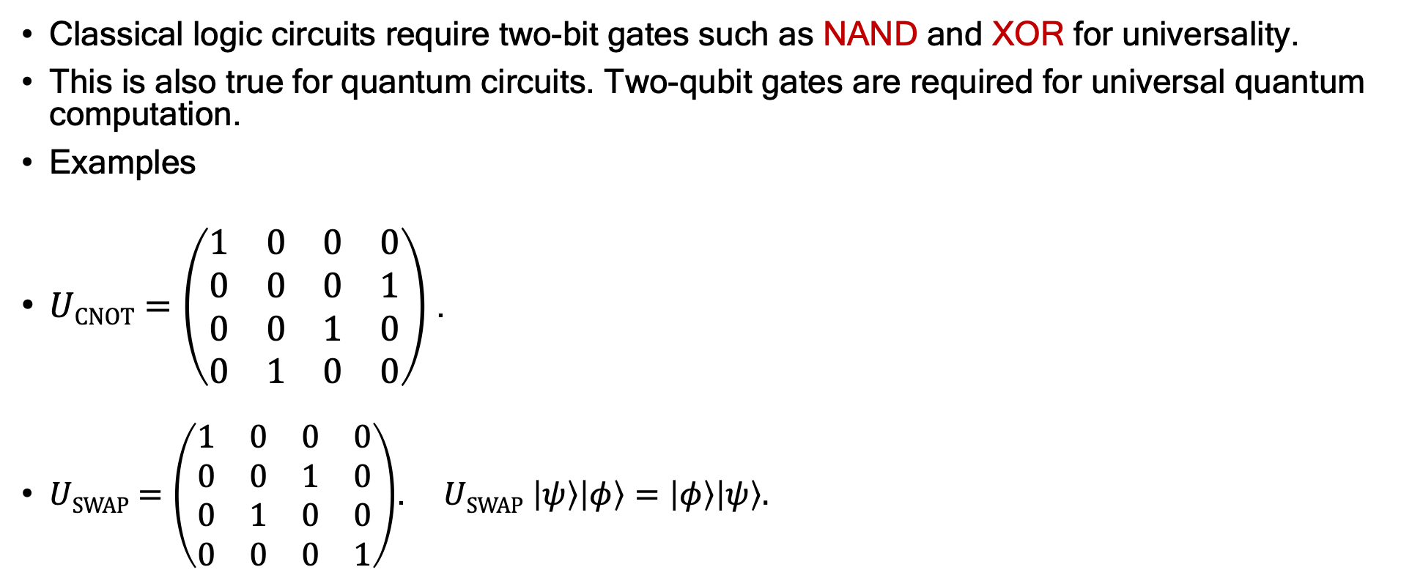
Two-Qubit Gates
Classical logic circuits require two-bit gates such as NAND and XOR for universality.
This is also true for quantum circuits. Two-qubit gates are required for universal quantum computation.
Examples
$UCNOT=\left(\begin{matrix}1 & 0 & 0 & 0 \\ 0 & 0 & 0 & 1 \\ 0 & 0 & 1 & 0 \\ 0 & 1 & 0 & 0\end{matrix}\right)$ .
$USWAP=\left(\begin{matrix}1 & 0 & 0 & 0 \\ 0 & 0 & 1 & 0 \\ 0 & 1 & 0 & 0 \\ 0 & 0 & 0 & 1\end{matrix}\right)$. $USWAP$ $\left|ψ\right\rangle \left|φ\right\rangle =\left|φ\right\rangle \left|ψ\right\rangle .$
$$\left|y\right\rangle$$
$$\left|y\right\rangle$$
$|x⟩$
$$|x⊕y⟩$$
$U_{CNOT}\left|x\right\rangle \left|y\right\rangle =|x⊕y⟩|y⟩$. $UCNOT$ flips $|x⟩$ if $\left|y\right\rangle =|1⟩$.
Does nothing to $|x⟩$ if $\left|y\right\rangle =|0⟩$. Similar to XOR.
$$\left|φ\right\rangle$$
$$\left|ψ\right\rangle$$
$$\left|ψ\right\rangle$$
$$\left|φ\right\rangle$$

Slide 17


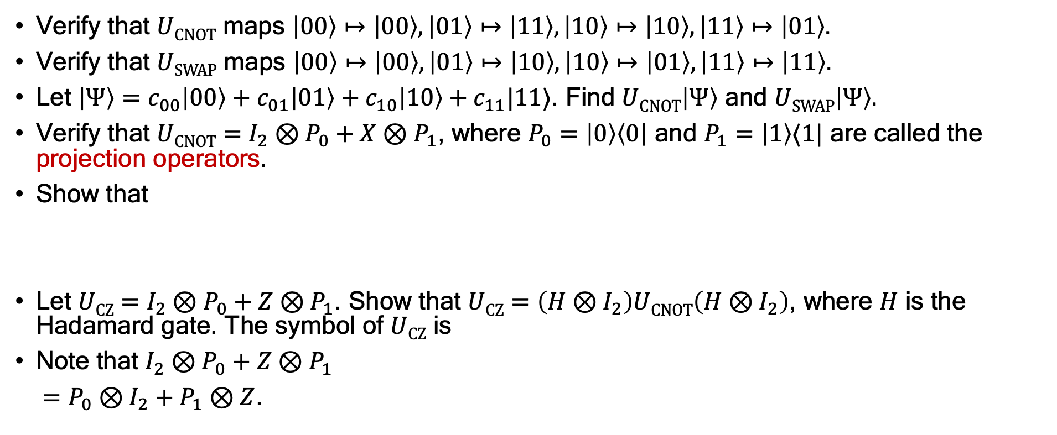
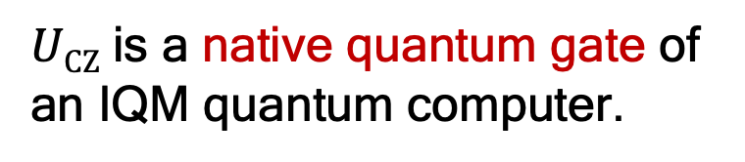
Exercise
Verify that $UCNOT$ maps $\left|00\right\rangle ↦\left|00\right\rangle , \left|01\right\rangle ↦\left|11\right\rangle , \left|10\right\rangle ↦\left|10\right\rangle , \left|11\right\rangle ↦\left|01\right\rangle .$
Verify that $USWAP$ maps $\left|00\right\rangle ↦\left|00\right\rangle , \left|01\right\rangle ↦\left|10\right\rangle , \left|10\right\rangle ↦\left|01\right\rangle , \left|11\right\rangle ↦\left|11\right\rangle .$
Let $\left|Ψ\right\rangle =c_{00}\left|00\right\rangle +c_{01}\left|01\right\rangle +c_{10}\left|10\right\rangle +c_{11}|11⟩$. Find $UCNOT\left|Ψ\right\rangle$ and $USWAP\left|Ψ\right\rangle .$
Verify that $UCNOT$ $=I_{2}⊗P_{0}+X⊗P_{1}$, where $P_{0}=\left|0\right\rangle \left\langle 0\right|$ and $P_{1}=\left|1\right\rangle ⟨1|$ are called the projection operators.
Show that
Let $UCZ=I_{2}⊗P_{0}+Z⊗P_{1}$. Show that $UCZ=\left({H⊗I}_{2}\right)UCNOT\left(H⊗I_{2}\right)$, where $H$ is the Hadamard gate. The symbol of $UCZ$ is
Note that $I_{2}⊗P_{0}+Z⊗P_{1}$
$=P_{0}⊗I_{2}+P_{1}⊗Z$.
$UCZ$ is a native quantum gate of an IQM quantum computer.

Slide 18
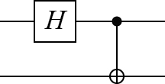
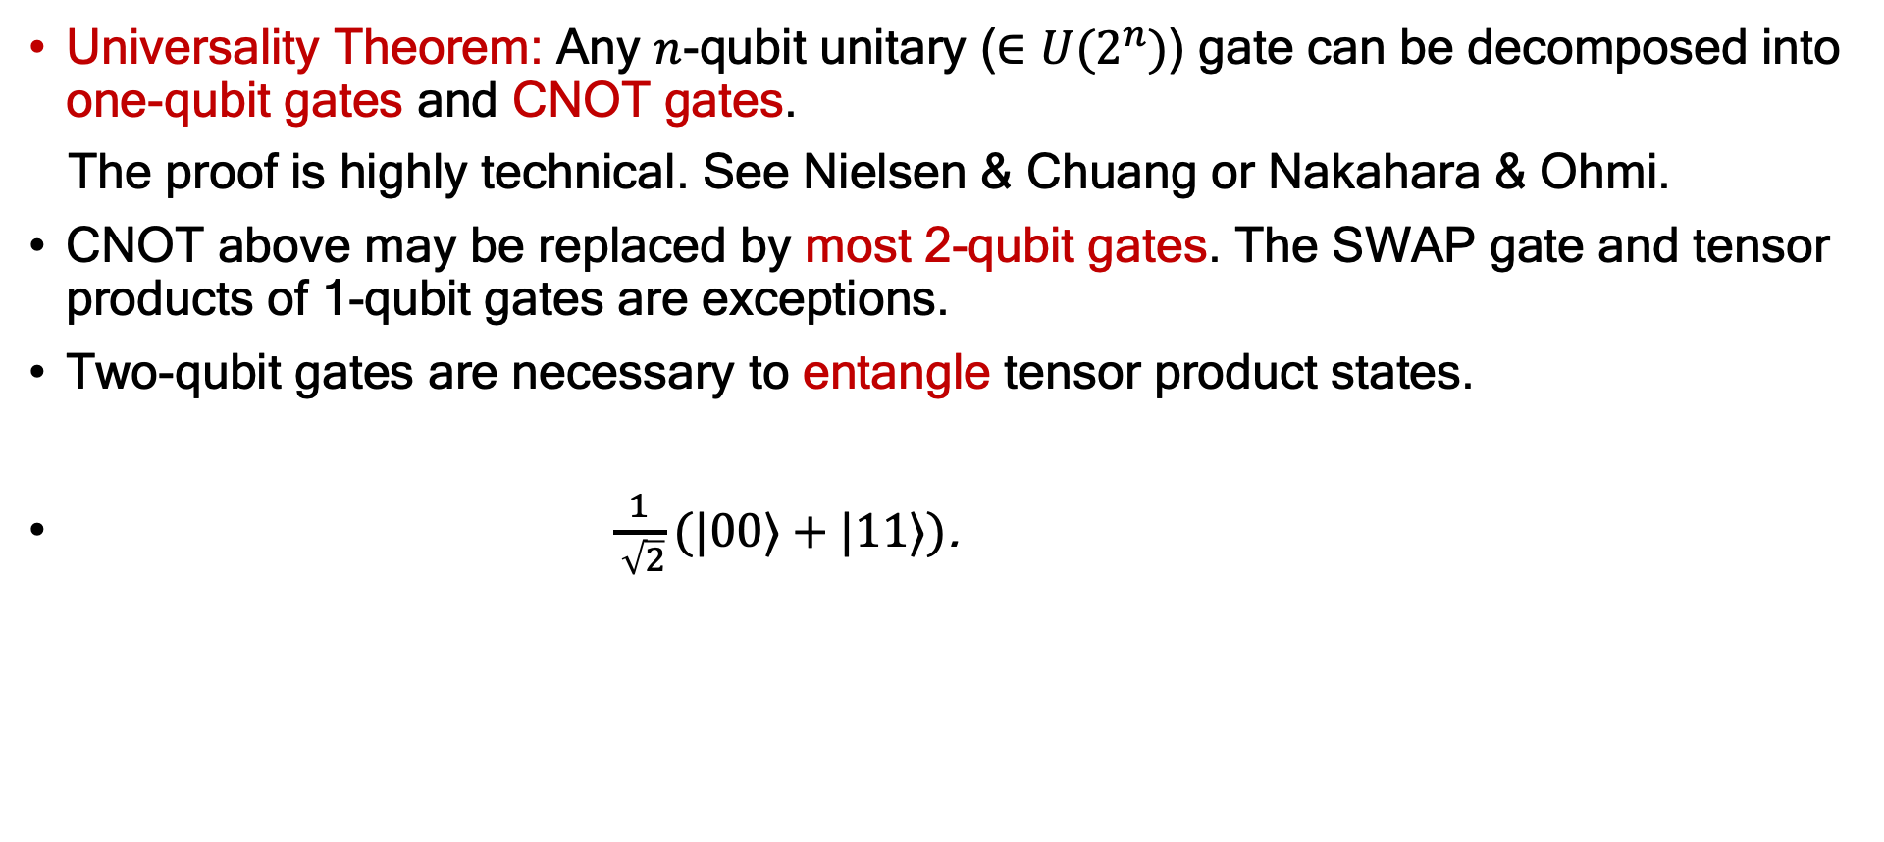
Two-Qubit Gates
Universality Theorem: Any $n$-qubit unitary ($∈U(2^{n})$) gate can be decomposed into one-qubit gates and CNOT gates.
The proof is highly technical. See Nielsen & Chuang or Nakahara & Ohmi.
CNOT above may be replaced by most 2-qubit gates. The SWAP gate and tensor products of 1-qubit gates are exceptions.
Two-qubit gates are necessary to entangle tensor product states.
$\frac{1}{ \sqrt{2}}(|00⟩+|11⟩)$.
$$|0⟩$$
Exercise: $\left|Φ_{±}\right\rangle =\frac{1}{\sqrt{2}}(|00⟩±|11⟩)$ and $\left|Ψ_{±}\right\rangle =\frac{1}{\sqrt{2}}(|01⟩±|10⟩)$ are called the Bell states. Find quantum circuits that generate $\left|Φ_{−}\right\rangle$ and $\left|Ψ_{±}\right\rangle$ from $|00⟩$.
$$|0⟩$$
$$\frac{1}{\sqrt{2}}\left|0\right\rangle ⊗(|0⟩+|1⟩)$$

Slide 19
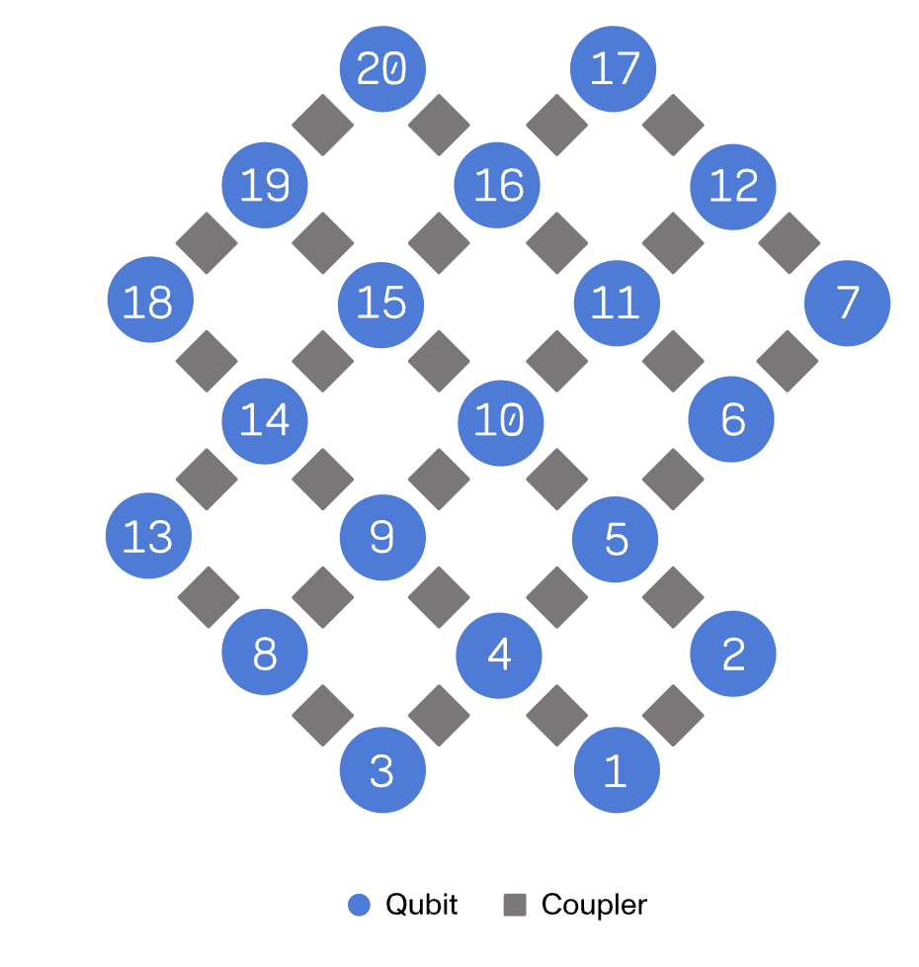
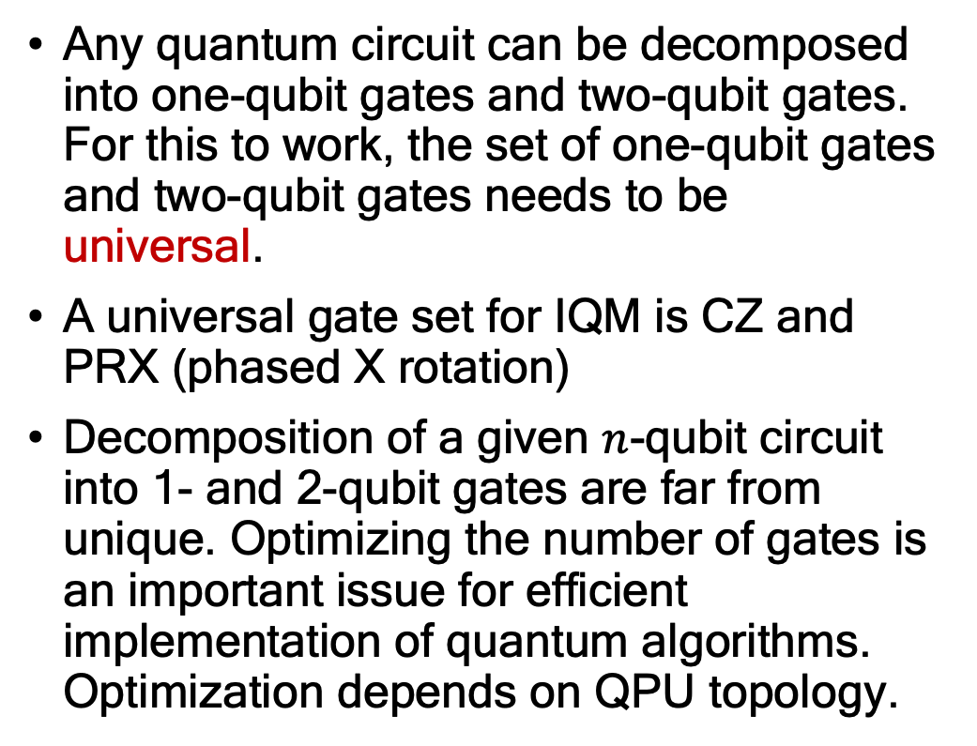
Summary
Any quantum circuit can be decomposed into one-qubit gates and two-qubit gates. For this to work, the set of one-qubit gates and two-qubit gates needs to be universal.
A universal gate set for IQM is CZ and PRX (phased X rotation)
Decomposition of a given $n$-qubit circuit into 1- and 2-qubit gates are far from unique. Optimizing the number of gates is an important issue for efficient implementation of quantum algorithms. Optimization depends on QPU topology.
QPU topology of IQM Garnet available via IQM Resonance

