Slide 1
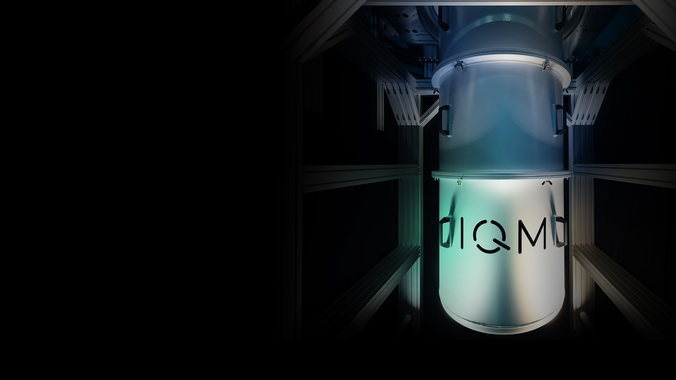






Introduction to Quantum Computing
A lecture series by IQM and HS RM
Authors: Stefan Seegerer, Mikio Nakahara, Nikolay Tcholtchev
Last Updated 06/2025
www.meetiqm.com

Slide 2
Why think about different computing paradigms?

Slide 3

Sorting a list of numbers
8
2
5
3

Slide 4
Sorting a list of numbers
2
8
5
3

Slide 5
Sorting a list of numbers
2
3
5
8

Slide 6
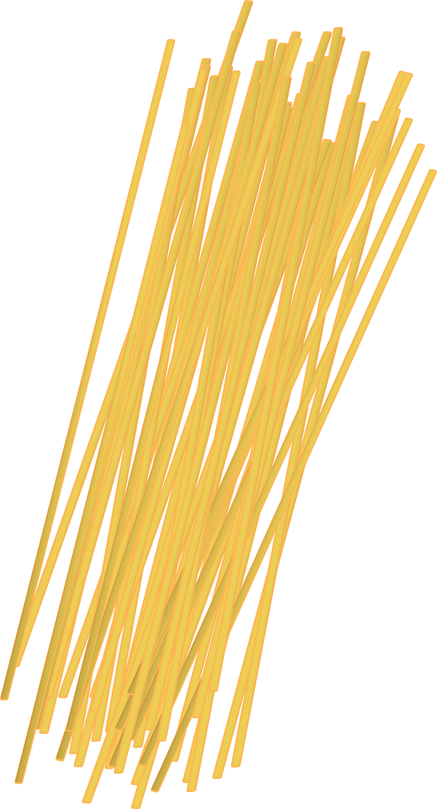
Thinking about new computing paradigms can lead to more efficient solutions

Slide 7
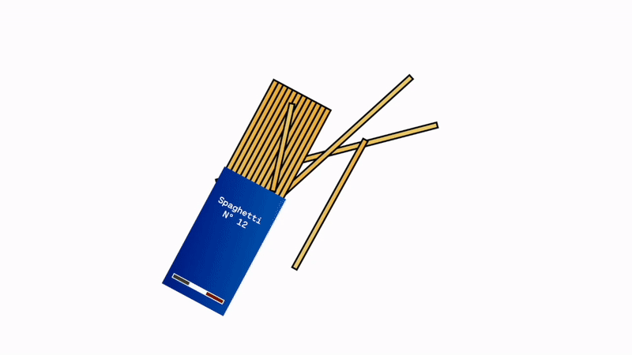

Slide 8
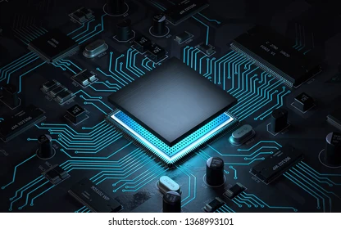
There are problems, a classical computer cannot (efficiently) solve
Problem with current computers:
Intractable problems
Fundamental limits
Time & power limits
Current approach is not scalable!
“Latest findings suggest global computing is more likely responsible for between 2.1% and 3.9% of greenhouse gas emissions.“
https://www.upi.com/Science_News/2021/09/10/communications-tech-carbon-emissions/8771631295350/

Slide 9
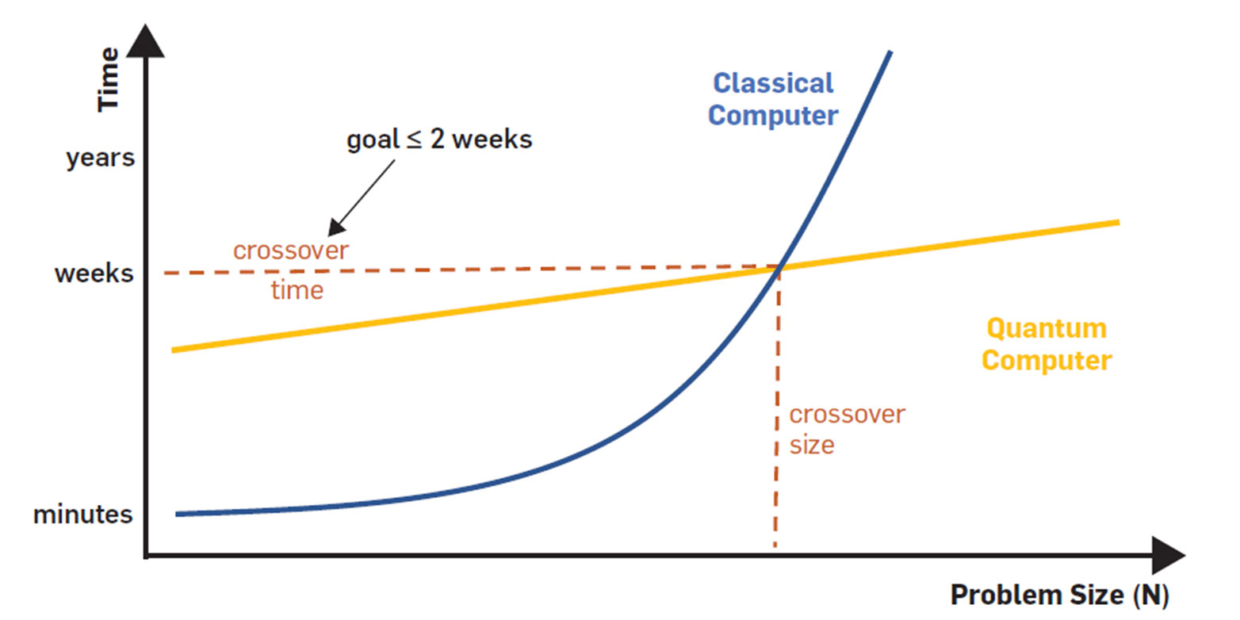
There are problems, a classical computer cannot (efficiently) solve
Graphics: ETH Zurich, Microsoft, ACM

Slide 10
Overview
Computational complexity depends on the resource to implement the algorithm.
Different physical systems may be employed for information processing. Choosing a different one sometimes gives a different computational complexity than digital information processing.
Quantum information processing and quantum computation employ quantum systems to store and process information, which may reduce computational complexity for some tasks.

Slide 11
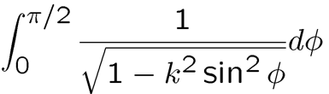
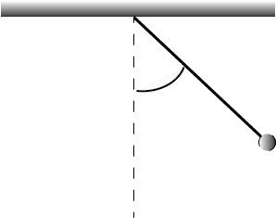



Information is Physical. (R Landauer (IBM), 1991)
Physics laws can be used for information processing/computation.
Example: Evaluate the complete elliptic integral of the first kind
$K\left(k\right)=$ . . $K\left(k\right)=\frac{π}{2}{\sum_{n=0}^{∞}{[}\frac{\left(2n−1\right)‼}{\left(2n\right)‼}]}^{2}k^{2n}.$
Use physics. The period of a pendulum is $T=4\sqrt{\frac{L}{g}}K\left(k\right), k=sin\frac{θ_{0}}{2}.$
It may take a few minutes to set up a pendulum. It is much shorter than the time required to build a digital computer from scratch.
A physical system may be used as a computational resource. Its usage is limited in general though.
$$L$$
$$θ_{0}$$

Slide 12

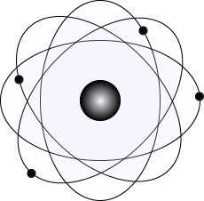
Complexity depends on the device for processing
Complexity depends on a system to implement an algorithm.
There are some problems whose complexity may be reduced if they are implemented with complex vectors and matrices acting on them.
And quantum physics, the physics of the microscopic world, is described by complex vectors and matrices. Let’s use this system to execute such algorithms!

Slide 13
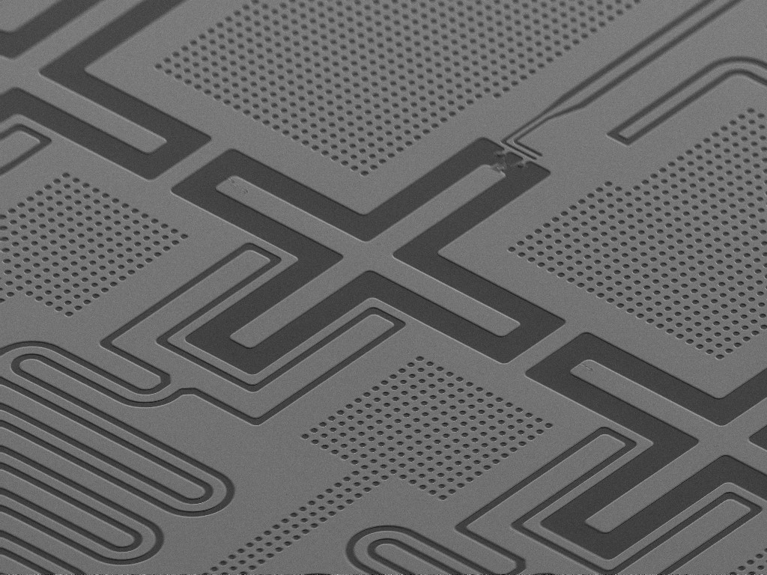
Quantum Information Processing
Thanks to the progress of nanotechnology, it is now possible to fabricate a nanoscopic system that follows the laws of quantum mechanics. Superconducting qubits (=quantum bit) employed in IQM quantum computers are an example of such devices.

Slide 14
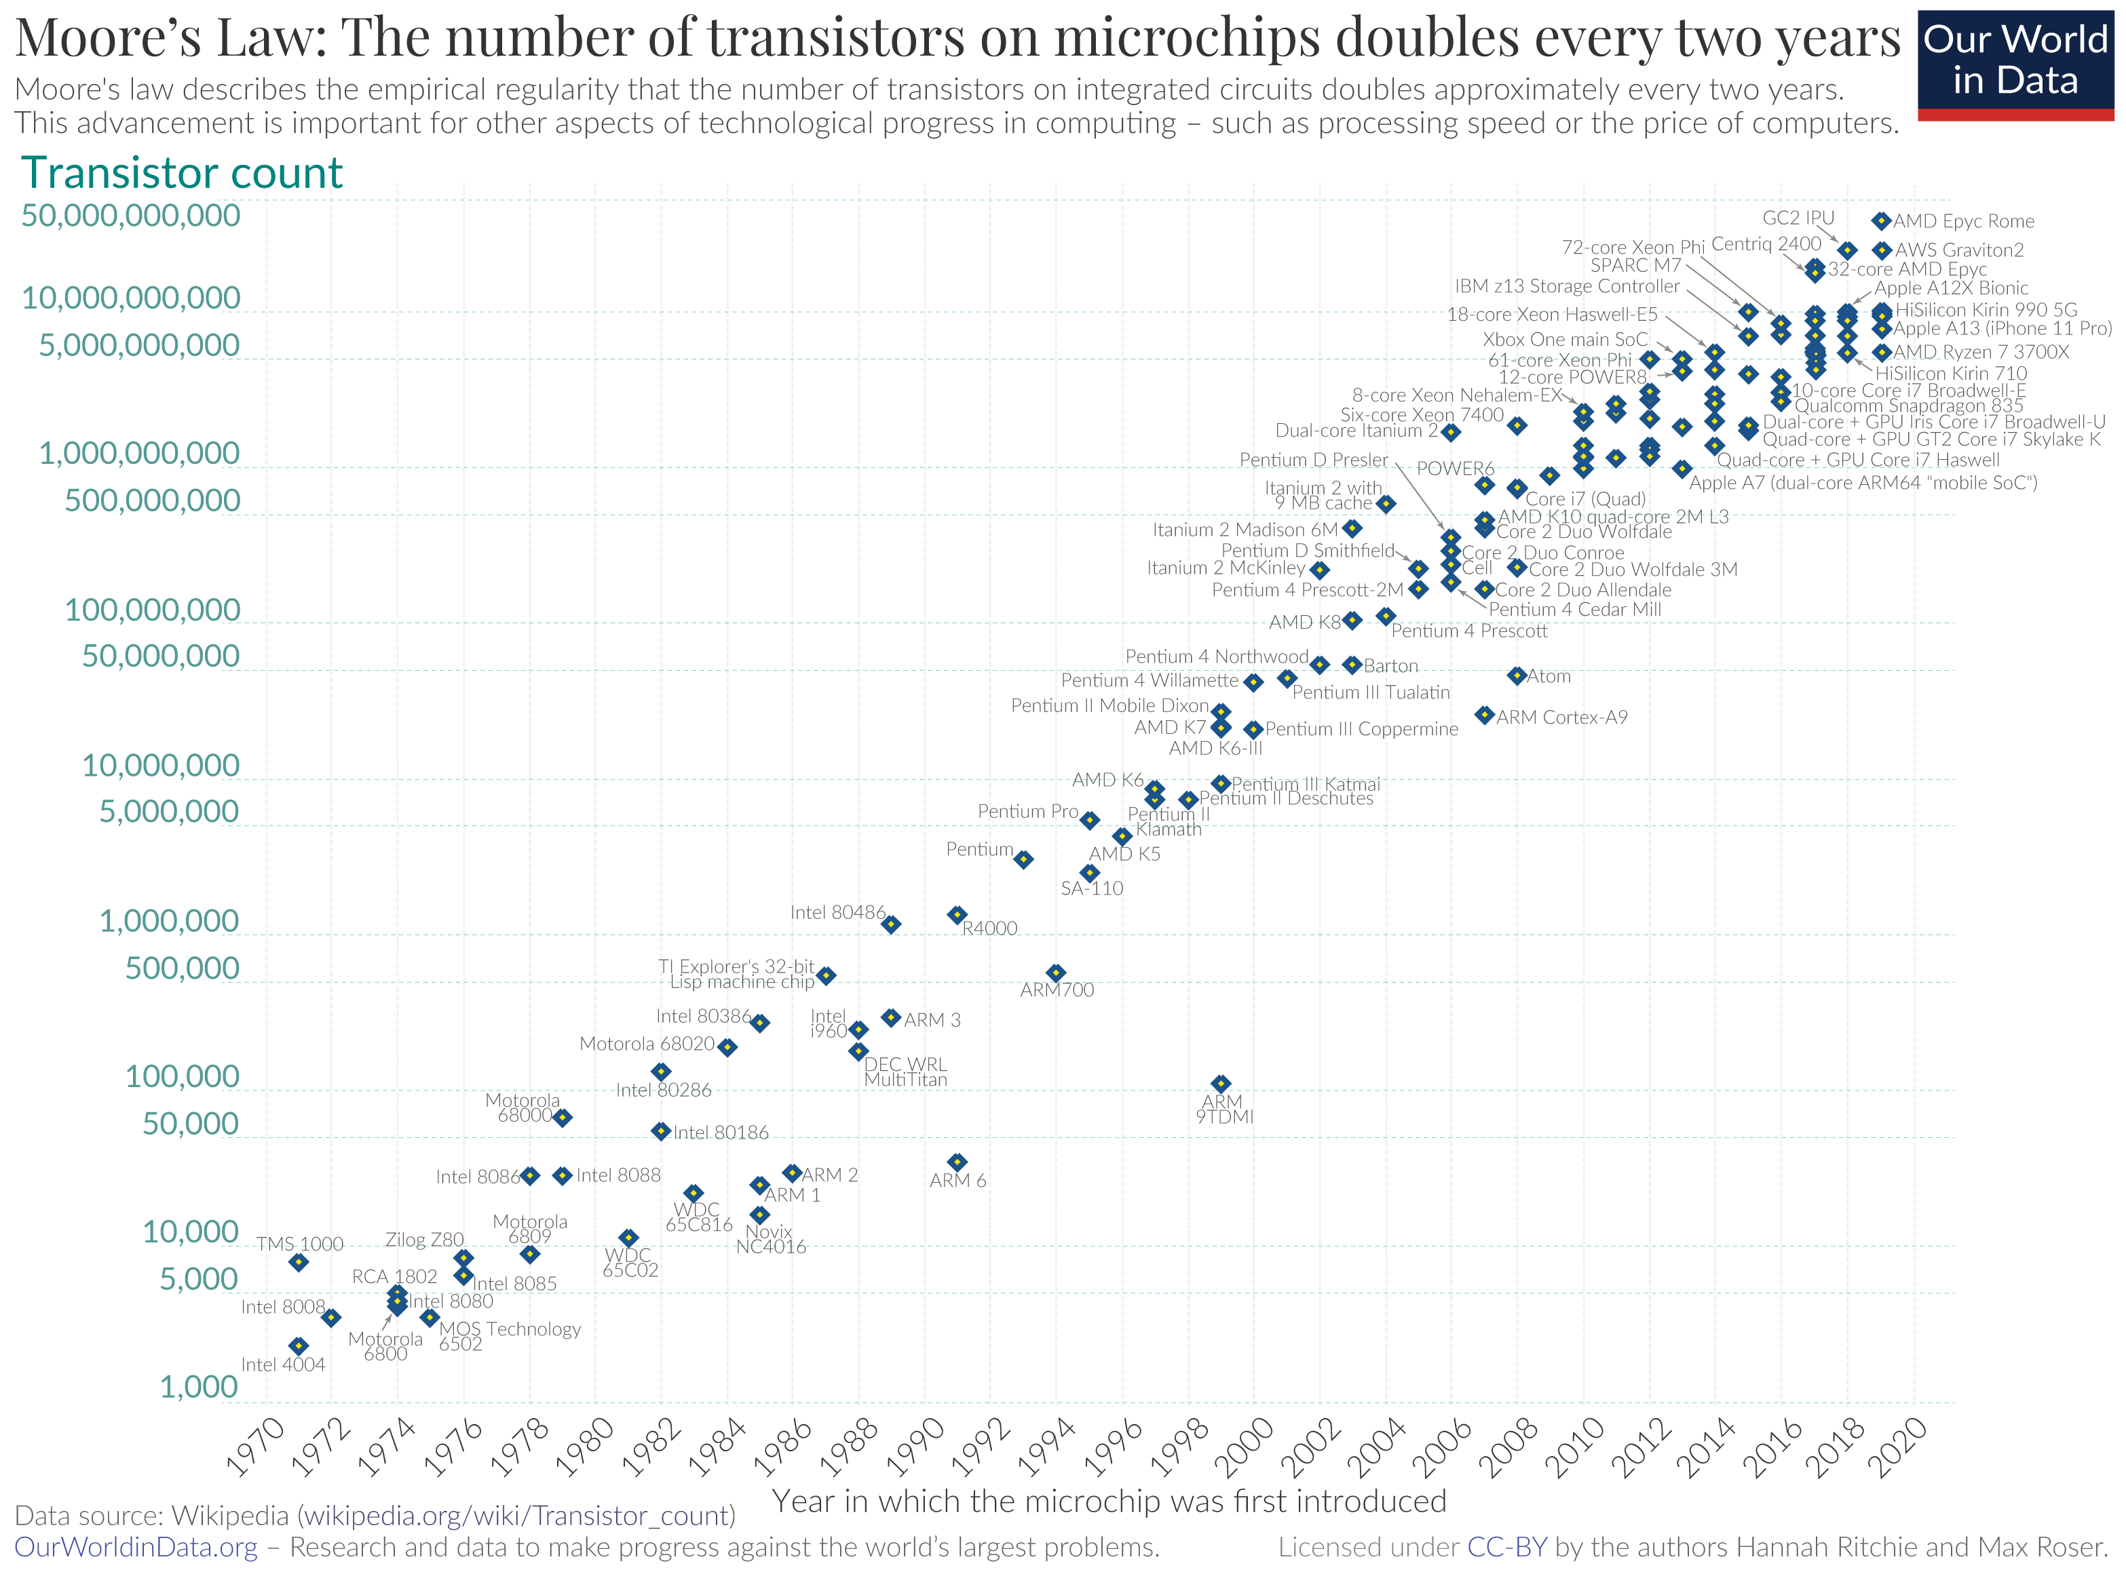
Another Motivation for Quantum Computing
Moore’s law: The number of transistors that can be packed into a CPU is expected to double every two years.
As transistors shrink, we are rapidly approaching the atomic scale, where classical physics breaks down and quantum effects become dominant.
These quantum effects, rather than being an obstacle, offer a new way to process information, leading to quantum computing.
CC-BY 4.0 by Max Roser, Hannah Ritchie

Slide 15
Bits and Qubits

Slide 16
Classical Computer vs. Quantum Computer
Classical bit
0
State can be measured repeatedly
2 distinct states
switch on/off
1
Quantum bit
0
Measurement of the state will cause it to fall back to 0 and 1, no repeated measurement
Point on the surface of a sphere
Superposition of 2 basis states
1

Slide 17

What is quantum computing?
Basis states:
0
1
Classical computer vs.
Quantum computer
→ 1 qubit can be in a superposition of 2 basis states
→ A 1 bit state can be just one out them
Quantum computers follow different rules than classical computers – those of quantum physics.
Bit vs. Qubit (quantum bit)
A bit can be either 0 or 1, while a qubit can be in a superposition: qubit can be both 0 and 1 at the same time.
Measurement will yield either 0 or 1.
1Qubit
0
Two qubits can be entangled. Changing one directly impacts the other.
0
1
1

Slide 18
What is quantum computing?
Basis states:
00
01
10
11
Classical computer vs.
Quantum computer
→ 2 qubits can be in a superposition of all 4 basis states
→ A 2-bit state can be just one out them
Quantum computers follow different rules than classical computers – those of quantum physics.
Bit vs. Qubit (quantum bit)
2 Qubits
A bit can be either 0 or 1, while a qubit can be in a superposition: qubit can be both 0 and 1 at the same time.
Measurement will yield either 0 or 1.
2 Qubits
1Qubit
0
Two qubits can be entangled. Changing one directly impacts the other.
2 x basis states
0
1
1

Slide 19
What is quantum computing?
000 001 010 011
100 101 110 111
3 qubits can be in a superposition of all 2³ = 8 basis states
A 3-bit state can be just one of them
Basis states:
000
100
010
110
001
101
011
111
Classical computer vs.
Quantum computer
Quantum computers follow different rules than classical computers – those of quantum physics.
3Qubits
3Qubits
3Qubits
Bit vs. Qubit (quantum bit)
2 Qubits
A bit can be either 0 or 1, while a qubit can be in a superposition: qubit can be both 0 and 1 at the same time.
Measurement will yield either 0 or 1.
2 Qubits
1Qubit
2 x basis states
0
Two qubits can be entangled. Changing one directly impacts the other.
2 x basis states
0
1
1

Slide 20


What is quantum computing?
000 001 010 011
100 101 110 111
3 qubits can be in a superposition of all 2³ = 8 basis states
A 3-bit state can be just one of them
51 Qubits
300 Qubits
300 Qubits
300 Qubits
Classical computer vs.
Quantum computer
300 Qubits
Quantum computers follow different rules than classical computers – those of quantum physics.
50 Qubits
50 Qubits
50 Qubits
50 Qubits
3Qubits
3Qubits
3Qubits
Bit vs. Qubit (quantum bit)
2⁵⁰ states
2 Qubits
A bit can be either 0 or 1, while a qubit can be in a superposition: qubit can be both 0 and 1 at the same time.
Measurement will yield either 0 or 1.
2 Qubits
1Qubit
Classical supercomputers hit a roadblock at 50 qubits (Technology Review)
2 x basis states
0
Two qubits can be entangled. Changing one directly impacts the other.
2 x basis states
0
1
1

Slide 21
What is quantum computing?
000 001 010 011
100 101 110 111
3 qubits can be in a superposition of all 2³ = 8 basis states
A 3-bit state can be just one of them
Classical computer vs.
Quantum computer
300 Qubits
300 Qubits
300 Qubits
300 Qubits
Quantum computers follow different rules than classical computers – those of quantum physics.
50 Qubits
50 Qubits
50 Qubits
50 Qubits
2³⁰⁰ states
3Qubits
3Qubits
3Qubits
Bit vs. Qubit (quantum bit)
2⁵⁰ states
2 Qubits
A bit can be either 0 or 1, while a qubit can be in a superposition: qubit can be both 0 and 1 at the same time.
Measurement will yield either 0 or 1.
2 Qubits
1Qubit
Classical supercomputers hit a roadblock at 50 qubits (Technology Review)
2 x basis states
0
Two qubits can be entangled. Changing one directly impacts the other.
2 x basis states
0
1
Exponential increase in computational capacity
Enables new algorithms and solutions to previously intractable problems
1

Slide 22
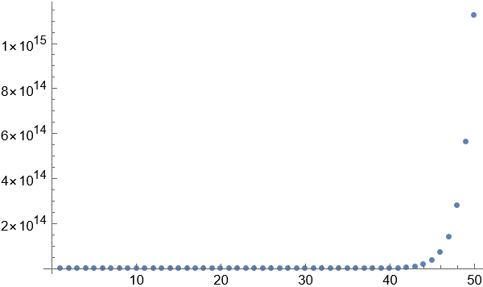

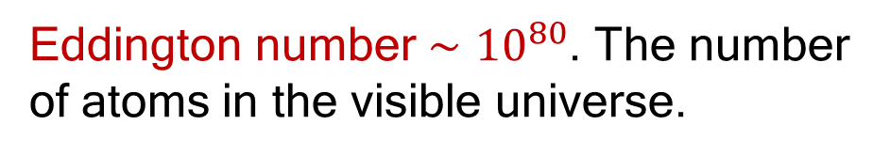
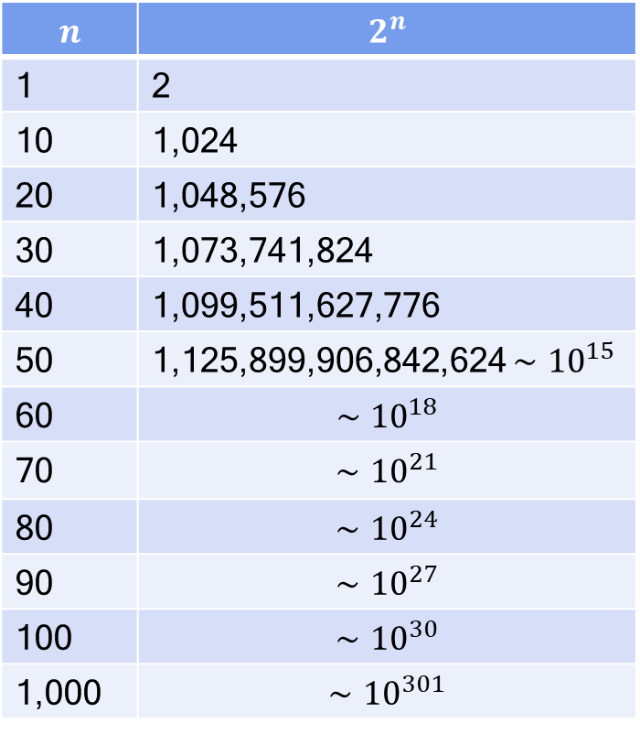
“Quantum Parallelism”
$$n$$ | $$2^{n}$$
1 | 2
10 | 1,024
20 | 1,048,576
30 | 1,073,741,824
40 | 1,099,511,627,776
50 | 1,125,899,906,842,624 $∼{10}^{15}$
60 | $$∼{10}^{18}$$
70 | $$∼{10}^{21}$$
80 | $$∼{10}^{24}$$
90 | $$∼{10}^{27}$$
100 | $$∼{10}^{30}$$
1,000 | $$∼{10}^{301}$$
Bit is replaced by qubit in quantum computing.
$n$ qubits represent up to $2^{n}$ different states
simultaneously.
1,099,511,627,776
1,073,741,824
Eddington number $∼{10}^{80}$. The number of atoms in the visible universe.

Slide 23
Computational Complexity

Slide 24



A suitable measure for complexity
1 apples
3 apples
In general, the effort required in terms of memory or time can be determined
Time is often the limiting factor
Sliced apple (space)
Apple compote (space)
Sliced apple (time)
1 min
3 min
Apple compote (time)
2 min
2 min

Slide 25
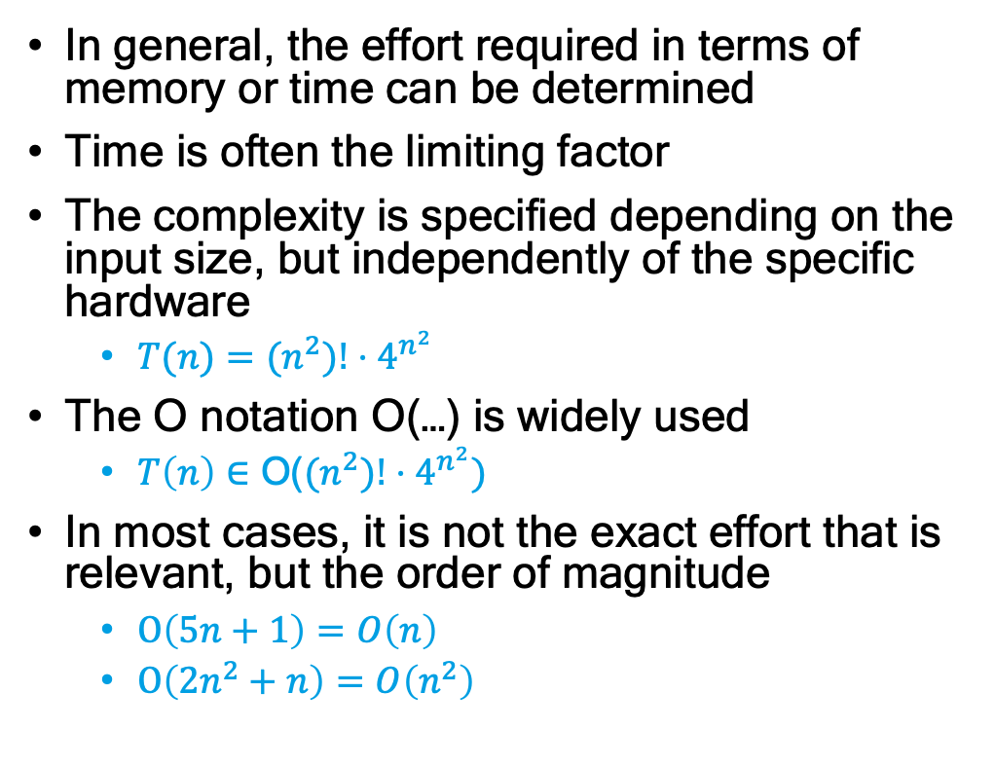


A suitable measure for complexity
1 apple
3 apples
In general, the effort required in terms of memory or time can be determined
Time is often the limiting factor
The complexity is specified depending on the input size, but independently of the specific hardware
  $T(n)=$ ${(n}^{2})!⋅4^{n^{2}}$
The O notation O(…) is widely used
  $T\left(n\right)∈$ O(${(n}^{2})!⋅4^{n^{2}})$
In most cases, it is not the exact effort that is relevant, but the order of magnitude
  $O\left(5n+1\right)=O\left(n\right)$
  $O\left(2n^{2}+n\right)=O\left(n^{2}\right)$
Sliced apple (space)
Apple compote (space)
Sliced apple (time)
1 min
3 min
$T\left(n\right)=3n∈O(n)$
Apple compote (time)
2 min
2 min
$T\left(n\right)=1∈O(1)$

Slide 26
Complexity of algorithms
Notation | Type | Example
O(1) | constant | Add an item to the end of a list
O(n) | Linear | Finding an item in an unsorted list
O(n^{c}) | Polynomial | Bubble Sort
O(c^{n}) | Exponential | Traveling Salesman Problem, using dynamic programming
O(n!) | Factorial | Traveling Salesman Problem, using brute force

Slide 27
Complexity of algorithms
 | n | n² | 2^{n} | n!
n=10 | < 1s | < 1s | < 1s | 4s
n=30 | < 1s | < 1s | 18 m | 10²⁵y
n=50 | < 1s | < 1s | 36 y | Very long
n=100 | < 1s | < 1s | 10¹⁷ y | Very long
n=1000 | < 1s | 1s | Very long | Very long
n=10000 | < 1s | 2 m | Very long | Very long
n=100000 | < 1s | 3 h | Very long | Very long
n=1000000 | 1s | 12 d | Very long | Very long
Assuming one Million Instructions per second (MIPS)
The power of one Motorola 68000 (current processors have 100 000 MIPS)
Notes:
1 MIPS (Motorola 68000 from 1979)
90.000 MIPS (i9-10900K)

Slide 28
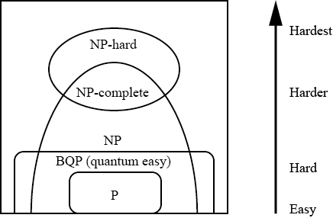
Computational Complexity
P: Solved in polynomial time.
NP: Verified in polynomial time.
NP-complete: Most difficult in NP.
NP-hard: At least as difficult as NP-complete. (Find the best solution among the NP-complete solutions, for example.)
BQP (Bounded error, Quantum, Polynomial time): Solvable in polynomial time by a quantum computer.

Slide 29
Caution: Not All Algorithms Can Be Improved
A physical system cannot be an all-purpose computer (pendulum/spaghetti).
A quantum computer makes use of wave nature of quantum states. There are interference, superposition and entanglement associated with this. They do not exist in a classical (i.e., digital) computer.
Typical quantum algorithm; Grover’s database search, Shor’s factorization. They require a full-fledged quantum computer with built-in quantum error correction (QECC).
Currently available quantum computers, including the IQM quantum computer, are called the NISQ (Noisy Intermediate-Scale Quantum) computer. <1000 QB, no QECC. They are often used for the quantum-classical hybrid computation such as the Variational Quantum Eigensolver (VQE).

Slide 30
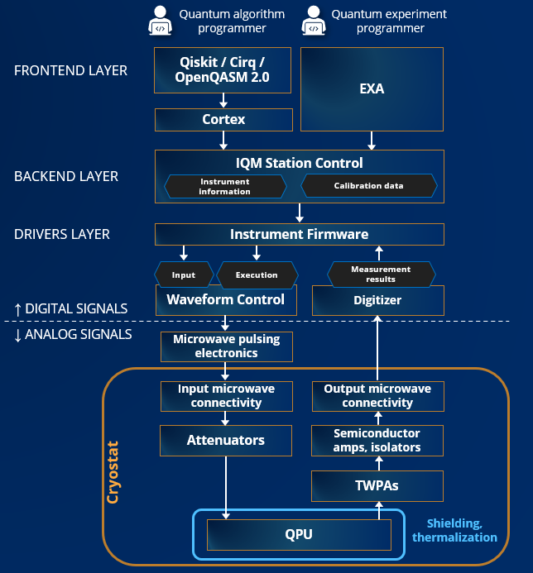
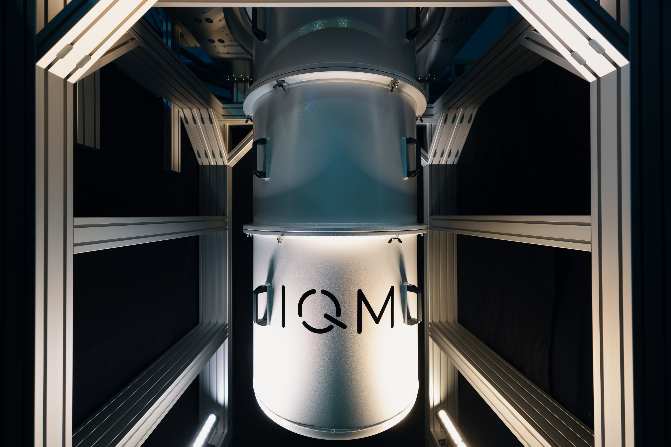
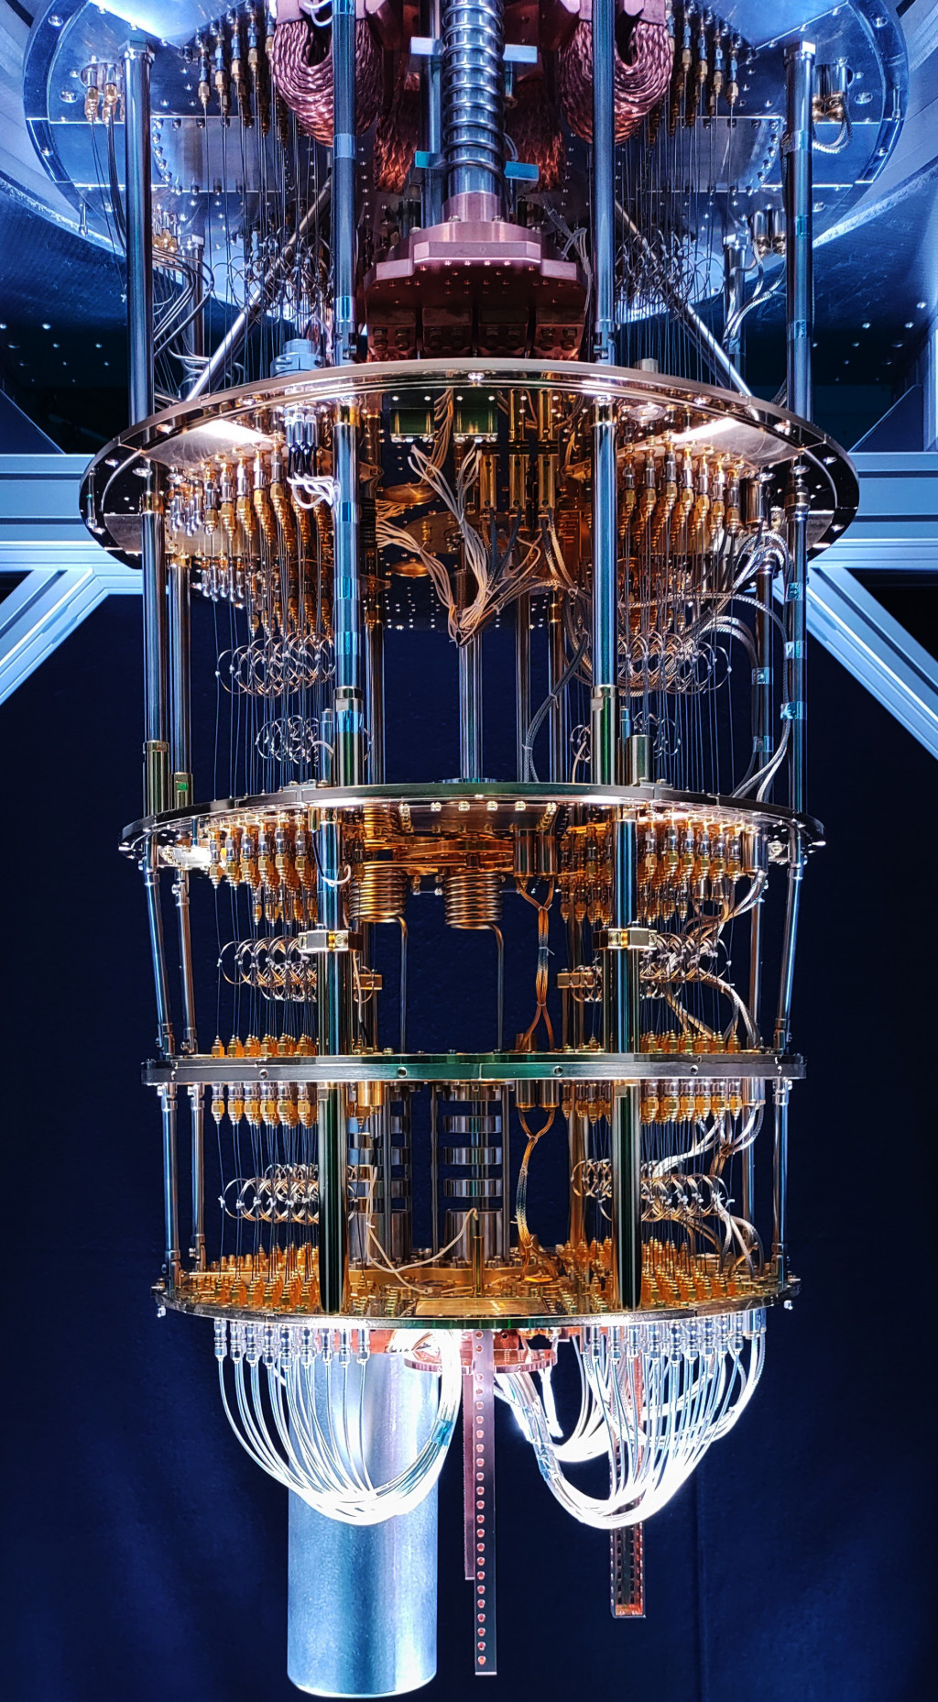
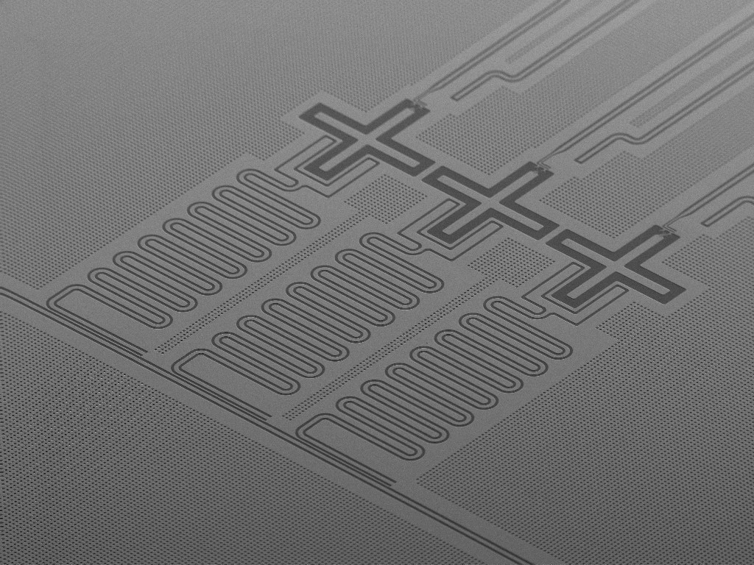
Brief Summary of IQM Quantum Computer
10 mK

Slide 31
Summary

Slide 32
Summary
Physical system may be employed for information processing and computation.
Quantum computing employs the law of quantum physics to store, process and transfer information.
Thanks to the progress of nanotechnology, we can fabricate nanoscale devices that follow the law of quantum mechanics. Superconducting qubit in IQM quantum computer is an example of such systems.
Currently available quantum computer is called NISQ (Noisy Intermediate-Scale Quantum) computer. No QECC (N). <1000 qubits (IS).
We will see how quantum information processing is different from and superior to classical one in the following lectures.

Slide 33
Practical notes

Slide 34
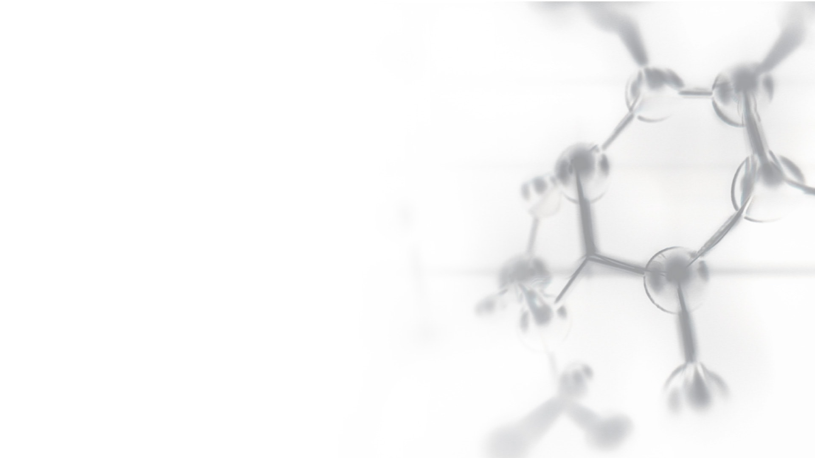

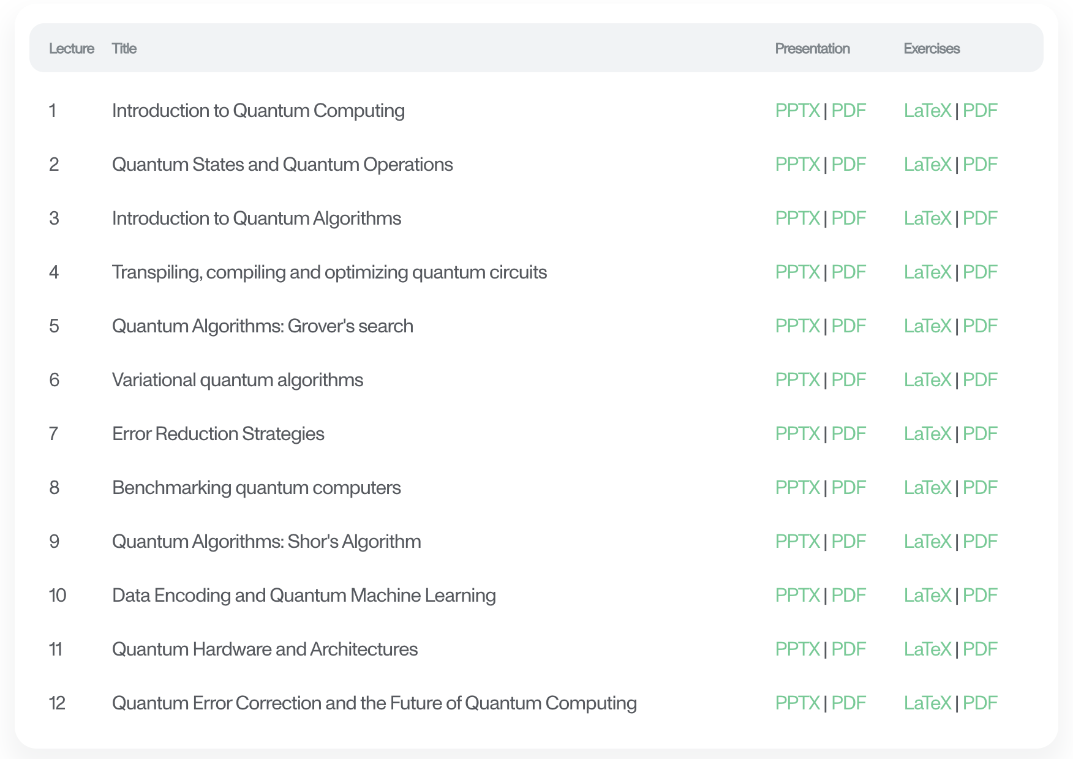

Outline of the course
CONFIDENTIAL

Slide 35
This course …
… is intended to be an introduction to the computing (not the physics aspects) of a quantum computer
… assumes you get actively engage with the lectures and the exercises
… uses qrisp as the SDK for developing quantum algorithms
… assumes access to quantum computers via IQM Resonance (freemium available) / IQM Server (on-prem users)
… is supported by the material and applets on IQM Academy

Slide 36



qrisp
qrisp.eu
qrisp is a high level programming framework for working with quantum computing programs
It’s pythonic
It’s open source
https://github.com/eclipse-qrisp/Qrisp
pip install „qrisp[iqm]“

Slide 37
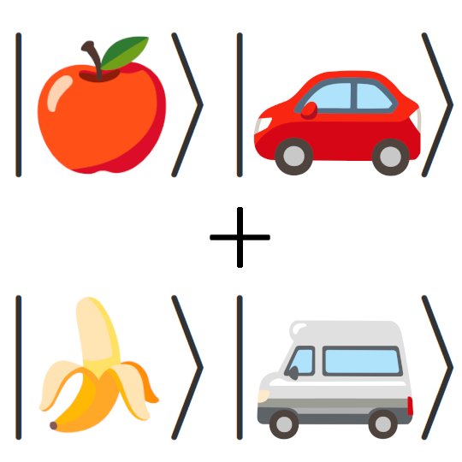


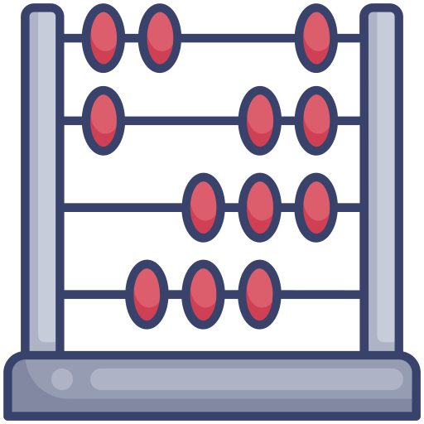


Features of qrisp (you will learn about these throughout the course)
Typed quantum variables
automatic Uncomputation,
i.e. Garbage Collection
Modularity
Arithmetics
Compatibility and
interoperability
Works with IQM hardware

Slide 38
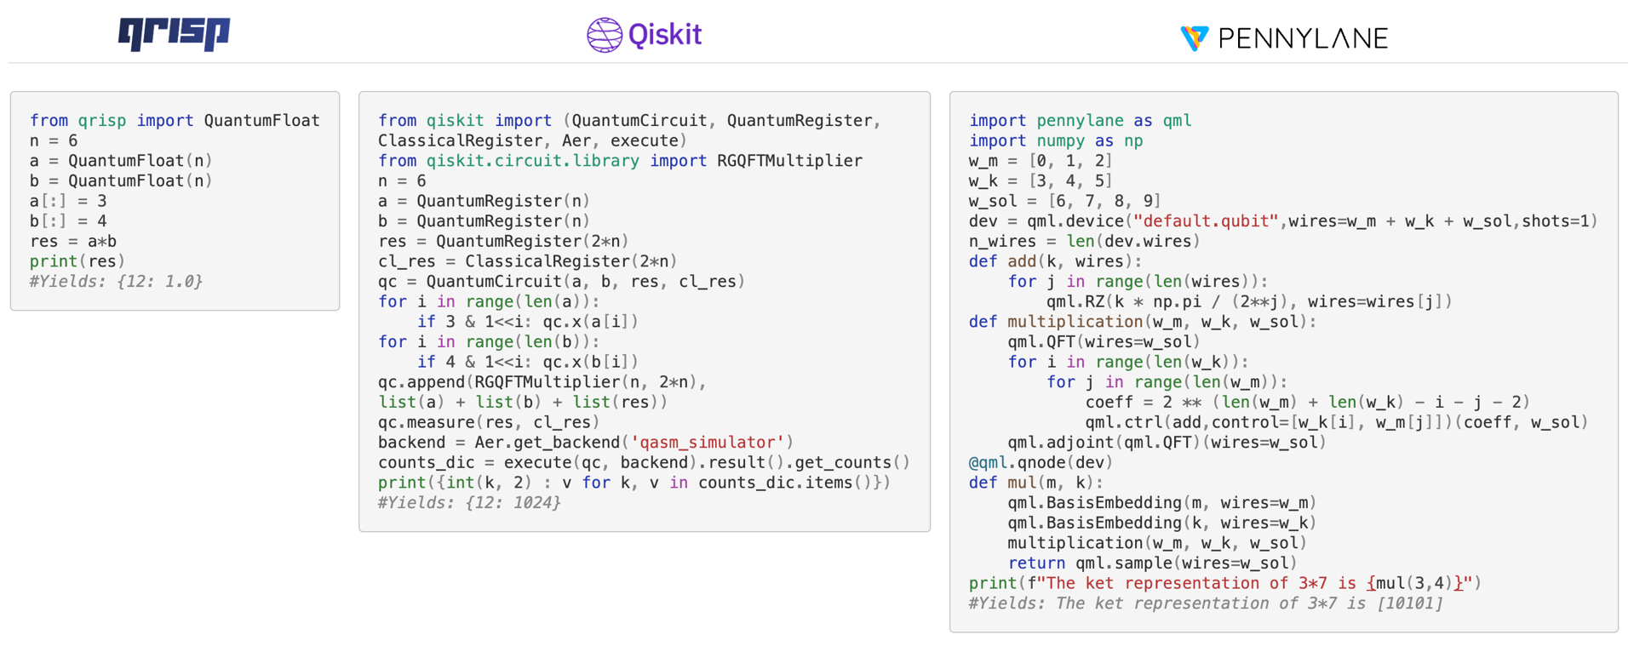
There are different quantum computing frameworks, but qrisp will enable you to learn what matters

Slide 39
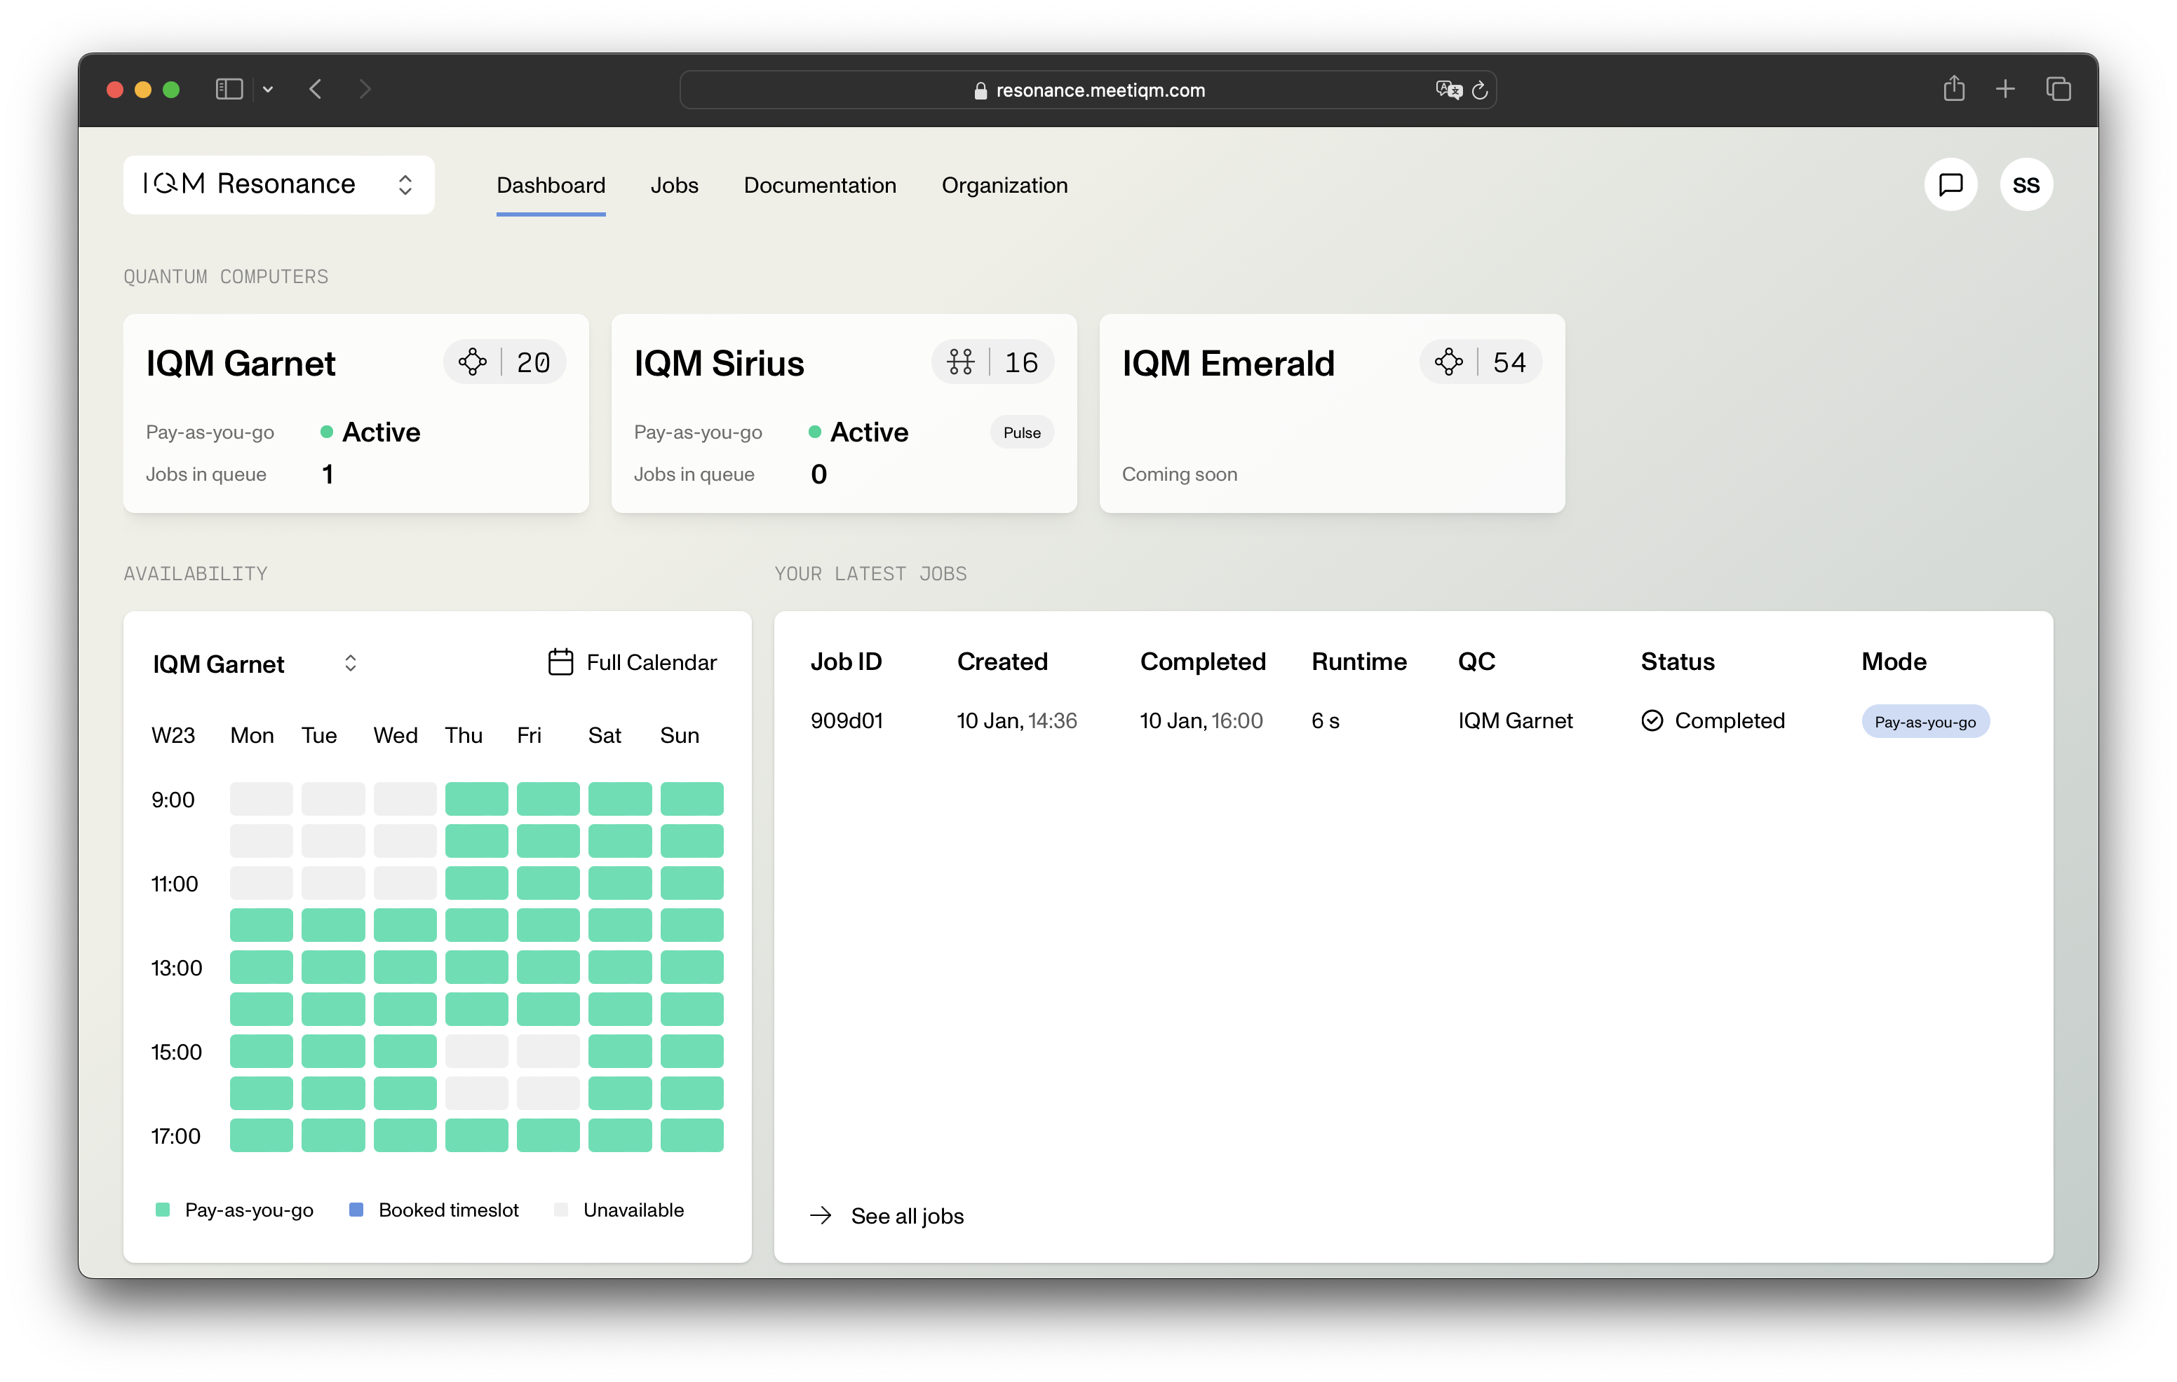

IQM Resonance / IQM Server
A platform to run and organize your quantum circuits.
Made for education and research.
Support for multiple frameworks (qrisp, qiskit, Cirq and more)

