Slide 1
KQCircuits:
Simulations
www.meetiqm.com
Niko Savola, Quantum Engineer Intern
WE BUILD QUANTUM COMPUTERS

Slide 2
Overview
Open-source simulations with Elmer
Demo
  Ansys support
  Cross-section simulations
  Loss-function optimiser
Simulation classes in KQC
  Parameter sweeps
Qubit– resonator properties with scQubits

Slide 3
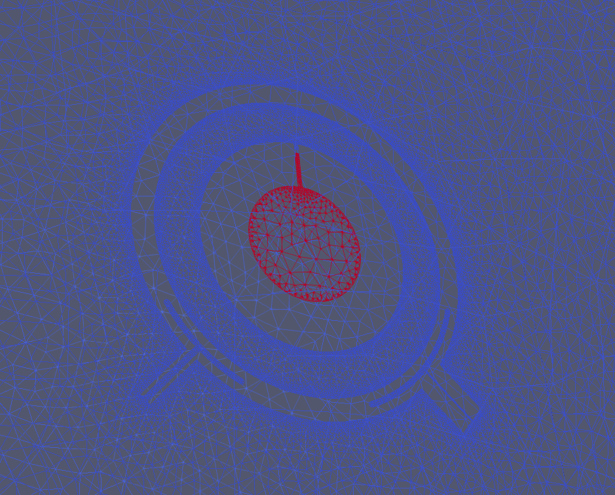
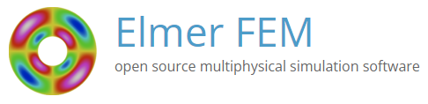
Installing Elmer
Open-source FEM solver developed at CSC (Non-profit state enterprise for scientific computing in Finland)

Slide 4
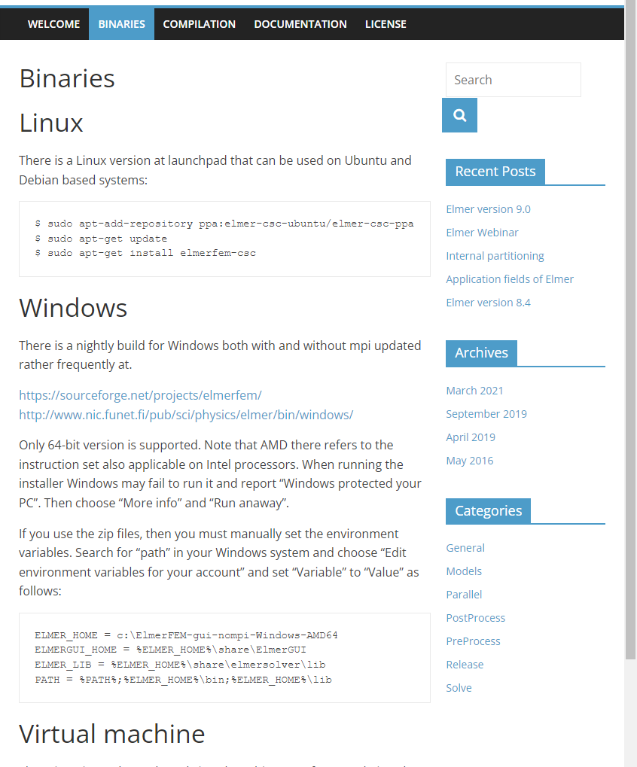
Preparing for simulations
Think where the simulations will be run
  Remote Linux server, locally on Windows?
Required open-source software
  gmsh, for meshing
    Should work by pip install gmsh
  Elmer, for finite-element
    Download and install binaries at elmerfem.org/blog/binaries/
  ParaView, for viewing results
gmsh and ParaView support Linux, macOS and Windows. Elmer provides binaries only for Debian Linux and Windows (but other OSs may be compiled)

Slide 5
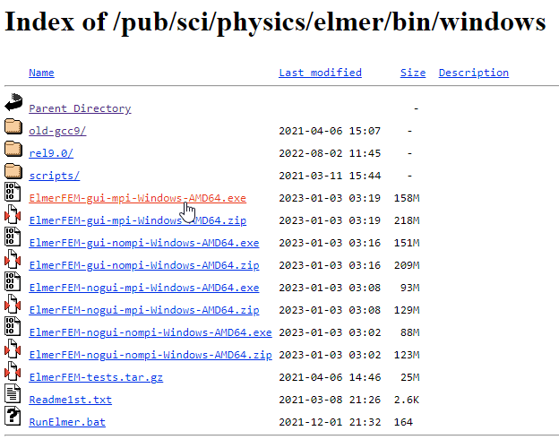
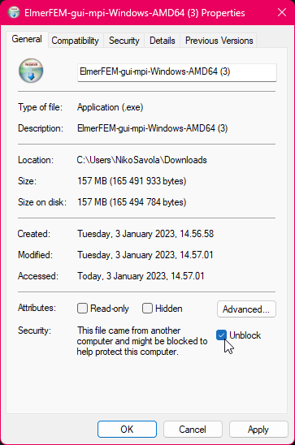
Installing Elmer
2. You likely need to Unblock the installer as it is not certified
3. Run the installer
This likely is the most unclear, so we'll walk through a typical Windows installation.
1. Download the gui-mpi version from nic.funet.fi/pub/sci/physics/elmer/bin/windows

Slide 6
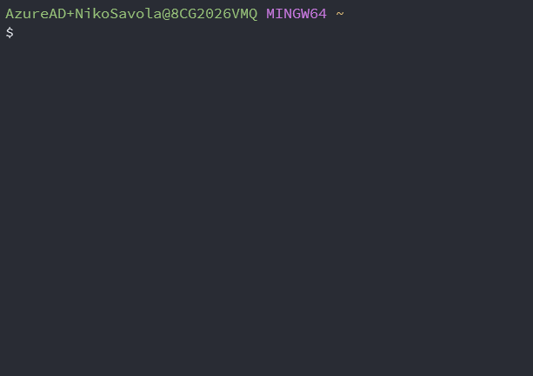
Installing Elmer
Test that Elmer works by running ElmerSolver in terminal
The simulations currently require running .sh files. To this end, we recommend using Git Bash.
Windows Subsystem for Linux (WSL) may be used as well. In this case, use Ubuntu WSL and follow the Debian instructions on the Elmer website:
sudo apt-add-repository \
ppa:elmer-csc-ubuntu/elmer-csc-ppa
sudo apt-get update
sudo apt-get install elmerfem-csc

Slide 7
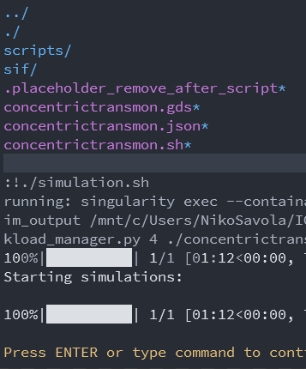

Alternative:
Singularity container
Similar to Docker images but work better in HPC environments
Pre-compiled container including KQCircuits, gmsh and Elmer provided at oras://ghcr.io/iqm-finland/kqcircuits:main-singularity
More info at KQCircuits docs → Developer Guide → Containers → Singularity usage

Slide 8
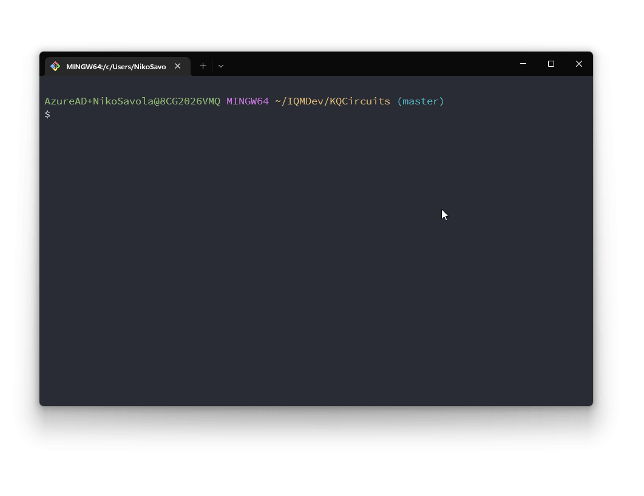
Running Simulations
As an example, let’s run a simulation script generating 4 simulations and run them in parallel.
From the root folder for KQC, run (or execute the file in your IDE)
python klayout_package/python/scripts/simulations/simple_workload_manager_example.py
This should open KLayout with the exported geometries, you may close this.

Slide 9
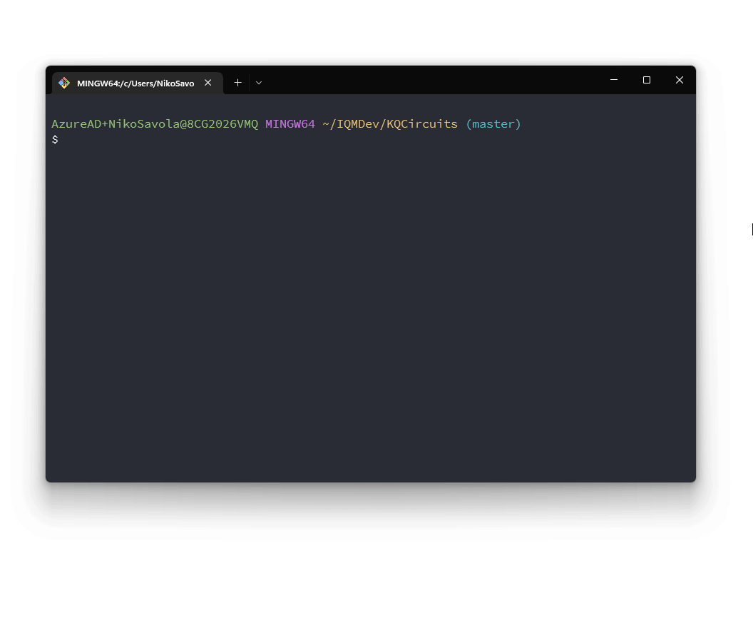
Running Simulations
Then go to your KQC tmp folder (KQCircuits/tmp by default). This may be overwritten with the KQC_TMP_PATH env.
Locate the script output folder simple_workload_manager_example_
output and enter it.
All of the exported simulations are run (in parallel) by executing ./simulation.sh
By default, the mesh is shown in gmsh before simulating. These windows need to be closed to continue.

Slide 10
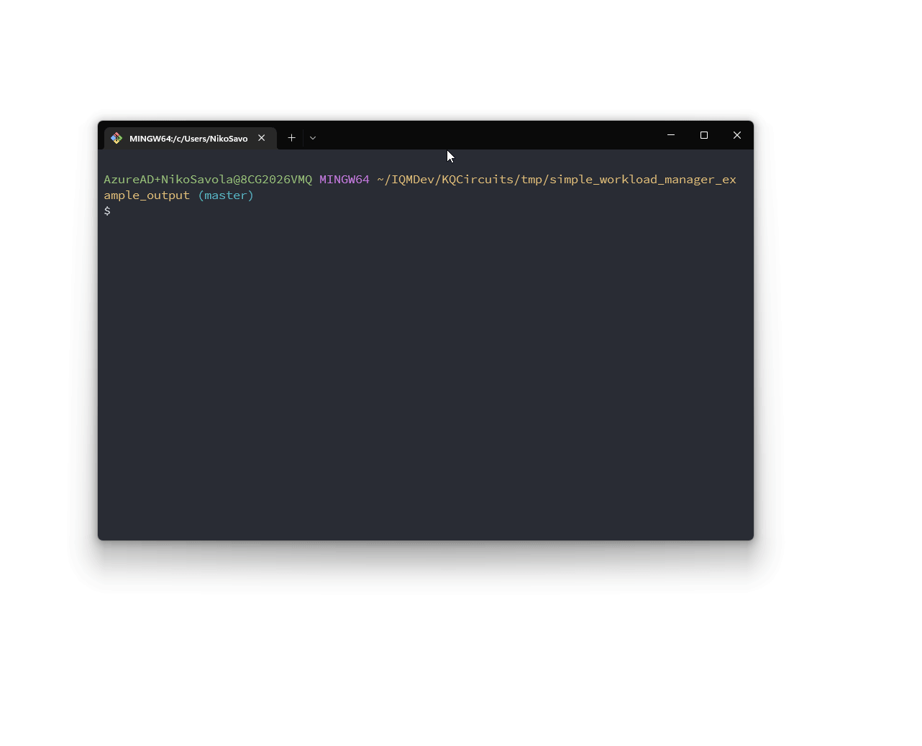
Viewing the results
We just did a capacitance simulation of three qubits with readout- and drivelines each. This provides a 9x9 capacitance matrix for examining coupling.
The matrix is stored in JSON form in corresponding _..._project_results.json files for each geometry variation.
ParaView may be used to see the field solutions. Although here it isn’t very interesting w/o enabling saving the electric field in Elmer. The field solution is stored in a .vtu file inside the individual simulation folders. Use the terminal with paraview or
File → Open inside ParaView.

Slide 11

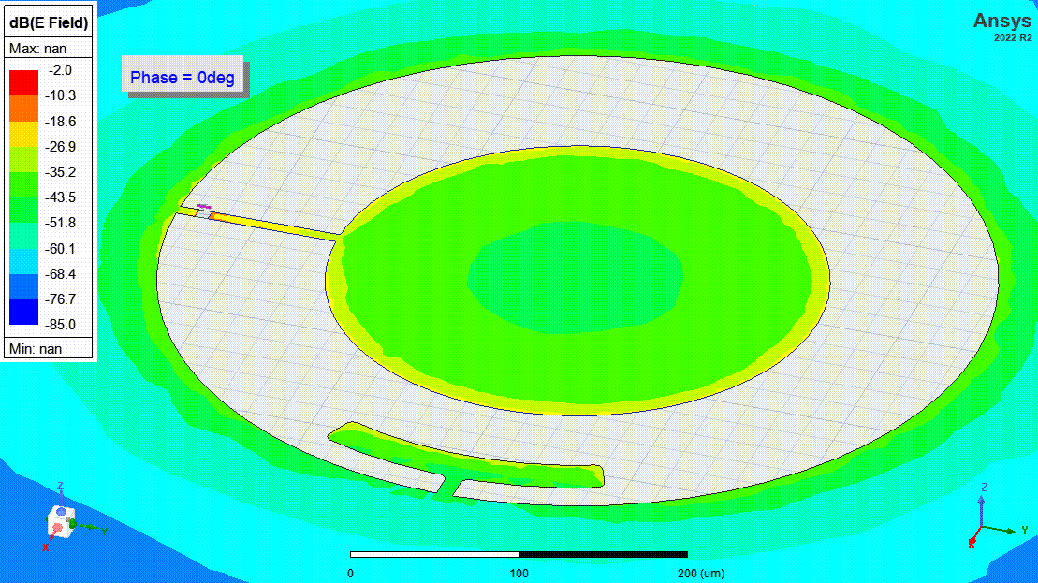
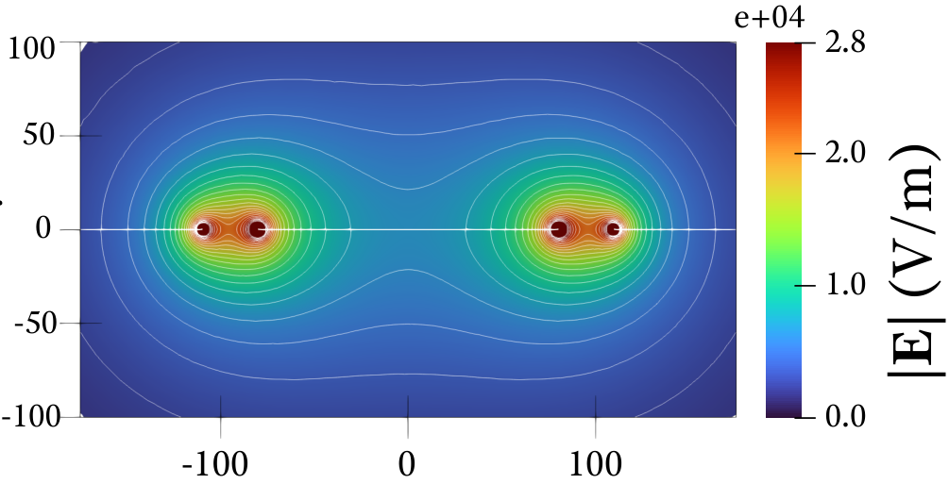
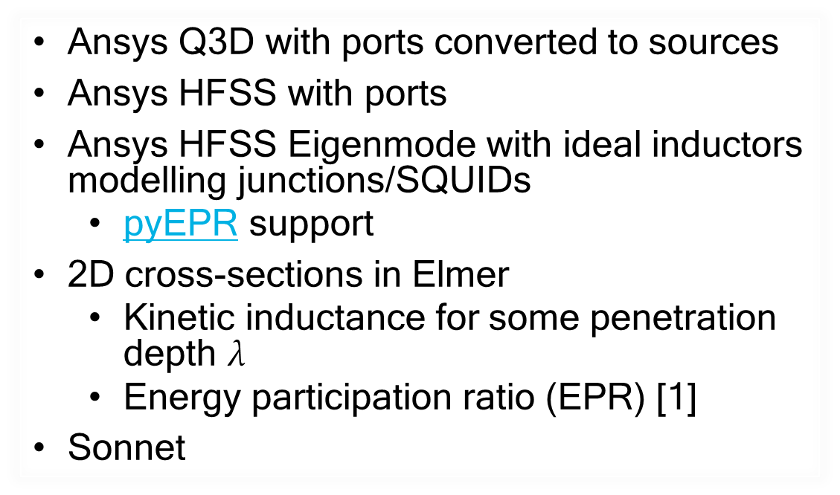
Other out-of-the-box simulations
Ansys Q3D with ports converted to sources
Ansys HFSS with ports
Ansys HFSS Eigenmode with ideal inductors modelling junctions/SQUIDs
  pyEPR support
2D cross-sections in Elmer
  Kinetic inductance for some penetration depth $λ$
  Energy participation ratio (EPR) [1]
Sonnet
[1] Z. K. Minev et al., ‘Energy-participation quantization of Josephson circuits’, npj Quantum Inf, vol. 7, no. 1, Art. no. 1, Aug. 2021

Slide 12
Running Simulations in Ansys
Note:
The API for the export functions differ a bit, as Ansys uses a different logic for adaptive meshing and convergence criteria by default.
Essentially, the user interface for running simulation batches is the same as Elmer:
Export simulation output folder with a Python script, but use the export_ansys function instead of export_elmer
Run the simulation.bat (Windows only due to being the main Ansys platform but easy to edit for Linux). This will import the geometry, setup the simulation and run the variations serially.
For Q3D, ..._project_results.json files in the same format are generated
export_parameters_ansys = {
'ansys_tool': 'q3d',
'path': dir_path,
'exit_after_run': True,
'percent_error': 0.3,
'maximum_passes': 18,
'minimum_passes': 2,
'minimum_converged_passes': 2,
}
export_parameters_elmer = {
'tool': 'capacitance',
'workflow': {
'python_executable': 'python',
'n_workers': 4,
'elmer_n_processes': 4,
'gmsh_n_threads': 4,
},
'mesh_size': {
'global_max': 50.,
'gap&signal': [2., 4.],
'gap&ground': [2., 4.],
'port': [1., 4.],
}
}
These differences may be seen in, for example, double_pads_sim.py

Slide 13

Creating Simulations in KQCircuits
Setting up simulations

Slide 14
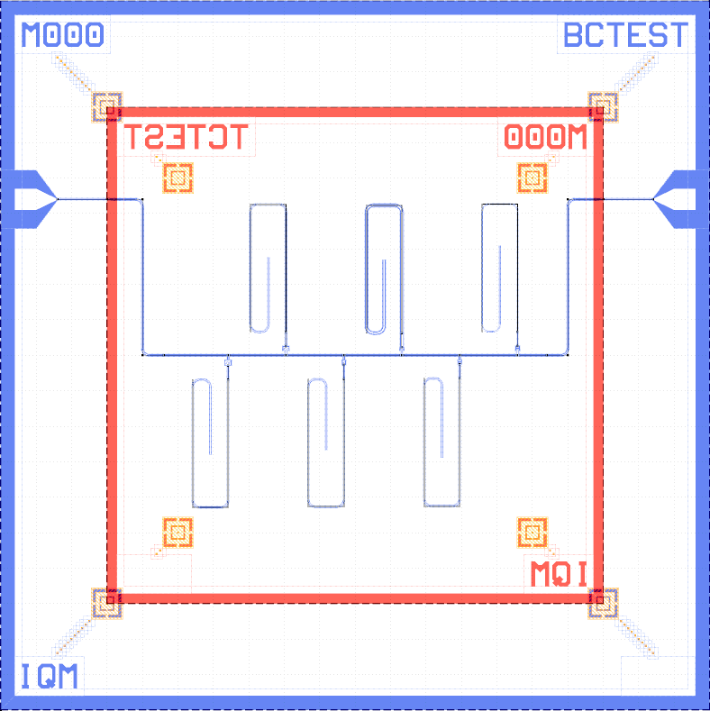
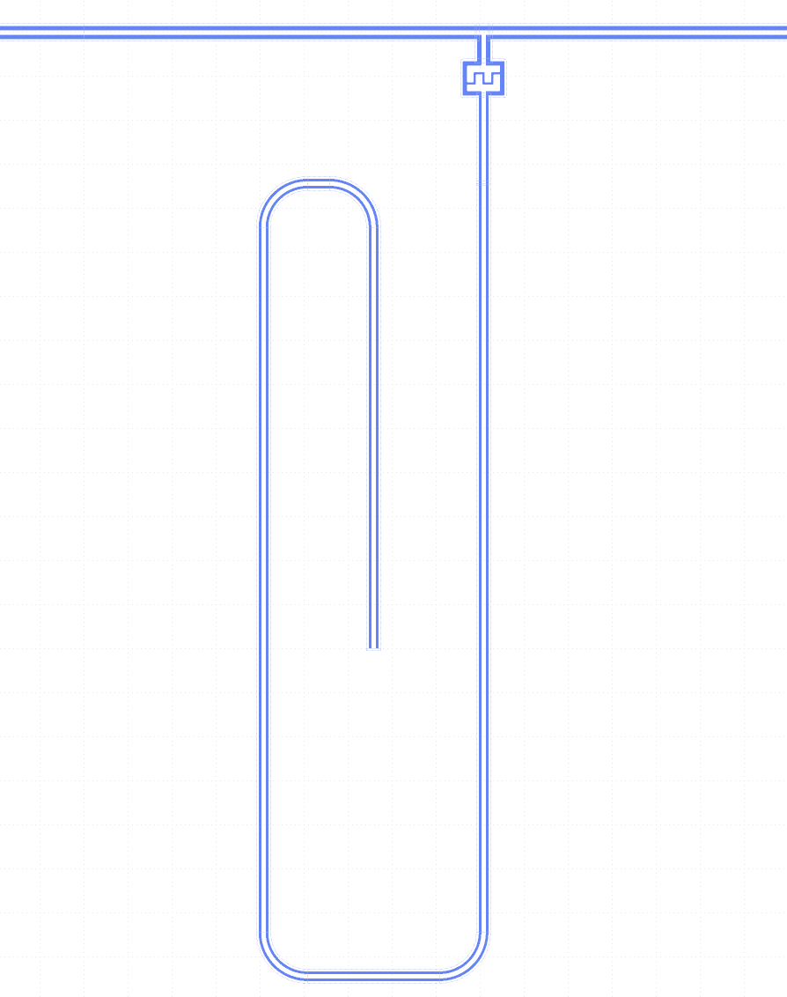
Creating Simulations
Chip
(differs from the one in the sample holder for illustrative purposes)
Let’s create our own simulations now. Designing the geometry is most of the work. Subsequently, we need to
Create a Simulation class from the geometry
  Geometry should be as limited as possible for computational feasibility
  Add ports where applicable
Create separate simulation script
Set the simulation settings
Export!
Typical simulation area

Slide 15
Create a Simulation class
from kqcircuits.qubits.concentric_transmon import ConcentricTransmon
from kqcircuits.simulations.simulation import Simulation
from kqcircuits.pya_resolver import pya
from kqcircuits.util.parameters import Param, pdt, add_parameters_from
from kqcircuits.simulations.port import InternalPort
@add_parameters_from(ConcentricTransmon, "*", junction_type="Sim", fluxline_type="none")
class ConcentricTransmonCouplingsSim(Simulation):
qubit_faces = Param(pdt.TypeList, "List of faces", ["1t1", "2b1"])
def build(self):
# Translation between elements faces and port faces
port_face = self.face_ids.index(self.qubit_faces[0])
# Insert the qubit
qubit_cell = self.add_element(ConcentricTransmon, **{**self.get_parameters(), 'face_ids': self.qubit_faces})
qubit_trans = pya.DTrans(0, False, (self.box.left + self.box.right) / 2, (self.box.bottom + self.box.top) / 2)
qubit_inst, refp = self.insert_cell(qubit_cell, qubit_trans, rec_levels=None)
# Add ports at the two islands
if self.junction_type == 'Sim':
self.ports.append(
InternalPort(1, refp["port_squid_a"], face=port_face))
self.ports.append(
InternalPort(2, refp["port_squid_b"], face=port_face))
# Add ports at the couplers
for i in range(len(self.couplers_angle)):
self.produce_waveguide_to_port(refp[f"port_coupler_{i+1}"], refp[f"port_coupler_{i+1}_corner"], i+3,
'bottom', a=self.couplers_a[i], b=self.couplers_b[i], face=port_face)
Geometry can be inserted, created, and combined as normal with the KLayout API.
Now we additionally add internal or edge ports with
self.ports.append(InternalPort(i, refpoint, face))
or for connections to edges of simulation area
self.produce_waveguide_to_port(
location, direction, edge[str])
Parametrization is copied from the qubit with @add_parameters_from

Slide 16
Create a
Simulation script
import logging
import sys
from pathlib import Path
from kqcircuits.simulations.concentrictransmon_couplings_sim import ConcentricTransmonCouplingsSim
from kqcircuits.pya_resolver import pya
from kqcircuits.simulations.export.elmer.elmer_export import export_elmer
from kqcircuits.simulations.export.simulation_export import export_simulation_oas, sweep_simulation, \
cross_sweep_simulation
from kqcircuits.util.export_helper import create_or_empty_tmp_directory, get_active_or_new_layout, \
open_with_klayout_or_default_application
# Prepare output directory
dir_path = create_or_empty_tmp_directory(Path(__file__).stem + "_output")
# Simulation parameters
sim_class = ConcentricTransmonCouplingsSim
sim_parameters = {
# Arguments for the base Simulation class
'name': 'concentrictransmon',
'box': pya.DBox(pya.DPoint(0, 0), pya.DPoint(2000, 2000)), # total area for simulation
'use_ports': True,
'use_internal_ports': True, # wave ports are actually internal (lumped) ports instead of at the edge
'waveguide_length': 100, # wave port length before terminating with InternalPort in this case
# Nominal qubit parameters for the inherited ConcentricTransmon
'r_inner': 110,
...
}
In a separate file importing the class (or in the same file for brevity)
First, let’s store our arguments for the Simulation class in the sim_parameters dictionary, such that, we will eventually call sim_class(…, **sim_parameters). This will be useful in a moment…

Slide 17
Setting Elmer parameters
elmer_export_parameters = {
'path': dir_path,
'tool': 'capacitance',
'workflow': {
'run_gmsh_gui': False,
'run_elmergrid': True,
'run_elmer': True,
'run_paraview': False
'n_workers': 1
'gmsh_n_threads’: 8,
'elmer_n_processes': 8,
'python_executable': 'python’
},
'linear_system_method': 'mg',
'p_element_order': 2,
'mesh_size’: {
'global_max': 50.,
'gap&signal': [2., 8.],
'gap&ground': [2., 8.],
'port': [1., 8.],
}
}
Details for the settings are in the export_elmer API and can change in the near future as Elmer development accelerates.
Number of processes and threads to use is set here along with the meshing parameters. Elmer does not currently use adaptive meshing so the mesh should be as fine as you need.

Slide 18
Parameter sweeps
# Get layout
logging.basicConfig(level=logging.WARN, stream=sys.stdout)
layout = get_active_or_new_layout()
simulations = [sim_class(layout, **sim_parameters)]
# Sweep given parameters independently
simulations += sweep_simulation(layout, sim_class, sim_parameters, {
# The nominal `sim_parameters` are overwritten with these
'r_inner': [70, 90, 100],
'r_outer': np.linspace(270, 290, 3),
})
# Full ND sweep of given parameters
simulations += cross_sweep_simulation(layout, sim_class, sim_parameters, {
'r_inner': [100, 110, 120],
'r_outer': np.linspace(270, 290, 3),
})
# Export simulation files
export_elmer(simulations, **elmer_export_parameters)
# Write and open OAS file
open_with_klayout_or_default_application(export_simulation_oas(simulations, dir_path))
To sweep parameters in the class (qubit in this case), we may use dictionary inputs for
sweep_simulation or cross_sweep_simulation
to easily generate Simulation classes with independent and full-ND sweeps, respectively.
Of course, any for-loops etc. for adding simulations are valid as well.
You should now be able to run the Python script
and the resulting simulation.sh as was done in the Elmer section!

Slide 19
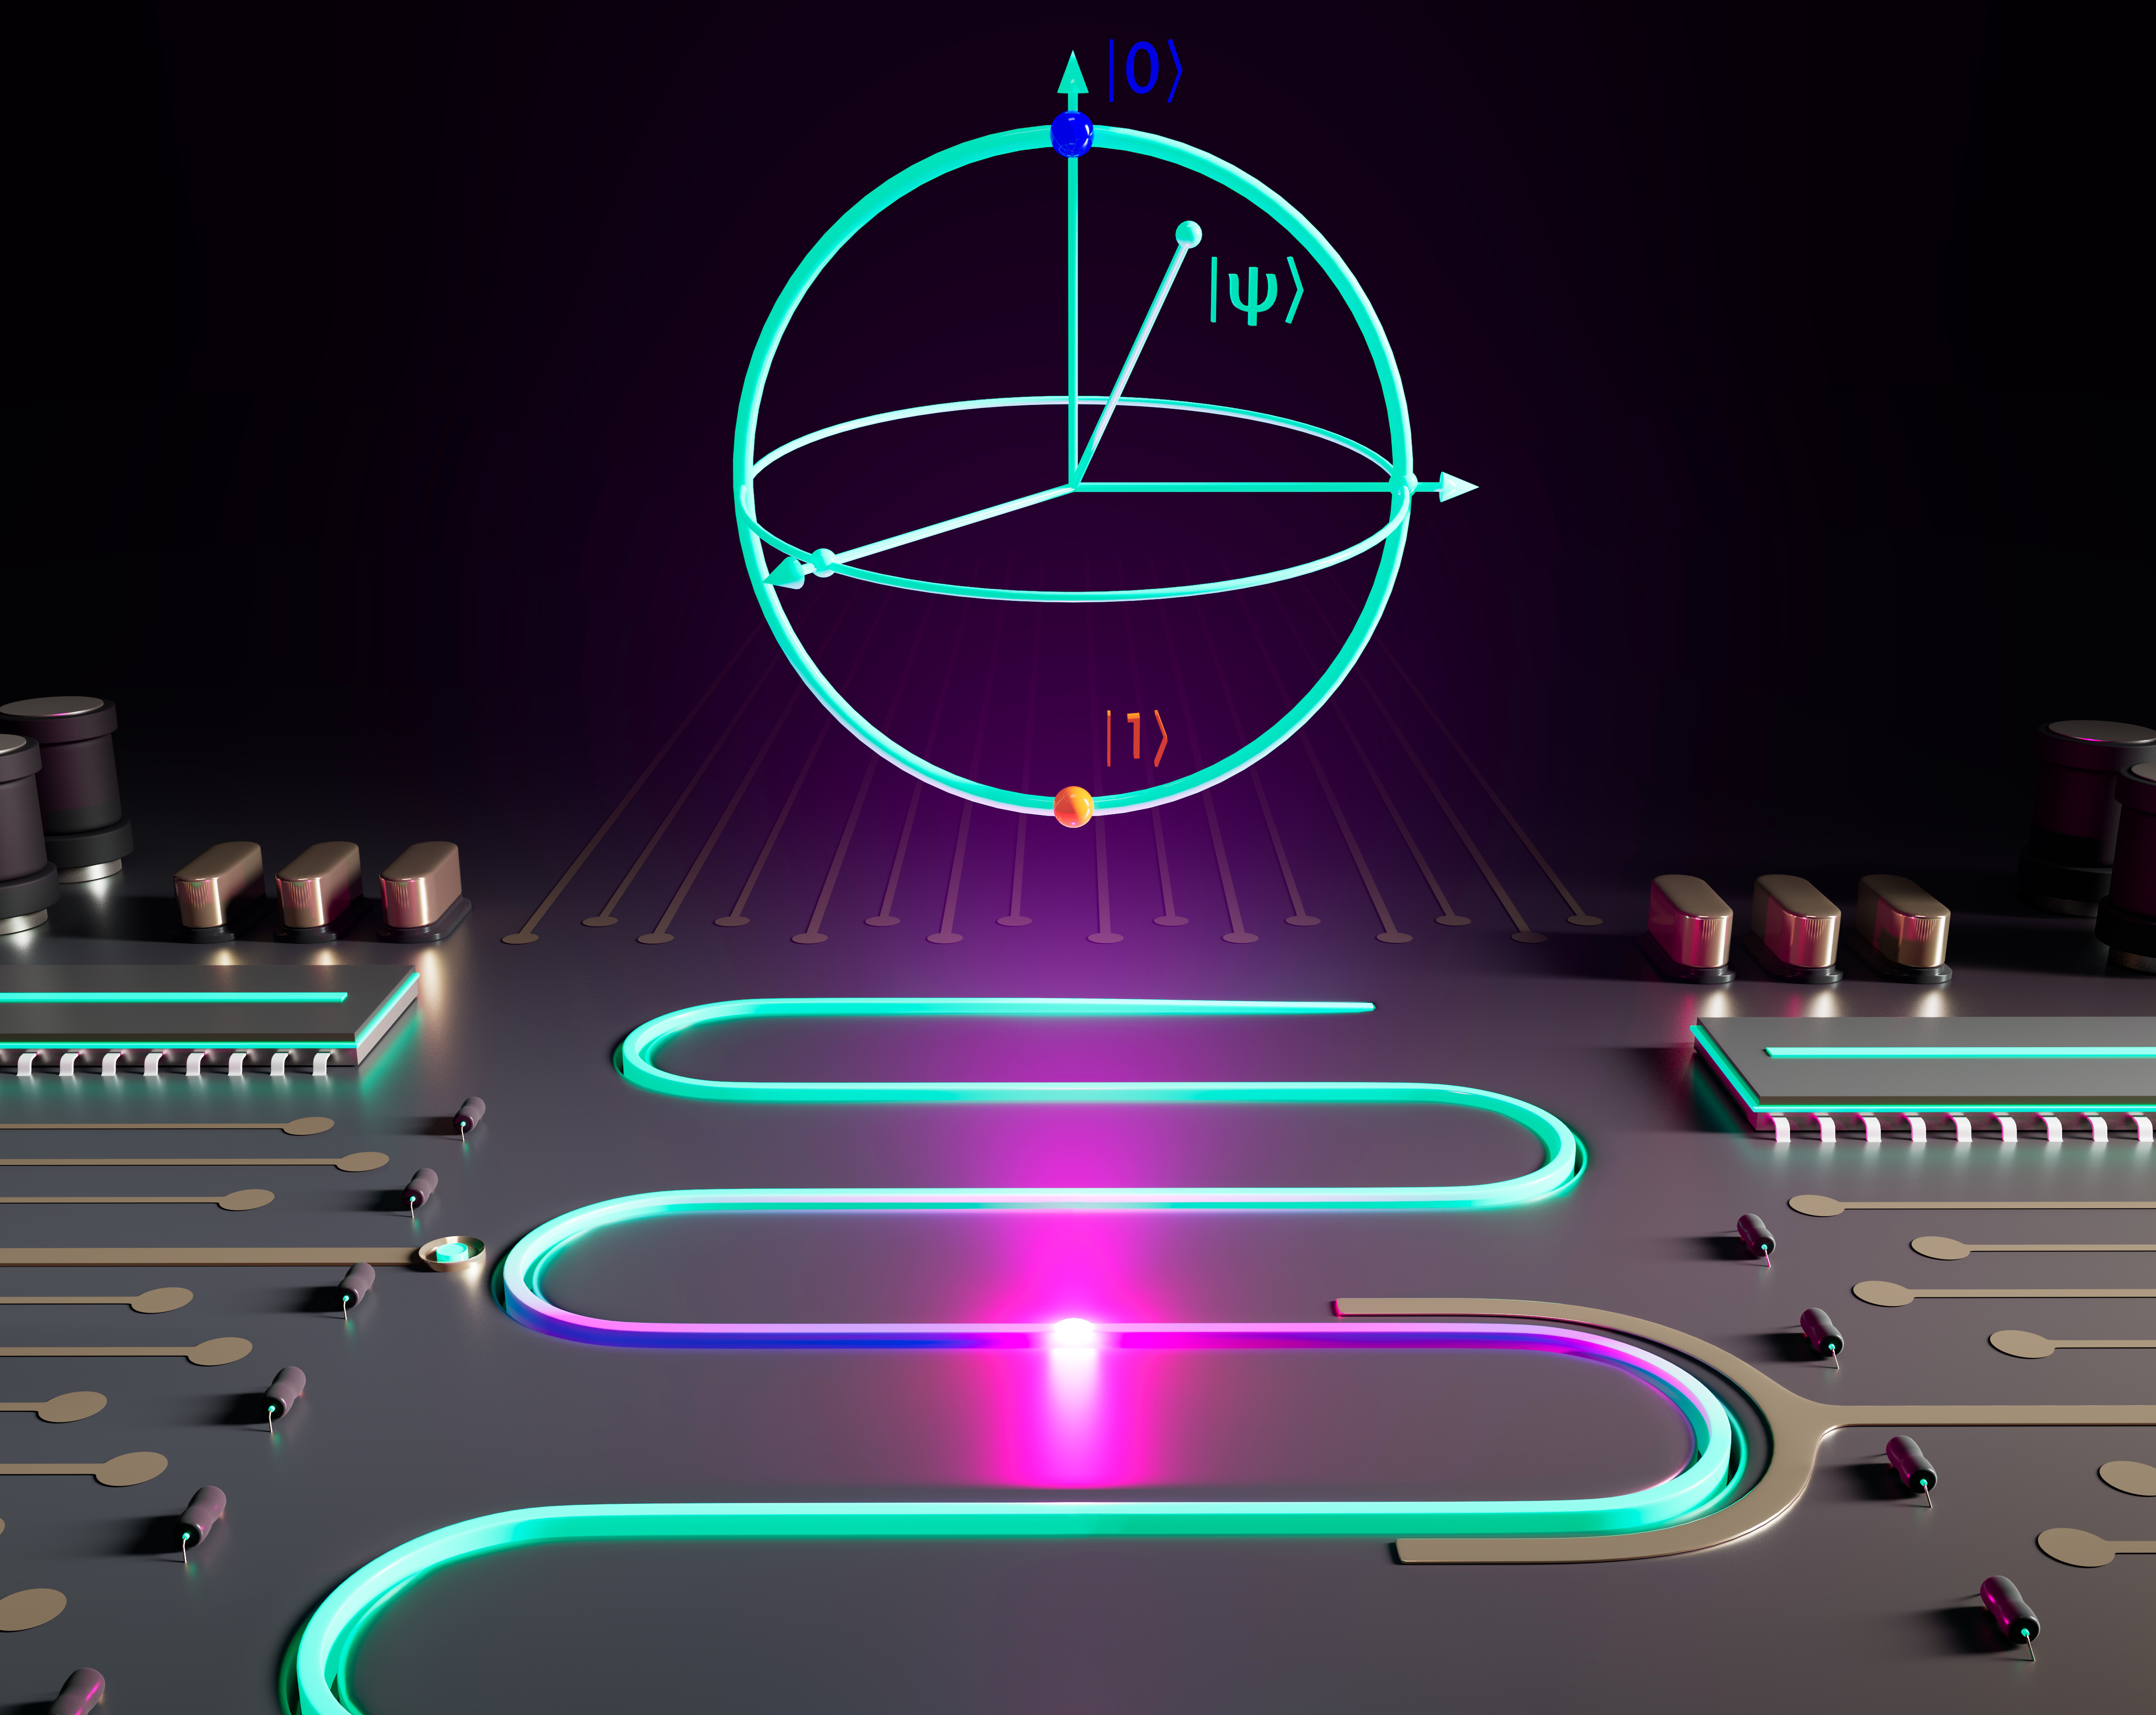
Qubit analysis
Figure. Artistic impression of a unimon qubit in a quantum processor. Credits: Aleksandr Kakinen.
Calculating qubit properties from the C-matrix

Slide 20
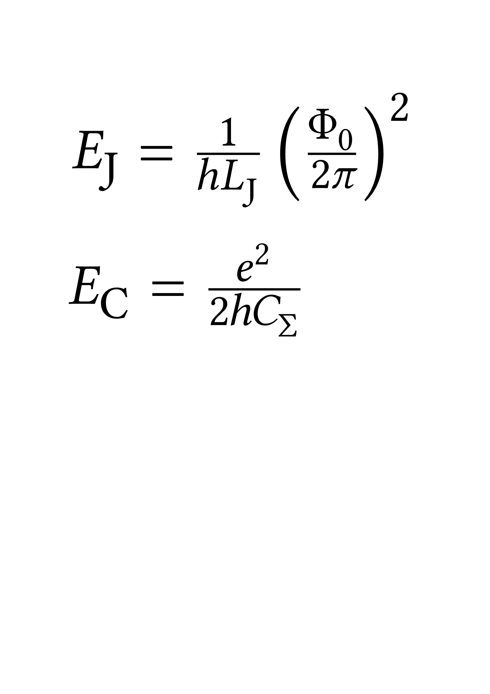
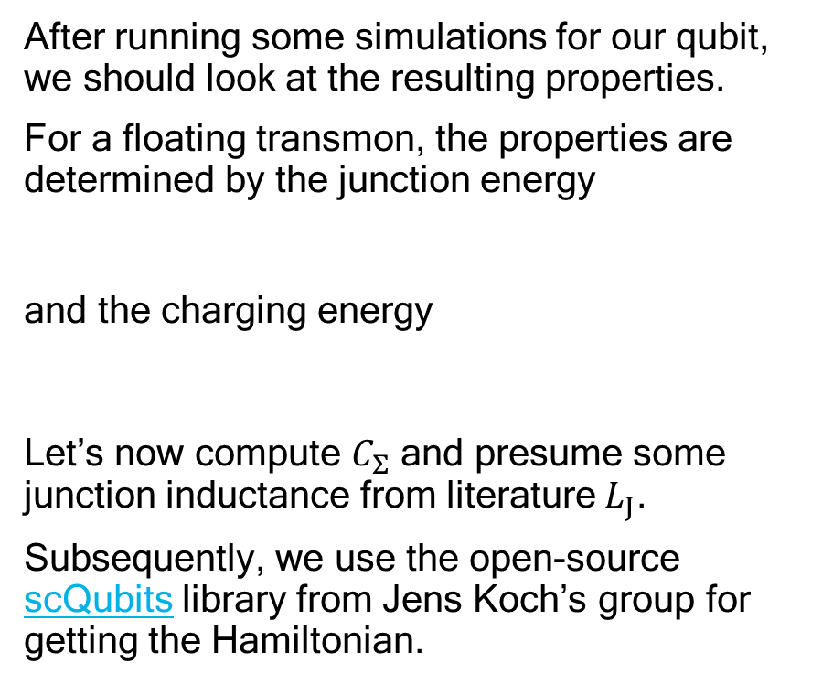

# THIS CODE IS ALSO PROVIDED IN A NOTEBOOK
import json
from pathlib import Path
import numpy as np
from matplotlib import pyplot as plt
import scqubits as scq
result_jsons = Path('results/').rglob('*results.json')
# Let's look at one result
result_json = next(result_jsons)
with open(result_json) as file_pointer:
result = json.load(file_pointer)
# For this case we should add a capacitive contribution of a full-length resonator to C_33.
# For 50 ohm and f=6 GHz,, this is roughly something like 450 fF.
# This will affect the C_Sigma little but will be relevant for estimating coupling g.
result['CMatrix'][2][2] += 450e-15
def C_Sigma_two_islands(data):
r""" Data argument is a dict with `CMatrix` key of a 3x3 capacitance matrix with a coupler as the last port.
Derived with the Lagrangian. See the following references for similar derivations:
[1] F. Marxer et al., “Long-distance transmon coupler with CZ gate fidelity above 99.8%”. arXiv:2208.09460, Dec. 19, 2022.
[2] A. P. A. Cronheim, “A Circuit Lagrangian Formulation of Opto-mechanical Coupling between two Electrical Resonators mediated by a SQUID”.
Delft University of Technology, Dec. 10, 2018. [Online]. Available: http://resolver.tudelft.nl/uuid:a4c72663-65c9-4857-8ffa-ebaf2cbc9782
Returns:
C_Sigma: Effective qubit total capacitance for :math:`C_\Sigma`.
C_q: Qubit island–island capacitance with correction from coupler.
C_r: Resonator capacitance with correction from qubit islands.
C_qr: Effective coupling capacitance between the qubit and the resonator.
"""
C_sim = data['CMatrix']
C_theta = (C_sim[0][0] + C_sim[0][2] + C_sim[1][1] + C_sim[1][2])
C_q = C_sim[0][1] + ((C_sim[0][0] + C_sim[0][2]) * (C_sim[1][1] + C_sim[1][2])) / C_theta
C_r = C_sim[0][2] + C_sim[1][2] + C_sim[2][2] - (C_sim[0][2] + C_sim[1][2]) ** 2 / C_theta
C_qr = (C_sim[0][2] * C_sim[1][1] - C_sim[1][2] * C_sim[0][0]) / C_theta
return C_q - C_qr ** 2 / C_r, C_q, C_r, C_qr
C_Sigma, C_q, C_r, C_qr = C_Sigma_two_islands(result)
print(f'{C_Sigma * 1e15} fF')
Compute $C_{Σ}$
After running some simulations for our qubit, we should look at the resulting properties.
For a floating transmon, the properties are determined by the junction energy
and the charging energy
Let’s now compute $C_{Σ}$ and presume some junction inductance from literature $L_{J}$.
Subsequently, we use the open-source scQubits library from Jens Koch’s group for getting the Hamiltonian.

Slide 21
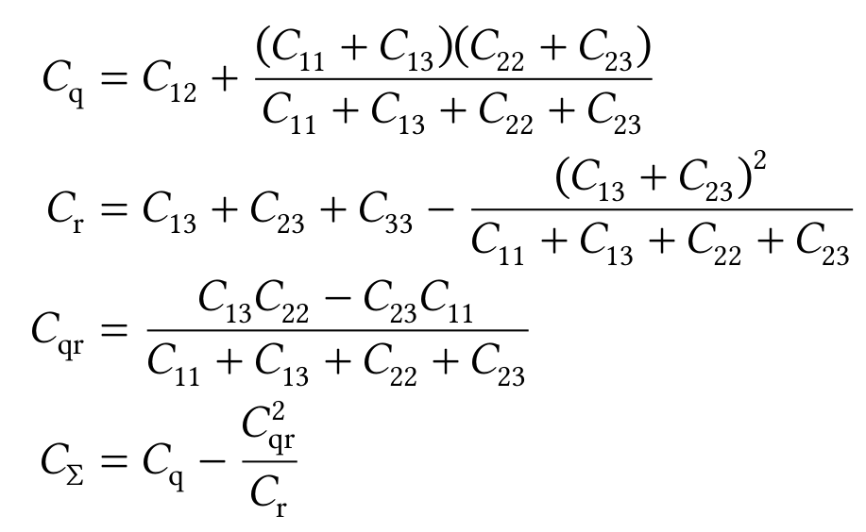

Lumped-element model for $C_{Σ}$

Slide 22
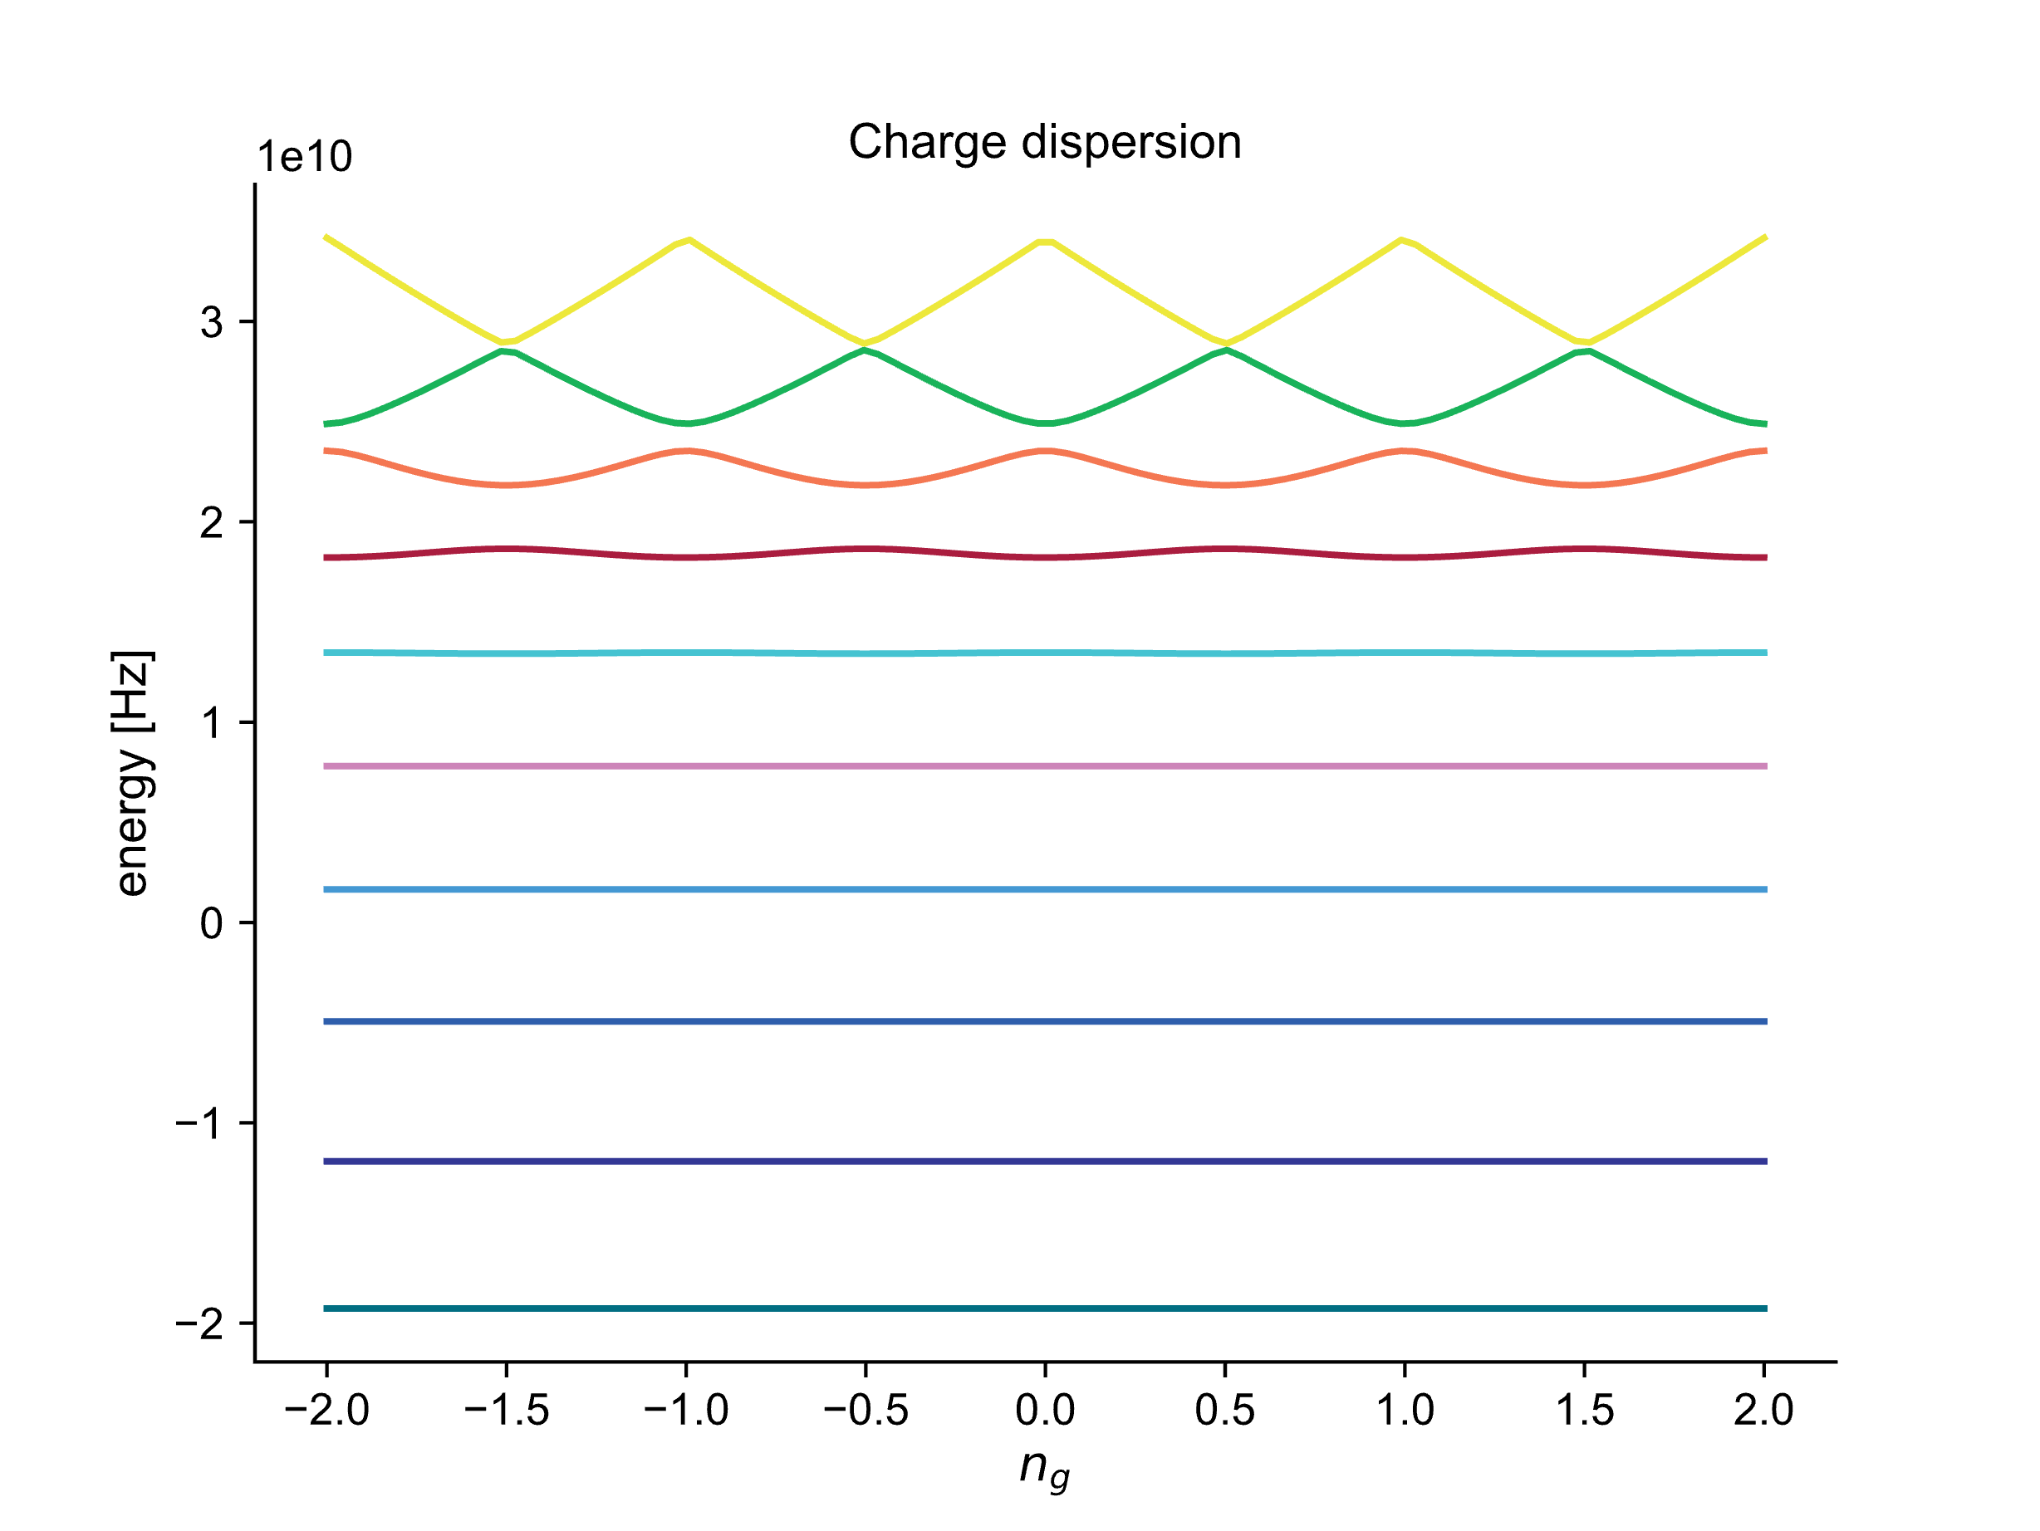
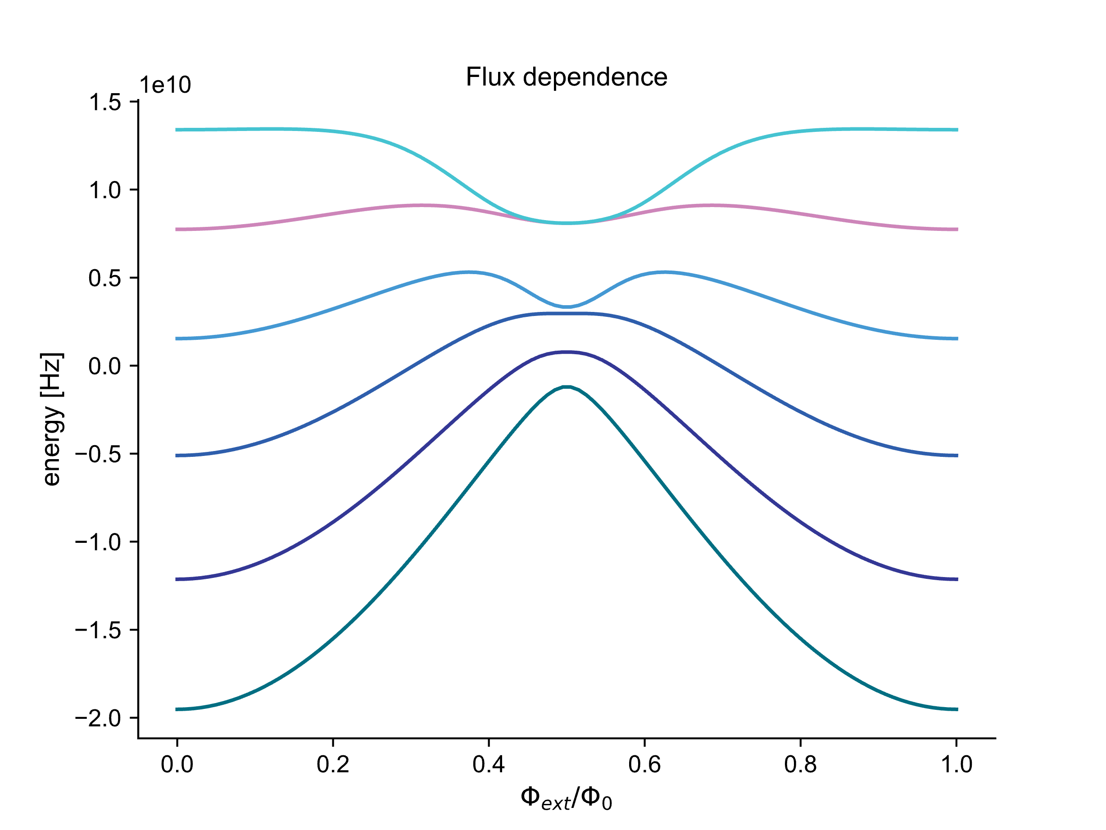
Energy vs. parameter
from scipy.constants import e, h, pi, physical_constants
L_J = 7.015e-9 # Example from E. Hyyppä et al., ‘Unimon qubit’, Nat Commun, vol. 13, no. 1, Art. no. 1, Nov. 2022
# Units on Hz for energy (E_J / h)
E_J = (physical_constants['mag. flux quantum'][0] / (2*pi)) ** 2 / (h * L_J)
E_C = e ** 2 / (2 * h * C_Sigma)
print(f'ratio = {E_J / E_C}')
scq.set_units('Hz') # Energy is now given in Hertz
transmon = scq.TunableTransmon(
EJmax=E_J,
EC=E_C,
d=0.1,
flux=0.95,
ng=0.5, # Default charge dispersion
ncut=30,
)
transmon.plot_wavefunction(which=(0, 1, 2, 3), mode='abs_sqr');
evals = transmon.eigenvals(3)
f_ge = evals[1] - evals[0]
print(f'f = {f_ge/1e9} GHz’)
transmon.plot_evals_vs_paramvals(param_name='flux', param_vals=np.linspace(0, 1, 100));
plt.title('Flux dependence')
fig, axes = transmon.plot_evals_vs_paramvals('ng', np.linspace(-2, 2, 100), evals_count=10, subtract_ground=False)
plt.title('Charge dispersion')
It’s easy to build your own design workflow around scQubits with qutip, skrf etc.
We can see how the transmon is well-protected against charge noise.
For more possibilities, consult the scQubits examples.

Slide 23
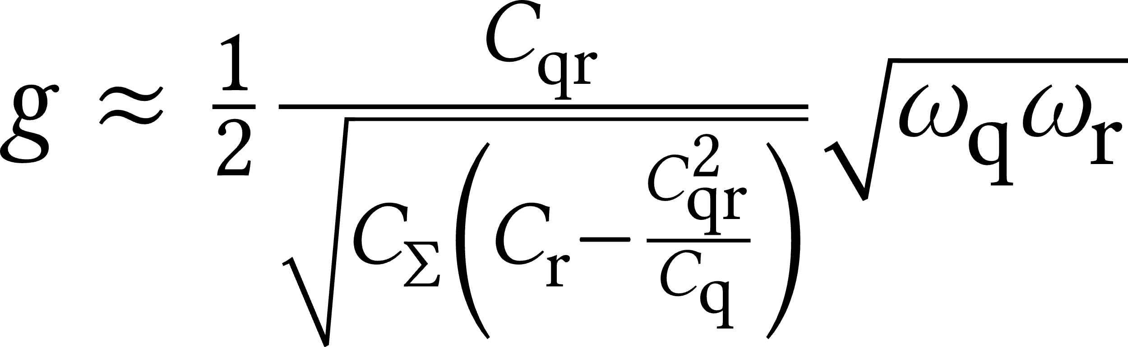
Exercise: Coupling to a resonator
g = ...
resonator = scq.Oscillator(
E_osc=...,
truncated_dim=10
)
hilbert_space = scq.HilbertSpace([transmon, resonator])
# For details, see Eq. 3.3 in J. Koch et al., ‘Charge-insensitive qubit design derived from the Cooper pair box’,
# Phys. Rev. A, vol. 76, no. 4, p. 042319, Oct. 2007
hilbert_space.add_interaction(
g_strength=g,
op1=transmon.n_operator,
op2=resonator.creation_operator,
add_hc=True
)
eigenvalues = hilbert_space.eigenvals(evals_count=20)
hilbert_space.generate_lookup()
g0 = eigenvalues[0] # lowest state
e0 = eigenvalues[hilbert_space.dressed_index((1, 0))] # qubit is excited, resonator is ground
f0 = eigenvalues[hilbert_space.dressed_index((2, 0))]
g1 = eigenvalues[hilbert_space.dressed_index((0, 1))]
e1 = eigenvalues[hilbert_space.dressed_index((1, 1))]
f_ge_coupled = ...
f_ef_coupled = ...
f_rr_coupled_g = ...
f_rr_coupled_e = e1 - e0
print(f'anharmonicity = {(f_ef_coupled - f_ge_coupled) / 1e6} MHz', f'chi = {0.5 * (f_rr_coupled_e - f_rr_coupled_g) / 1e6} MHz')
hilbert_space.hamiltonian()
scQubits also supports composite Hilbert spaces. These can be used to model multiple qubits and couplers etc. with qutip support. See Composite Hilbert Spaces for details.
1. Your task is to implement the missing parts to get the anharmonicity and dispersive shift when connected to a 6 GHz resonator.
The coupling is given by

Slide 24
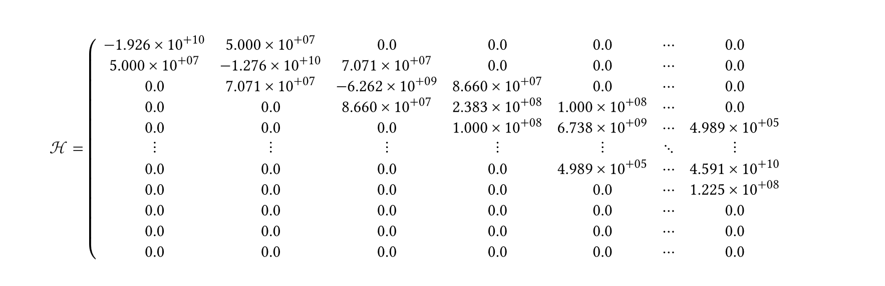
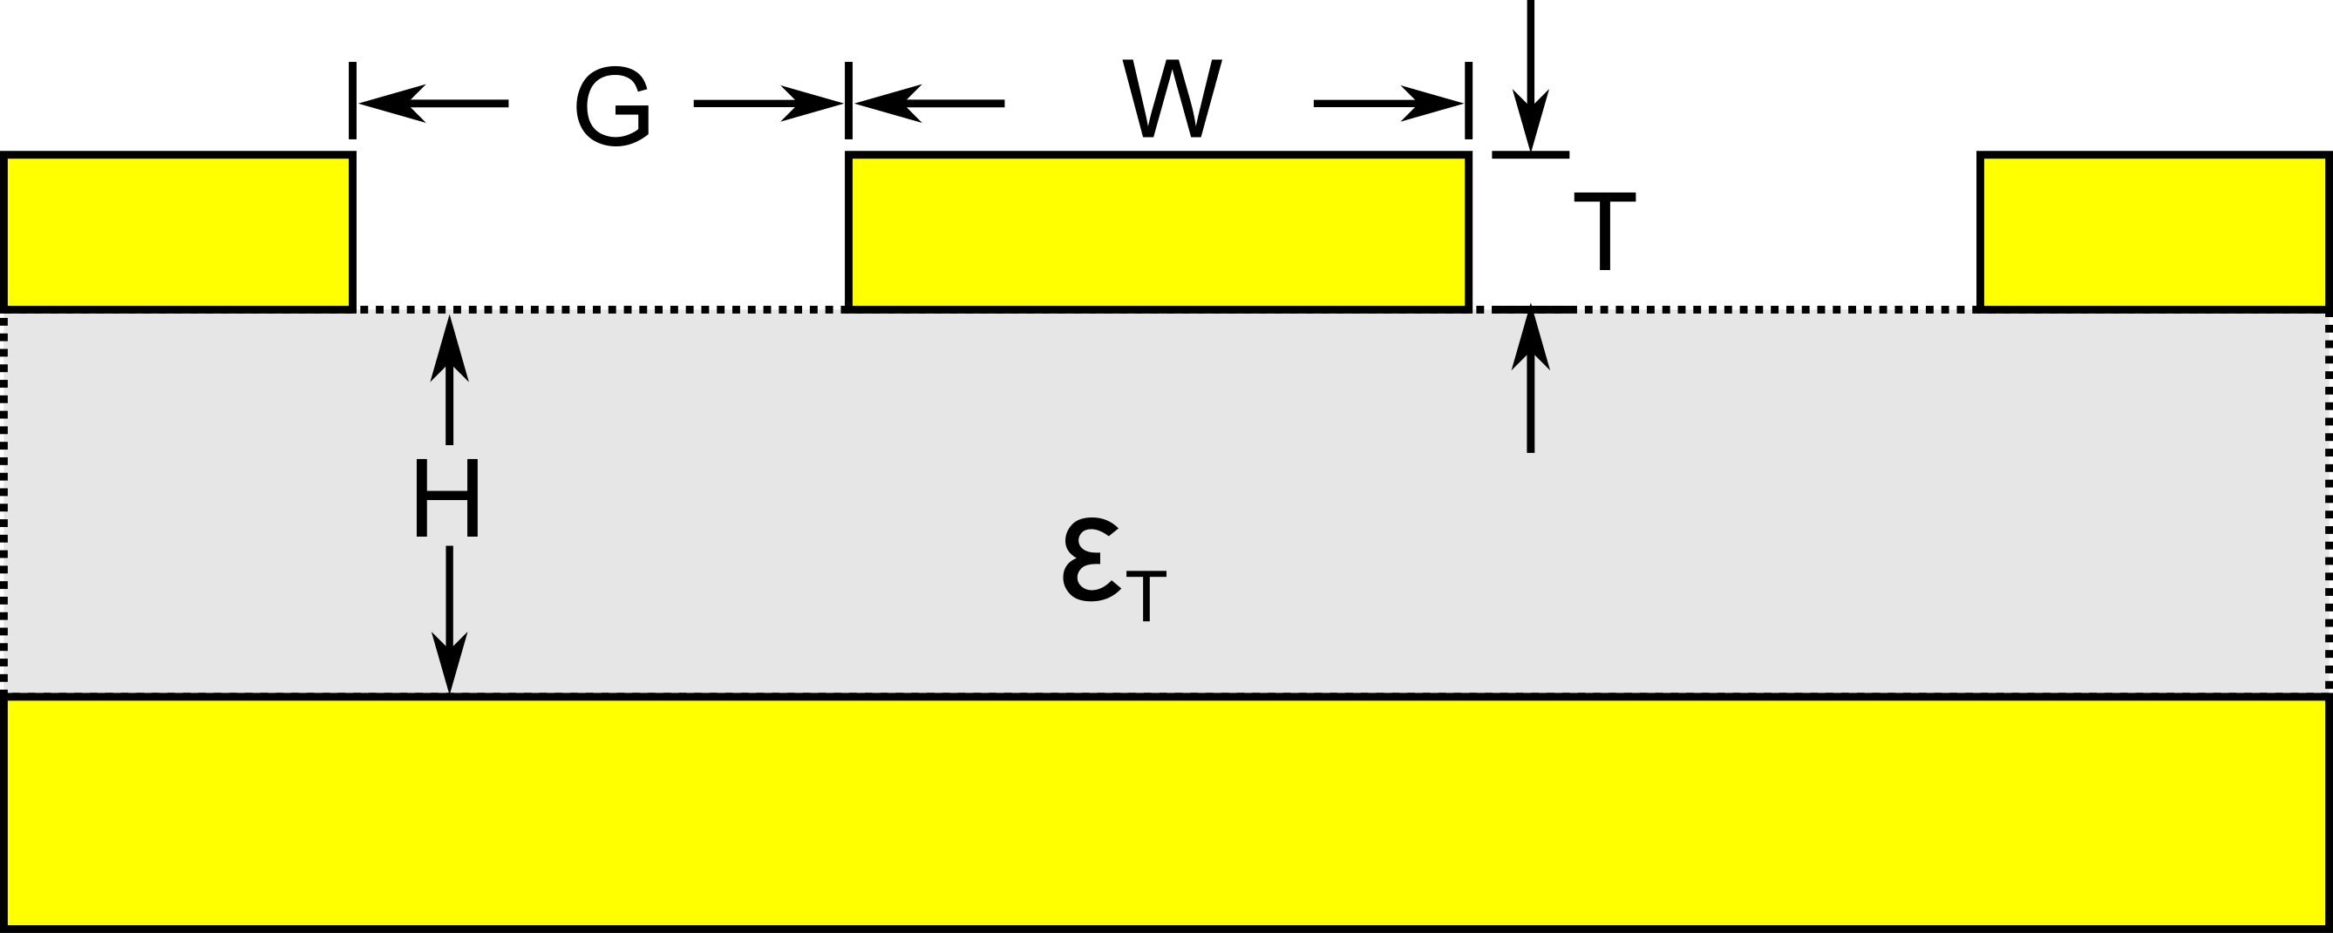
Exercise: Coupling to a resonator
2. Instead of simply adding 450 fF to C[2][2], add the correct value for a Z₀=100 Ω λ/4 CPW resonator with a frequency of 6 GHz. Does the qubit frequency change? How about the coupling?
You may use any online CPW calculators to get the properties. For a more programmable approach, something like scikit-rf may be used.
Use any reasonable values for the substrate properties.
hilbert_space.hamiltonian()

Slide 25

Summary
What we learned
Install and run simulations with Elmer
Setup your own simulations using KQCircuits
View simulation results, and use them for further analysis with scQubits
Please ask questions on the KQCircuits Discord or GitHub Discussions so that others with similar questions can see the answers

Slide 26

Niko Savola
Quantum Engineer Intern
niko@meetiqm.com
nikosavola

